Slide 1
Sequence Stratigraphy
Introduction
Christopher G. St.C. Kendall
803 – 312 1569
kendall@geol.sc.edu

Slide 2
Sequence Stratigraphy
A framework of genetically related stratigraphic facies geometries and their bounding surfaces used to determine depositional setting

Slide 3
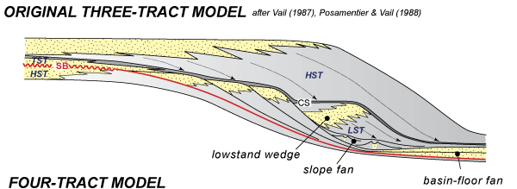
Sequence Stratigraphy
A framework of genetically related stratigraphic facies geometries and their bounding surfaces used to determine depositional setting
Facies Geometries
Surfaces
Establish Setting

Slide 4
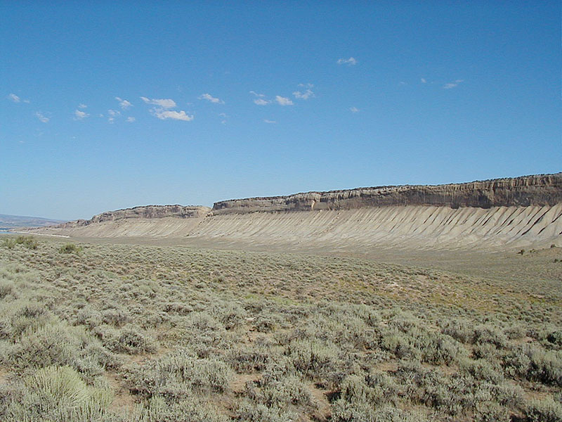
Book Cliffs – Prograding Cretaceous Shoreline
Sequence stratigraphic interpretation uses the composition and framework of genetically related stacked vertical facies successions, their geometries and their bounding surfaces to determine their depositional setting
PROGRADING
Photo by Torbjörn Törnqvis

Slide 5
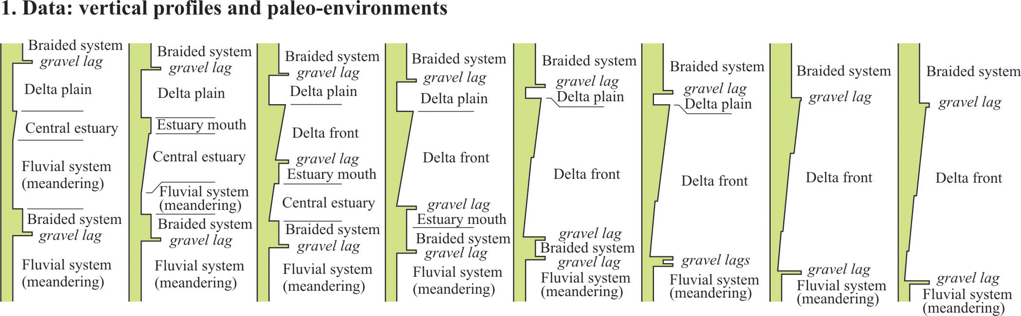
Book Cliffs – Prograding Cretaceous Shoreline
Use framework of genetically related stratigraphic facies geometries and their bounding surfaces to determine their depositional setting

Slide 6
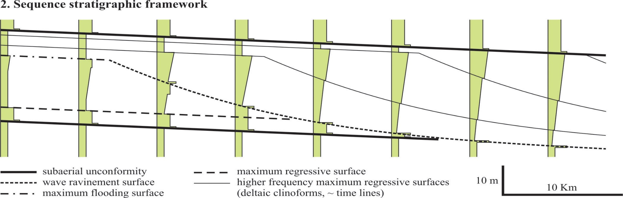
Book Cliffs – Prograding Cretaceous Shoreline
Use framework of genetically related stratigraphic facies geometries and their bounding surfaces to determine their depositional setting

Slide 7
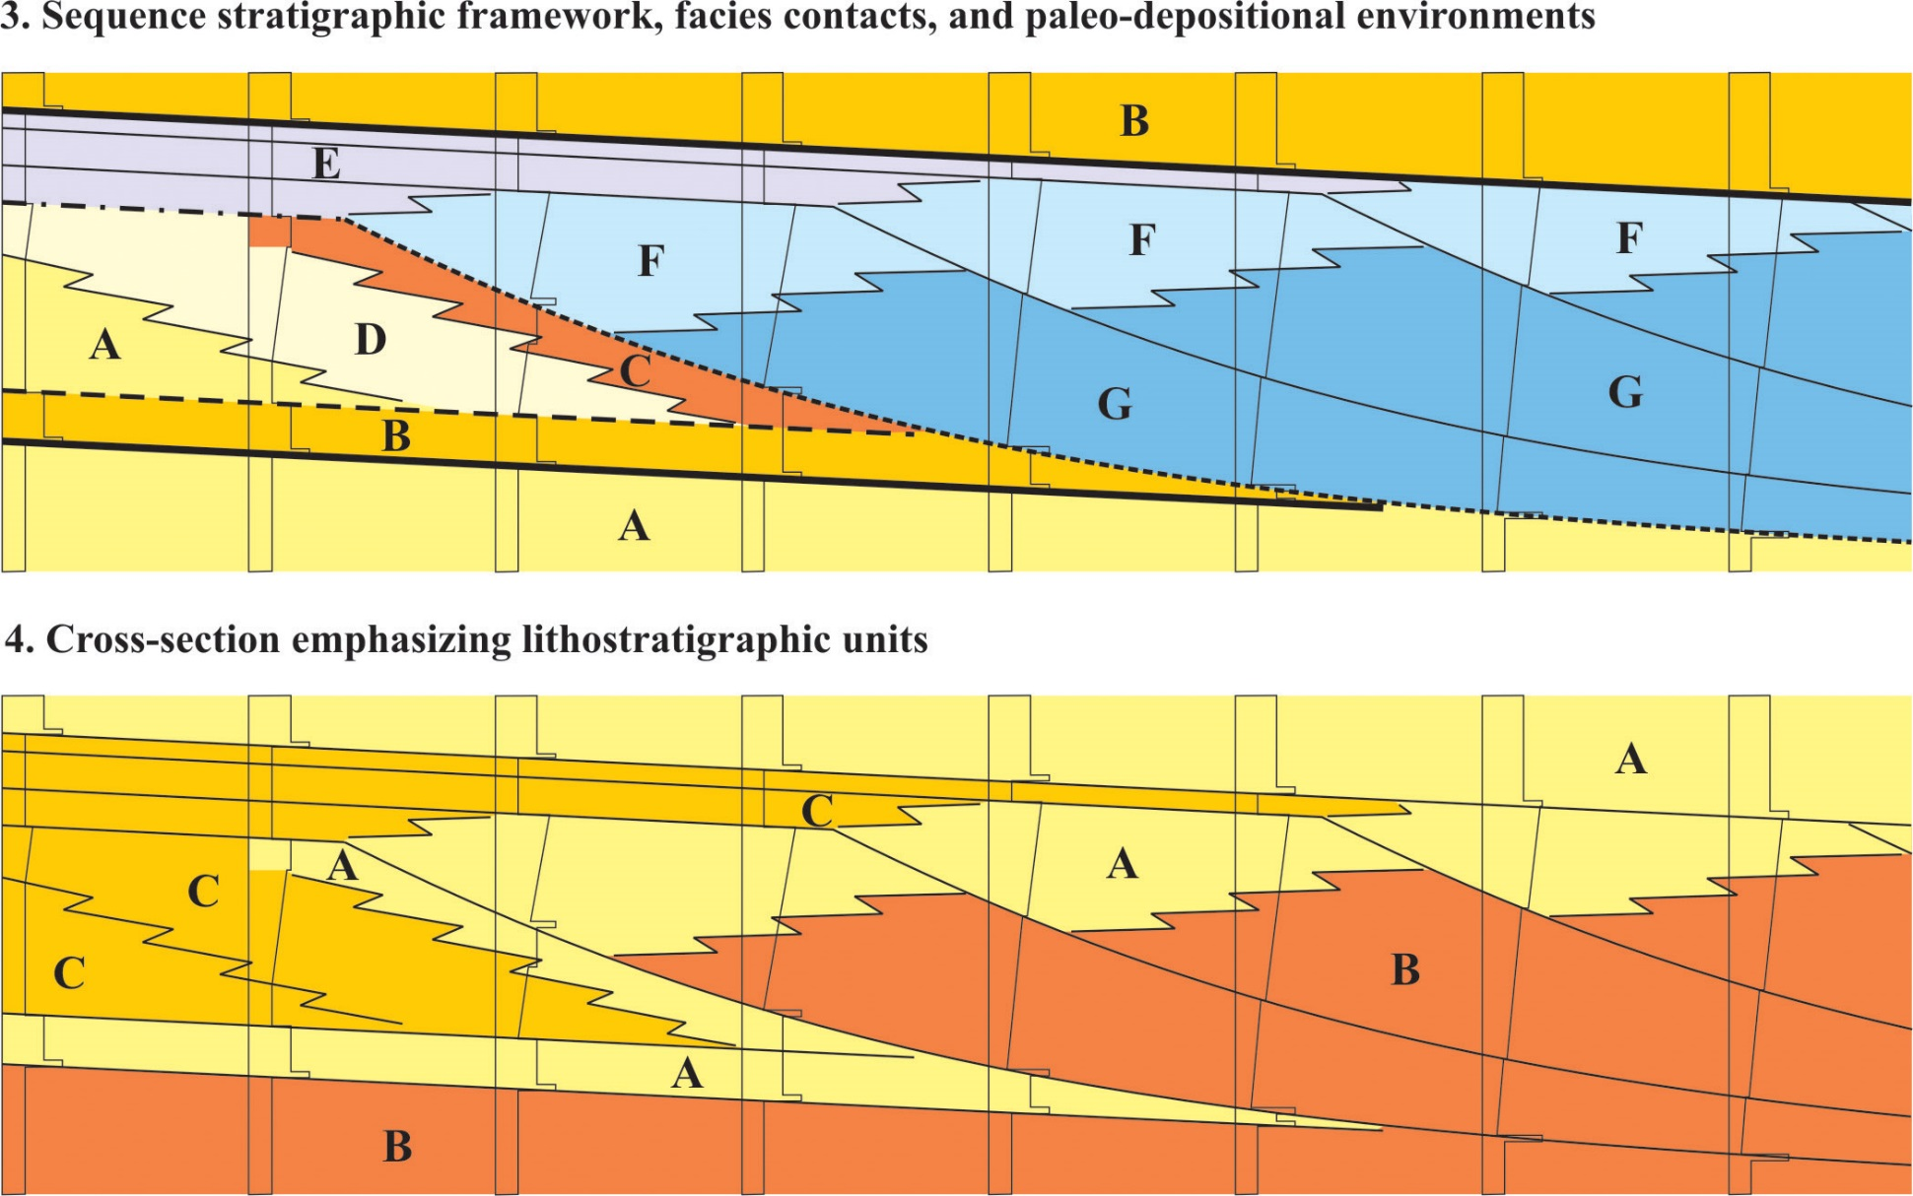
Book Cliffs – Prograding Cretaceous Shoreline

Slide 8
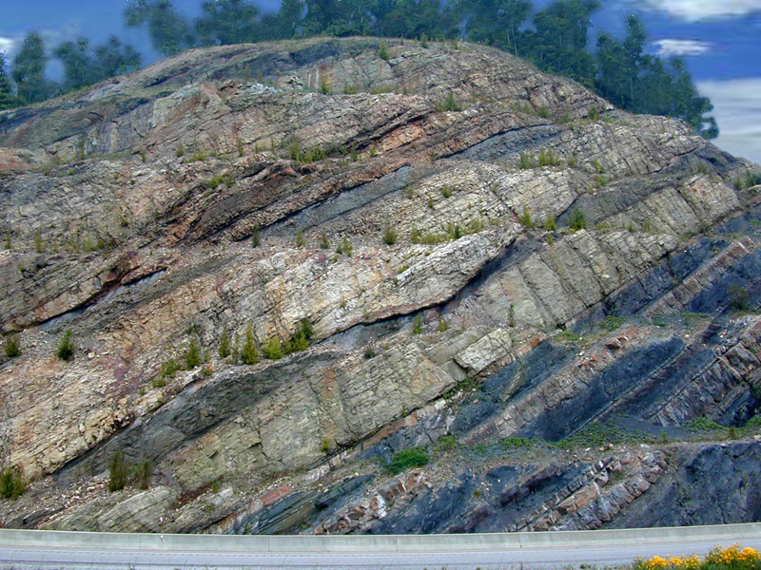
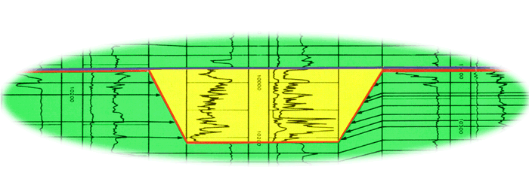
Sequence Boundary (SB) from well logs, core and outcrop
SB
mfs
TS
Erosion or incision of underlying flooding surfaces (mfs and TS)
Inferred from interruption in the lateral continuity of these surfaces
Establish a framework of genetically
related stratigraphic facies geometries
and their bounding surfaces to
determine depositional setting
“Sequence Stratigraphy – Basics”
C. G. St. C. Kendall

Slide 9
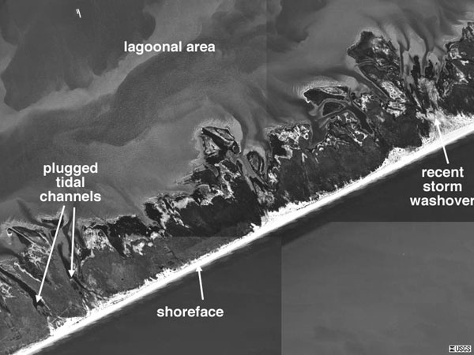
Barrier Island

Slide 10
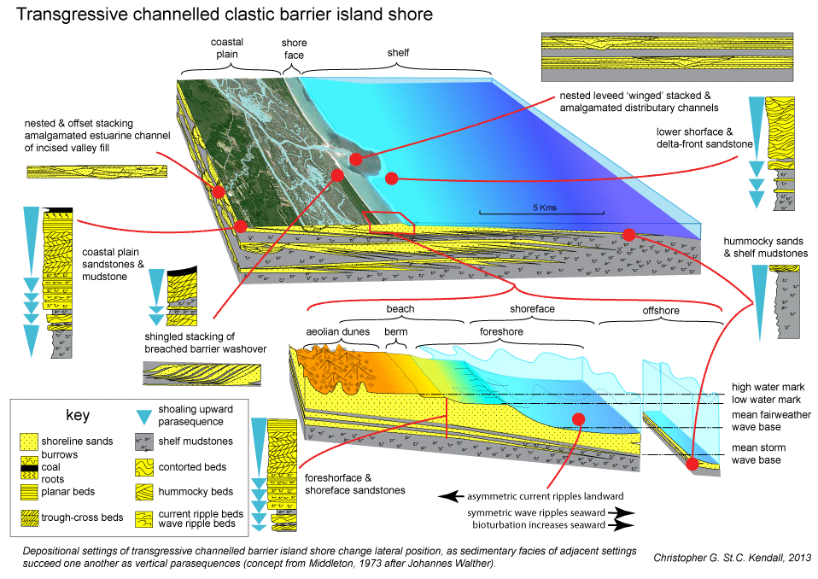
Coastal Elements

Slide 11
Sequence Stratigraphy
Interpretation involves:
Identify subdividing "surfaces" enveloping “discrete sediment body geometries” of sedimentary section.
Backstrip geometries from oldest to youngest
Reassemble these in order of formation, using subdividing surfaces, geometry, lithofacies & fauna to interpret the evolving character of depositional setting
Remember:-
Each stratal unit is defined and identified only by physical relationships of the strata, including lateral continuity and geometry of the surfaces bounding the units, vertical stacking patterns, and lateral geometry of the strata within the units." (Van Wagoner et al., 1990)

Slide 12
Sequence Stratigraphy
The surfaces subdividing sedimentary section are fundamental to sequence stratigraphic interpretation
As understanding of sedimentary systems & interpretation improves nomenclature of each surface can change
Changes in nomenclature often confuse a scientific methodology over laden with complex multi-syllable terms
Surface can be given names used before for different surface
Innocent geologists, not knowing terminology has been changed & lacking understanding of reason for change, may feel they are going stark staring mad

Slide 13
Sequence Stratigraphy
Subdivision & interpretation of sedimentary record using a framework surfaces seen in outcrops, well logs, & 2-D and 3-D seismic include:
Surfaces of erosion & non-deposition (Sequence Boundaries, Forced Regression Erosion Surface, Regressive Surface of Marine Erosion)
Flooding (Trangressive Surfaces [TS or Max Regressive Surface] &/or maximum flooding surfaces [mfs] Ravinement Surfaces [RS- transgressive
This framework used to predict the extent of sedimentary facies geometry, lithologic character, grain size, sorting & reservoir quality

Slide 14
Points to Note
Sequence are subdivided by
  Maximum Flooding Surfaces (mfs)
  Transgressive Surfaces (TS)
  Sequence Boundaries (SB)
Arrangement of vertical succession or stacking patterns of unconfined sheets
  Prograde (step seaward)
  Retrograde (step landward)
  Aggrade (build vertically)
Sheets and unconfined lobes containing
  Non-amalgamated bodies
Incised topographic fill
  Amalgamated, multi-storied bodies (e.g. incised valleys)
  Within unconfined lobes

Slide 15
Lecture Outline
Principles of Steno
Bedding Planes - How they form and significance with respect to time
Branches of Stratigraphy - Lithostratigraphy, Allostratigragraphy, and Sequence Stratigraphy
Events
Sequence stratigraphic subdividing boundaries
Clastic Sequence Stratigraphic Hierarchy
Carbonate Sequence Stratigraphic Hierarchy

Slide 16
Principles of Steno
Superposition: a succession of undeformed strata, oldest stratum its at base, with successive younger ones above. Establishes relative ages of all strata & their contained fossils
Original horizontality - stratification originally horizontal when sedimentary particles settled from fluids under influence of gravity, so if steeply inclined must have suffered subsequent disturbance
Original lateral continuity-strata originally extended in all directions until they thinned to zero or terminated against edges of original basin of deposition

Slide 17
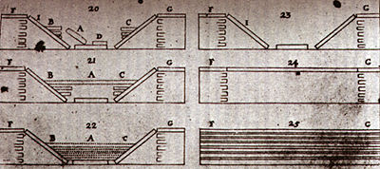
Principles of Steno

Slide 18
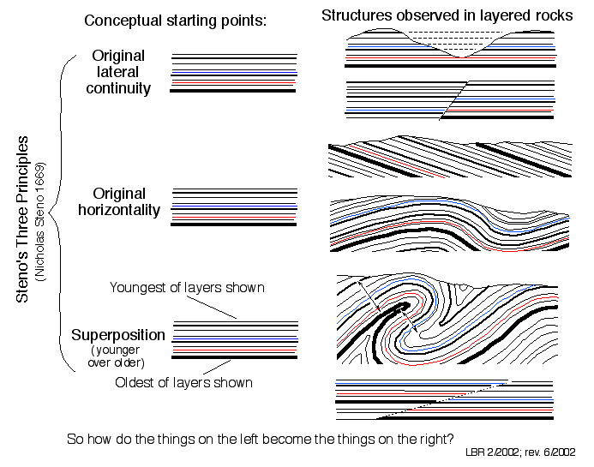
Principles of Steno
After Bruce Railsback, 2002

Slide 19
Introduction to Subdividing Surfaces
Range from
High frequency surfaces define beds
Lower frequency surfaces define parasequences (genetically related cycles or packages of sediment)
Lowest frequency major subdivisions in sedimentary section - the sequence

Slide 20
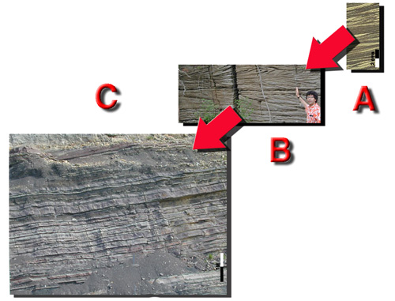
Time …… Varying Rates
Cross bedded Ordovician
beach carbonates accumulation - several years
Intertidal flaser
structures
accumulated
in minutes
Mississippian downslope fan deposits each bed hours but the section hundreds of thousands of years

Slide 21
Bounding Surfaces Defined
Internal and external surfaces of any
Bed
Parasequence
Stratigraphic Sequence
Products of unique associations of processes.

Slide 22
Bedding Planes
Beds are enclosed or bounded by sharply defined upper & lower surfaces or bedding planes.
These surfaces are easiest physical features of sedimentary rocks to identify in outcrop
Subdivide successions of sedimentary rock into beds
Used to determine relative order and timing of accumulation of sediments forming beds
Character of bedding planes, be they eroded, cemented, bored, bioturbated, or depositional surfaces used to aid in interpretation of sedimentary rocks.

Slide 23
Bedding Planes
Most probably formed by erosion of unconsolidated sediment collected at sediment surface. Weight of sediment, just beneath sediment surface, causes sediment to dewater, compact & become cohesive
Less cohesive sediment of surface truncated & expose surface of firmer cohesive sediment below at bedding plane surface in response to:
  Storm waves
  Fast flowing currents of water (say in tidal or fluvial channels)
  Turbid flow of a density current

Slide 24

Bedding Planes

Slide 25
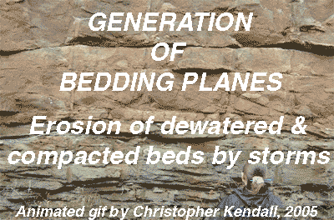
Bedding Planes

Slide 26
Timing, surfaces and layers linked
Sedimentary layering of a stratigraphic section has a vast array of dimensional hierarchies
Range from units millimeters thick that might be formed over seconds to thousands of feet thick and formed of millions of years
Each layer no matter its dimension and whatever the time involved in its deposition, is bounded by surfaces that transgress time

Slide 27
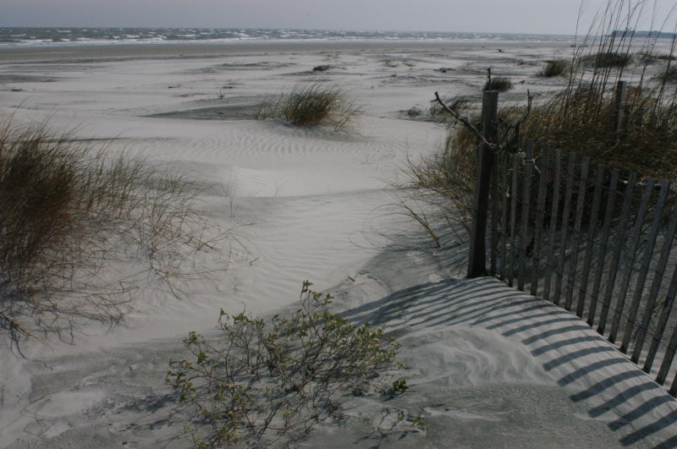
Beach Foreshore and Backshore

Slide 28
Timing, surfaces and layers linked
Foreshore swash units millimeters thick might have formed over seconds but preserve events the collectively formed over weeks to months
Each layer no matter its dimension and whatever the time involved in its deposition, is bounded by surfaces that transgress time

Slide 29
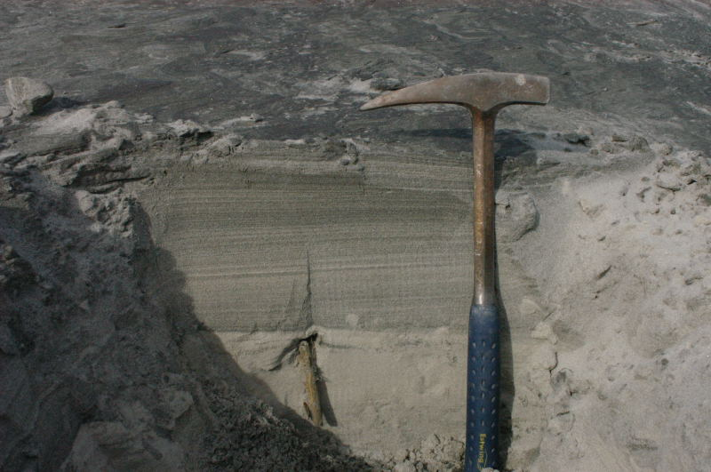
Beach Backshore Low Angle Swash Events

Slide 30
Bounding Surfaces Defined
Internal and external surfaces of any
Bed
Parasequence
Stratigraphic Sequence
Products of unique associations of processes.

Slide 31
Parasequences
A “parasequence” is a relatively conformable succession of genetically related beds or bedsets (within a parasequence set) bounded by marine flooding surfaces or their correlative surfaces (Van Wagoner, at SEPM's 1985 Midyear Meeting).

Slide 32
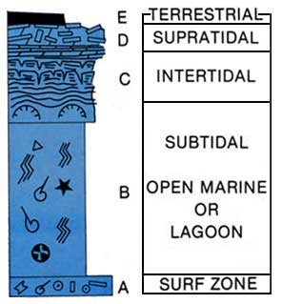
Shelf
Cycle
James
-
Vertical
Association
Accumulated
Laterally
Parasequences
Shoaling
Up
Cycle

Slide 33
Western Coast of the United Arab Emirates - Parasequences
52ºE
40
40
10
54ºE
I R A N
56ºE
N
A R A B I A N
20
MASANDAM
PENINSULA
Wind direction of
“Shamal”
Strait of Hormuz
20
40
40
10
G U L F
40
26ºN
40
Ras Al
Khaimah
GULF OF
OMAN
20
Dubai
North Eastern Coast
Fujairah
Q A T A R
G R E A T
10
10
10
Northwest Coast
P E A R L
10
40
10
Ras
Ghanada
20
Jabal
Odaid
10
B A N K
ABU
DHABI
10
B A R R I E R
10
Jabal Dhanna
Khor Al Bazam
Al Ain
24ºN
Central Coast
O M A N
S A U D I
A R A B I A
Western Coast
U N I T E D A R A B E M I R A T E S
50 km
Coastal provinces of United Arab Emirates and bathymetry of Southern
Arabian Gulf in fathoms (modified from Purser, 1973).

Slide 34
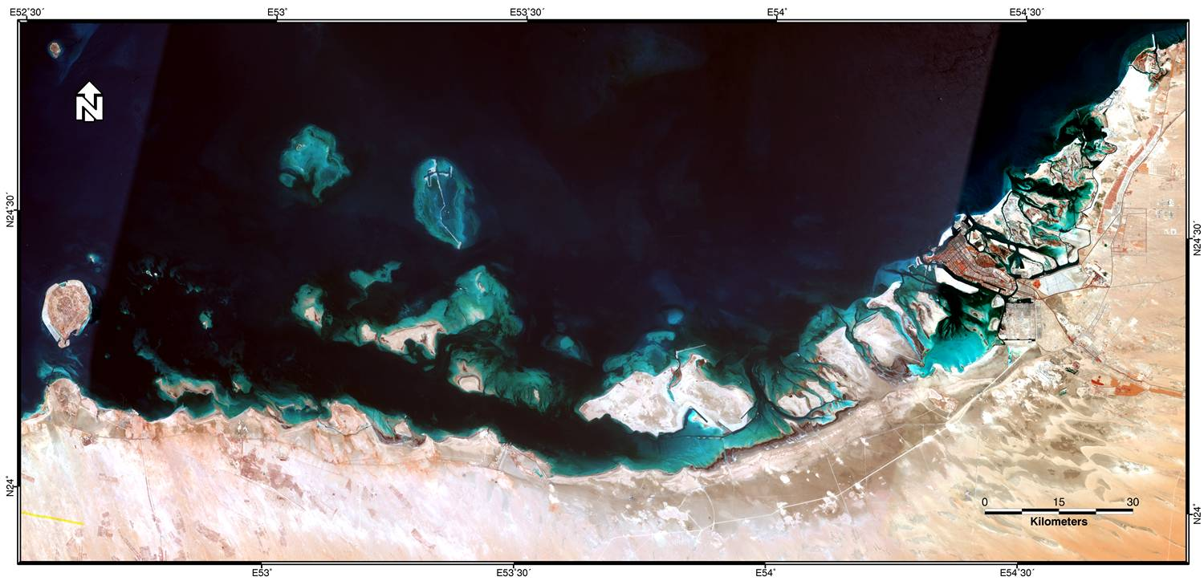
Western Coast of the United Arab Emirates - Parasequences

Slide 35
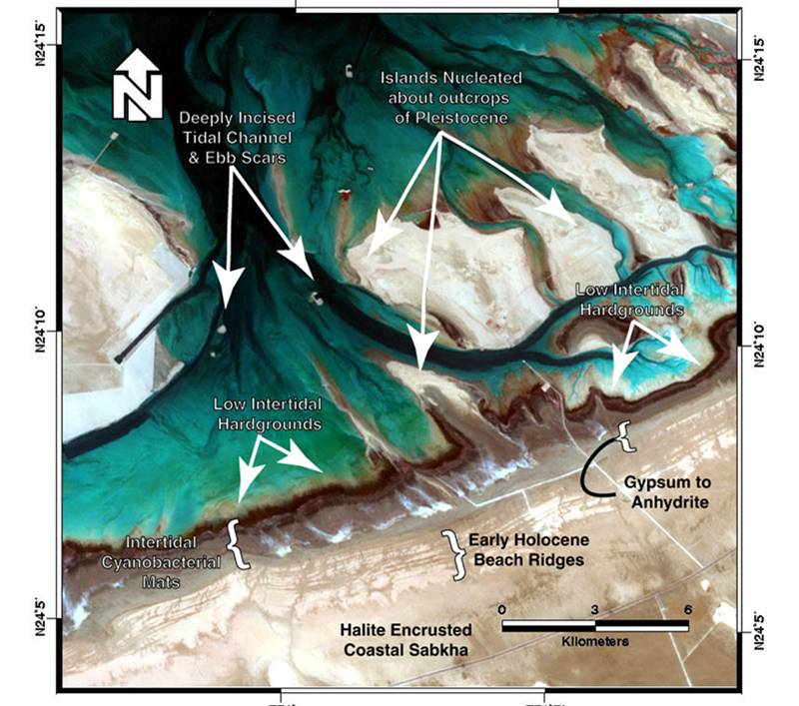
Western Coast of the United Arab Emirates - Parasequences

Slide 36
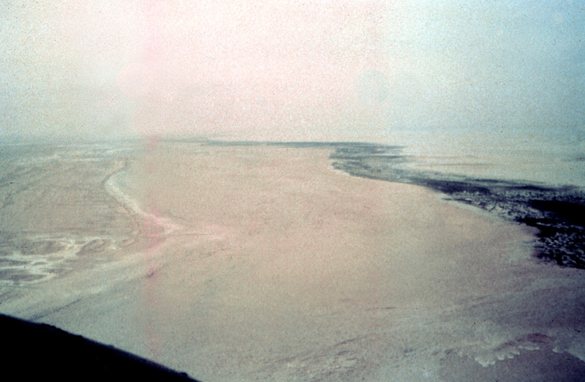
Western Coast of the United Arab Emirates - Parasequences
High Intertidal
Cyanobacterial
Flats
Intertidal
Carbonate
Flats
Earlier High
Energy Beaches
Supratidal
Sabkha
Evaporites

Slide 37
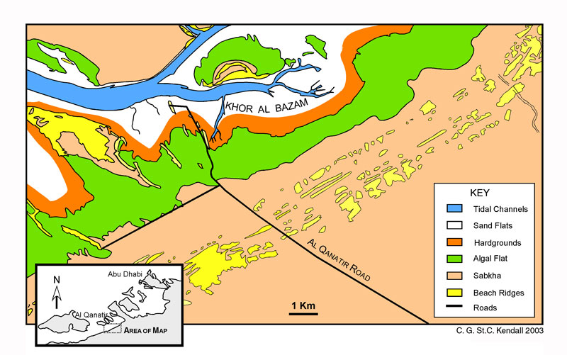
Intertidal Sand
& Mud Flats
Western Coast of the United Arab Emirates - Parasequences
Tidal Channels
Hardgrounds
Beach Ridges
Cyanobacterial
Mats
Sabkha

Slide 38


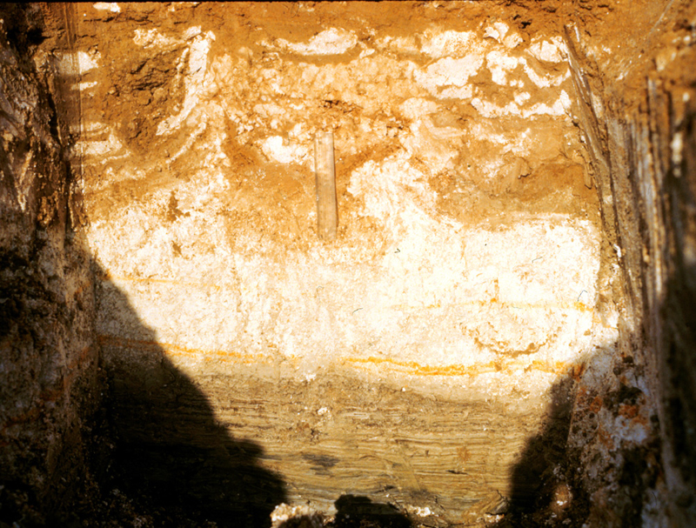
The Ancient Egyptians Knew This Before Walther
Shoaling
Up
Cycle
Or may be not?
Washover Sediments
Anhydrite
Cyanobacterial Peat

Slide 39
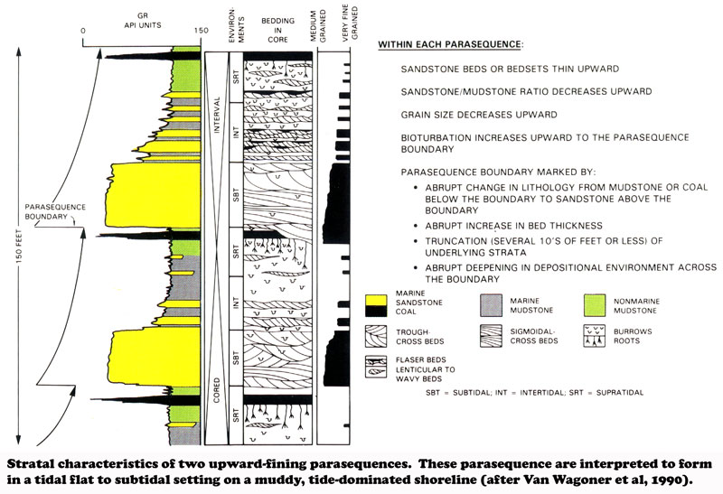
Parasequences
Marine Flooding Surface
Marine Flooding Surface
Marine Flooding Surface

Slide 40
Walther’s Law and Parasequences
As per Walther’s law parasequences of related facies adjacent to one another in a continuous vertical sequence are assumed to have accumulated adjacent to one another laterally
  Applies only to a section with no unconformities.
  Applies to a section without subdividing diachronous boundaries, including transgressive surfaces (TS) and the maximum flooding surfaces (mfs).
Even though a section of parasequences is subdivided by diachronous surfaces, Fuzzy Logic assumes this does not contravene Walther’s Law

Slide 41
Parasequences

Slide 42
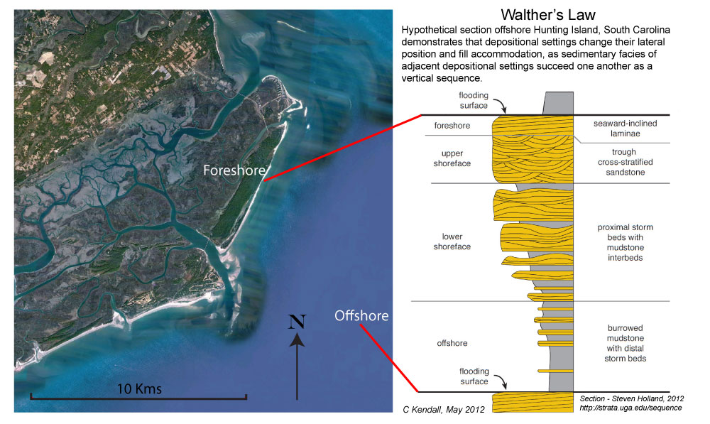
Parasequences

Slide 43
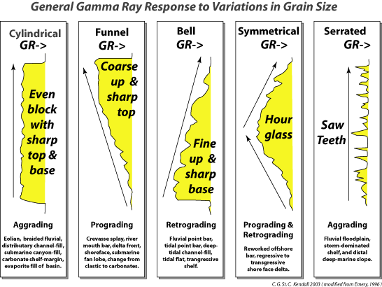
Clastic Parasequence Hierarchies

Slide 44
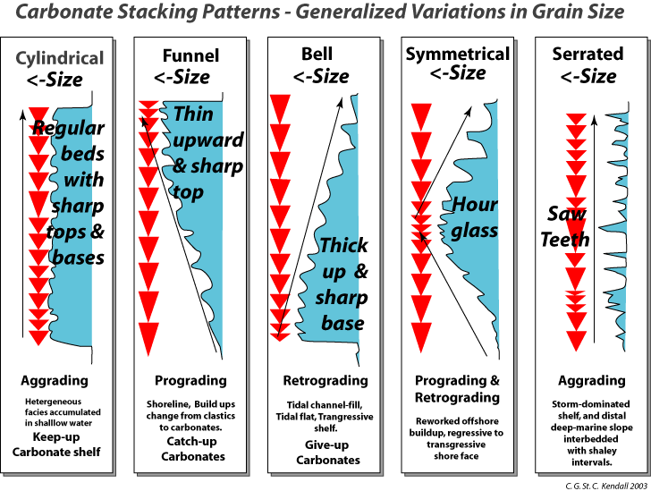
Carbonate Parasequence Hierarchies

Slide 45
Bounding Surfaces Defined
Each layer no matter its dimension and whatever the time involved in its deposition, is bounded by surfaces that transgress time
The interpretation of depositional setting for a section cut by diachronous surfaces must contravene Walther’s Law
However Fuzzy logic simplify this by assuming
  Bounding surfaces and
  Layers of sediment are of the same age

Slide 46
Timing, surfaces and layers linked
Application of Steno's principles and Walther’s Law provide powerful and useful simplifications that assume the sediments packaged by surfaces accumulated within discrete moments of time.
If one thinks about this, these simplifications don’t contravene logic (which is literally Fuzzy) and it aids in the interpretation of the sedimentary section.

Slide 47
Bounding Surfaces Defined
Internal and external surfaces of any
Bed
Parasequence
Stratigraphic Sequence
Products of unique associations of processes

Slide 48
Stratigraphic Sequence
A relatively conformable succession of genetically related strata bounded at their upper surface and base by unconformities and their correlative conformities (Vail, et al., 1977
Sequence is composed of succession of genetically linked deposition systems (systems tracts) and is interpreted to be deposited between eustatic-fall inflection points (Posamentier, et al., 1988).
Sequences and system tracts they enclose are subdivided and/or bounded by a variety of "key" surfaces that bound or envelope these discrete geometric bodies of sediment. These mark changes in depositional regime "thresholds" across that boundary.

Slide 49
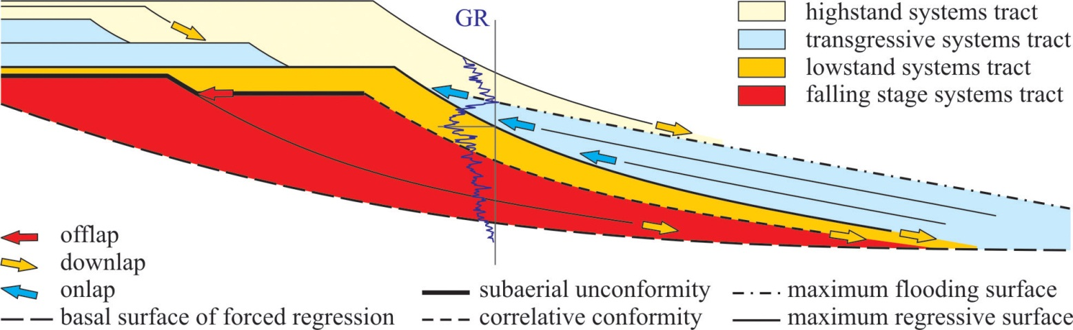
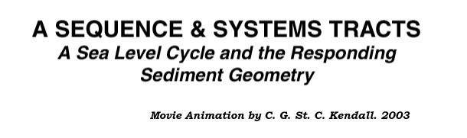
Stratigraphic Sequence

Slide 50
Stratigraphic Sequence
Surfaces subdivide sedimentary section and the geometries enclosed. Interpreted by iteratively applying conceptual models linking the processes that formed them. Provides:
Relative time framework to sedimentary succession
Better understanding inter-relationship of depositional settings and their lateral correlation

Slide 51
Stratigraphic Sequence
Study of rock relationships within a time-stratigraphic framework of repetitive, genetically related strata bounded by surfaces of erosion or non-deposition, or their correlative conformities (Posamentier et al., 1988; Van Wagoner et al., 1988).
Implicit but sometimes unstated connection between the external and internal surfaces of a sequence and base level change.

Slide 52
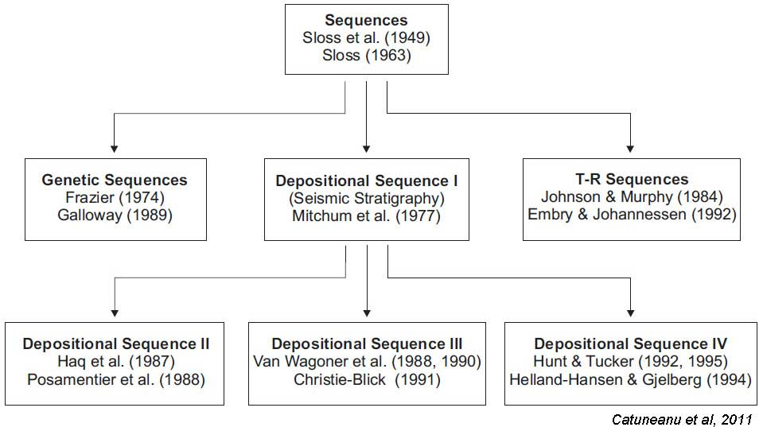
Sequence Stratigraphy – Conceptual Depositional Models

Slide 53
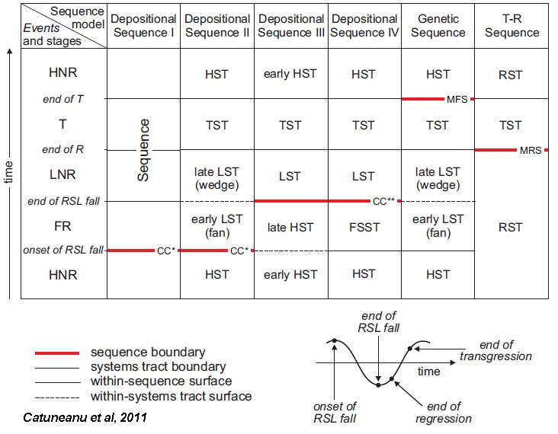
Sequence Stratigraphy – Conceptual Depositional Models
Abbreviations: RSL – relative sea level; T – transgression; R – regression; FR – forced regression; LNR – lowstand normal regression; HNR – highstand normal regression; LST – lowstand systems tract; TST – transgressive systems tract; HST – highstand systems tract; FSST – falling-stage systems tract; RST – regressive systems tract; T-R – transgressive-regressive; CC* – correlative conformity in the sense of Posamentier and Allen (1999); CC** – correlative conformity in the sense of Hunt and Tucker (1992); MFS – maximum flooding surface; MRS – maximum regressive surface.

Slide 54
Branches of stratigraphy
Lithostratigraphy: maps lithofacies independent of subdividing external & internal boundaries
Allostratigraphy: bounding discontinuities including erosion surfaces, marine flooding surfaces, tuffs, tempestite, and/or turbidite boundaries etc. as time markers
Sequence Stratigraphy: higher level allostratigraphic model which interprets depositional origin of sedimentary strata as products of "relative sea level change"

Slide 55
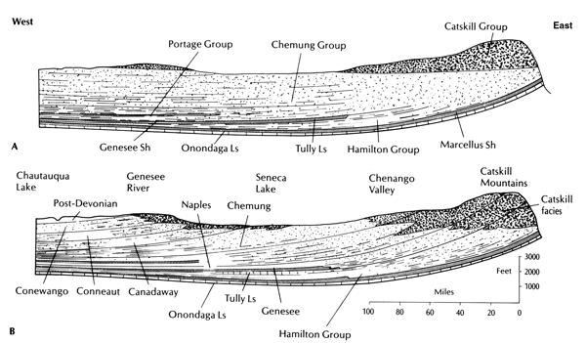
Lithostratigraphy & Allostratigraphy
Lithostratigraphy
Based on
Gross
Lithology
Allostratigraphy
Based on
Lithology
& Surfaces

Slide 56
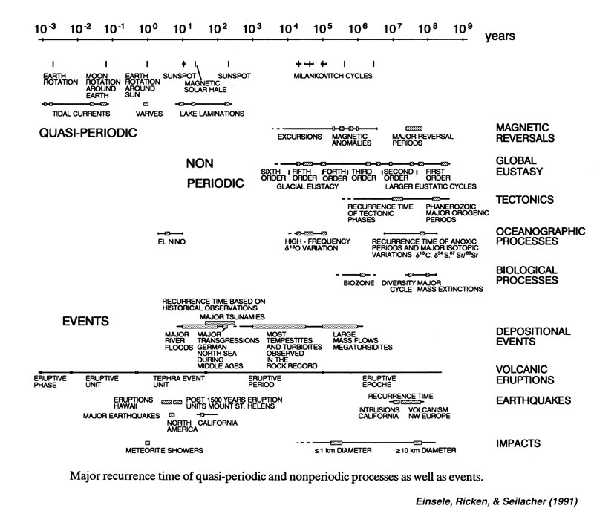
Event Stratigraphy - Quasi-Periodic & more

Slide 57
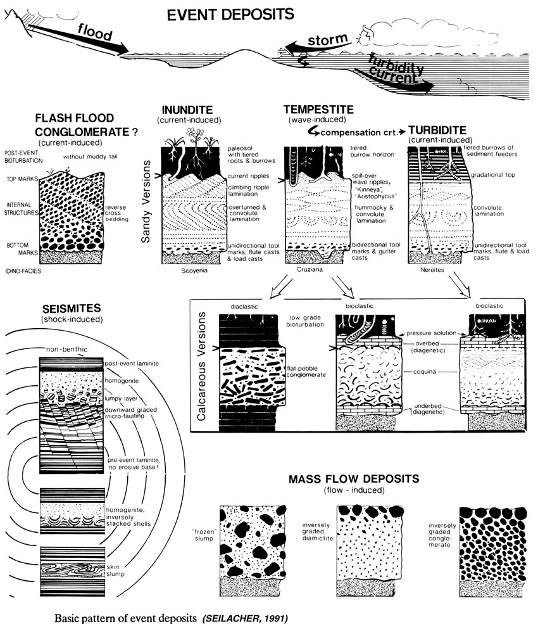
Allostratigraphic Events & Surfaces

Slide 58
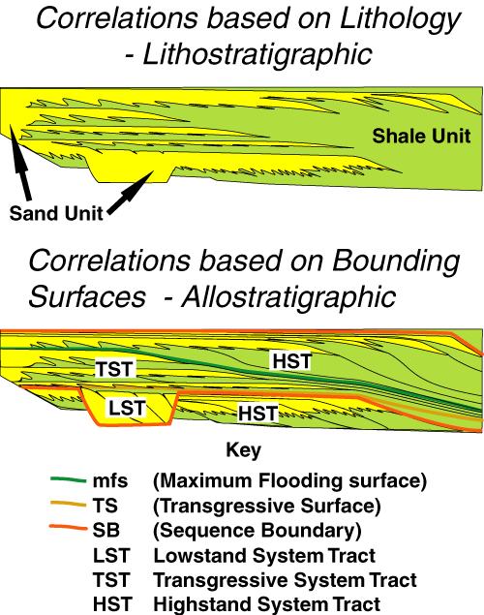
Lithostratigraphy & Allostratigraphy
Sequence Stratigraphic is a high level allostratigraphic model that uses "relative sea level change” to interpret the sedimentary strata

Slide 59
Lithostratigraphy and Allostratigraphy
Sequence Stratigraphy:
Higher level allostratigraphic model that interprets sedimentary strata in terms of bounding surfaces that are the products of "relative sea level change"

Slide 60
Sequence Stratigraphic Surfaces
These surfaces subdivide sedimentary rock, providing:-
Relative time framework for sedimentary succession
Better understanding of inter-relationship of depositional settings and lateral correlation
Conceptual models follow that link the processes that formed the sediments and enable the prediction of their gross geometries

Slide 61
Sequence Stratigraphic Surfaces
Sequence stratigraphy is based on the following surfaces that systematically subdivide the sedimentary section:
SB
TS
mfs

Slide 62
Sequence Boundary (SB)
Envelope Sequence
Significant erosional unconformity & correlative disconformity formed by drop in base level (relative sea level?)
Erodes subaerial exposed sediment surface of earlier sequence or sequences
Diachronous boundary between underlying Highstand System Tract (HST) and overlying Falling Stage System Tract (FSST) or Early Lowstand System Tract (ELST)
Eroded surface of downstepping sediments deposited during accompanying forced regression associated with sea level fall

Slide 63
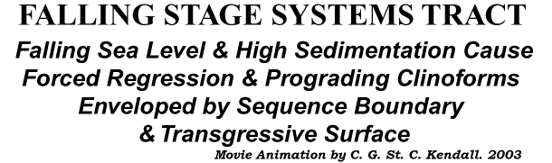
Sequence Boundary (SB)

Slide 64
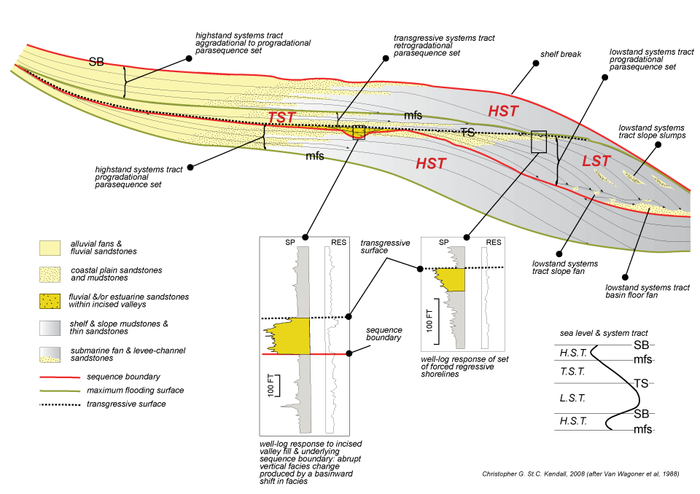
'Depositional' sequence Vail et al 1971

Slide 65
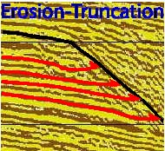
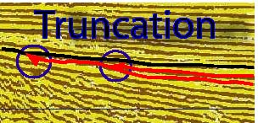
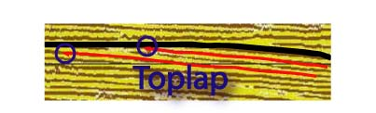
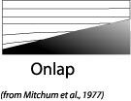
Sequence Boundary (SB) from Seismic

Slide 66
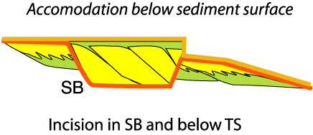
Sequence Boundary (SB) from Outcrop, Seismic & Wells
Erosion or incision of underlying flooding surfaces (mfs and TS)
Inferred from interruption in the lateral continuity of these surfaces

Slide 67
Sequence Boundary (SB) from well logs, core and outcrop
SB
mfs
TS
Erosion or incision of underlying flooding surfaces (mfs and TS)
Inferred from interruption in the lateral continuity of these surfaces
Establish a framework of genetically
related stratigraphic facies geometries
and their bounding surfaces to
determine depositional setting
“Sequence Stratigraphy – Basics”
C. G. St. C. Kendall

Slide 68
Sequence Stratigraphic Surfaces
Sequence stratigraphy is based on the following surfaces that systematically subdivide the sedimentary section:
SB
TS
mfs

Slide 69
Transgressive Surface (TS)
Product of rise in base level (relative sea level?)
Boundary between underlying Late Lowstand System Tract (LLST) and overlying Transgressive system tract (TST)
First significant marine-flooding surface of a sequence - often at base of most prominent onlap
Formed when rate of accommodation space develops faster than rate of sediment supply.
TS found when progradational stacking patterns change to aggradational and rate of sediment supply keeps pace with rate of relative sea-level rise

Slide 70
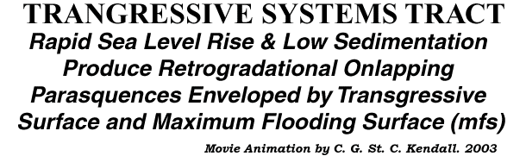
Transgressive Surface (TS)

Slide 71
Transgressive Surface (TS) Seismic
Defined by onlapping reflectors over and onto a surface (SB)

Slide 72
Transgressive Surface (TS) - well logs, core & outcrop
Erosion or incision of underlying onlapped sediment (Ravinement)
Glossifungites in this surface
Nick or neck on resistivity logs caused by presence of carbonate cements probably derived from the carbonate fauna eroded during Ravinement

Slide 73
Transgressive Surface (TS)
Defined by erosion or incision of underlying onlapped sediment (Ravinement)

Slide 74
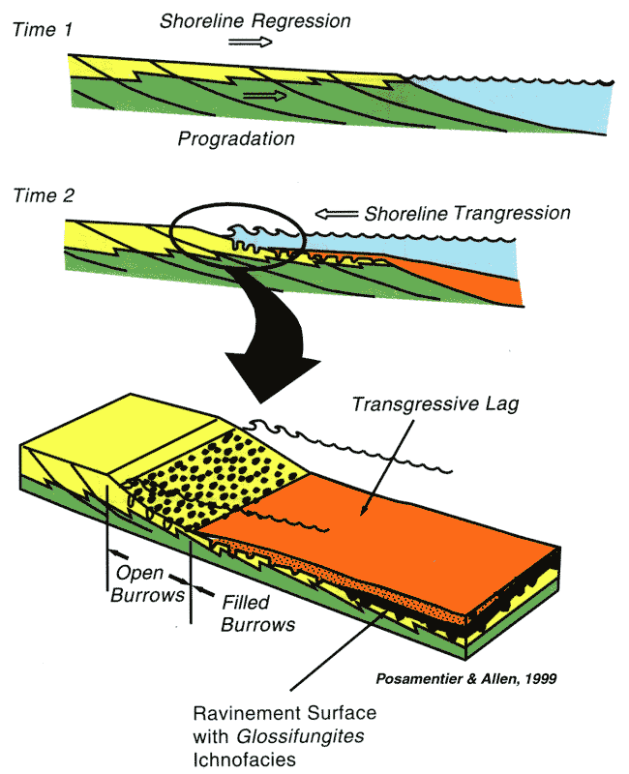
Formation of
Ravinement
Surface and
Glossifungites
Ichnofacies
Transgressive Surface (TS) - well logs, core & outcrop

Slide 75
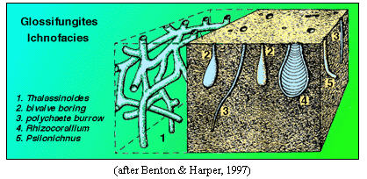
Transgressive Surface (TS) - well logs, core & outcrop
Inferred from presence of Glossifungites in this surface)

Slide 76
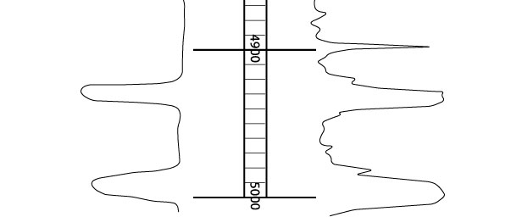
Transgressive Surface (TS) - well logs, core & outcrop
Inferred from presence of nick or neck on resistivity logs caused by presence of carbonate cements probably derived from the carbonate fauna eroded during the Ravinement

Slide 77
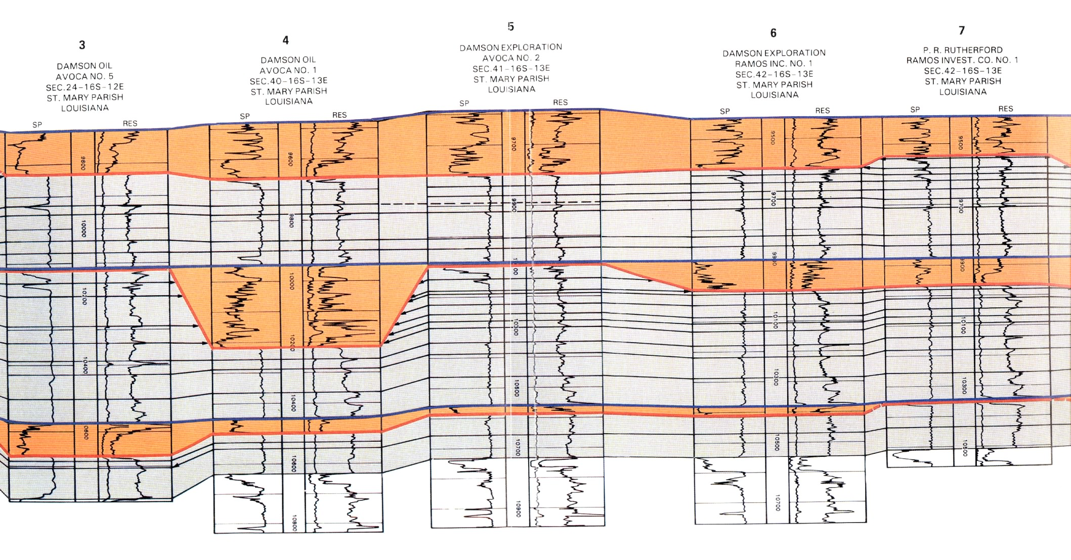
Transgressive Surface (TS) - well logs, core & outcrop
TS
TS

Slide 78
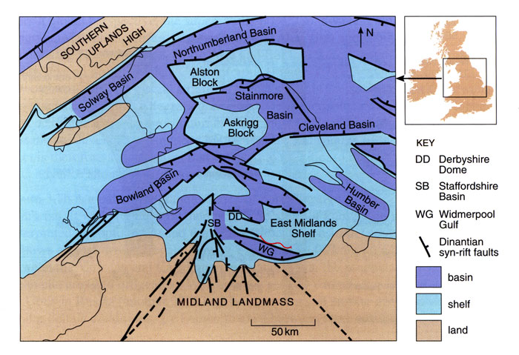
Transgressive Surface (TS) - well logs, core & outcrop
Section

Slide 79
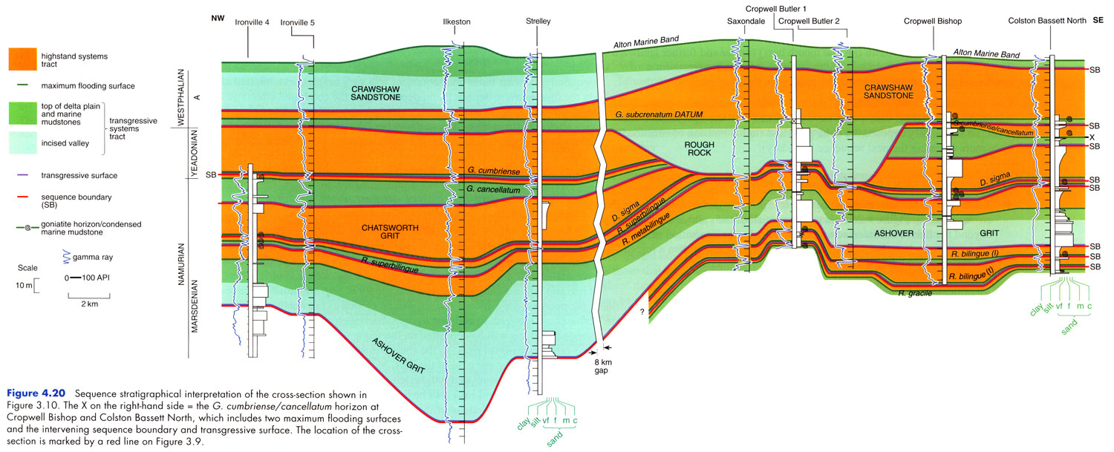
Transgressive Surface (TS) - well logs, core & outcrop
TS

Slide 80
Sequence Stratigraphic Surfaces
Sequence stratigraphy is based on the following surfaces that systematically subdivide the sedimentary section:
SB
TS
mfs

Slide 81
Maximum Flooding Surface (mfs)
Product of maximum flooding or transgression of shelf or stillstand in base level (sea level?)
Lies at boundary between underlying Transgressive system tract (TST) and overlying High stand system tract (HST)
Often expressed as a downlap surface.
Marine shelf and basinal sediments associated with this surface product of slow rates of deposition of pelagic-hemipelagic sediments
Often associated with condensed sections, high gamma ray signals and are usually thin

Slide 82
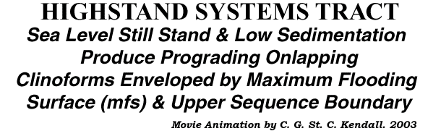
Maximum Flooding Surface (mfs)

Slide 83
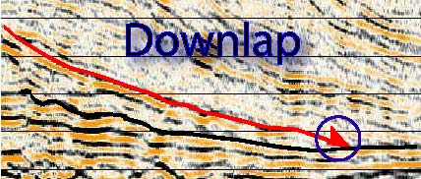
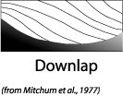
Maximum Flooding Surface (mfs)
Often expressed as a downlap surface

Slide 84

Maximum Flooding Surface (mfs)
Defined as lying immediately below the downlapping reflectors prograding reflectors of the HST

Slide 85
Maximum Flooding Surface (mfs) – Characteristics
Derived from well logs, cores, & outcrop
Defined by organic often radioactive (big kicks on gamma ray logs) black shales
Not infrequently overlain by coarser sediments (often sand sized)
Inferred from presence of condensed faunal association
Inferred from presence of finest grain size

Slide 86

Maximum Flooding
Surface
(mfs) well logs, core & outcrop
Maximum Flooding Surface (mfs)
MFS
After Hanford

Slide 87

Maximum Flooding
Surface (mfs) well logs, core & outcrop
Maximum Flooding Surface (mfs)
MFS
After Hanford

Slide 88

Maximum Flooding
Surface [mfs) well logs, core & outcrop
Maximum Flooding Surface (mfs)
MFS
After Hanford

Slide 89
Maximum Flooding Surface (mfs)
mfs
After Coe et al

Slide 90
Order & Hierarchy
Vail et al., (1977) define stratigraphic cycle order as frequency of time duration
Neal & Abreu, 2009 define “order” as hierarchal relationship of cyclic depositional units of different magnitudes
In this class order refers to the sequence in which layers are laid down; this is the succession of Neal and Abreu, 2009

Slide 91
Framework of SBs, TS & mfs Sequence Stratigraphic Prediction
Accommodation successions (Neal & Abreu, 2009)
produced by changes in rates of shelfal accommodation fill driven by base level change & sediment accumulation forming geometries that:
Prograde and aggrade (PA)
Retrograde (R)
Aggrade to prograde to degrade (APD).
Equivalent to HST, the TS and LST
Used to guide interpretation of conceptual models using sea level, sedimentation and or/age duration

Slide 92
Stratigraphic framework for facies prediction
(after Neal & Abreu, 2009)
Coastal accommodation (δA) & sediment fill (δS) rates form stratal stacking patterns of accommodation succession. Progradation to aggradation (PA),
retrogradation (R) motifs match lowstand, transgressive, and highstand systems tracts. APD systems tract indicates decreasing accommodation. APD systems
tract ending accommodation on the shelf can show degradational stacking, with no downward shift in coastal onlap. Sequence boundaries & initiation of other PA,
R, and APD cycles with downward shift in coastal onlap and onlapping of proximal facies over distal ones.

Slide 93
Accommodation Successions
Depositional Sequences
Idealized Facies Distribution
(after Neal & Abreu, 2009)

Slide 94
Seismic profile of Pelotas Basin - PA, R and APD Sequence Sets
PA (progradation to aggradation), R (retrogradation), and APD
(aggradation to progradation to degradation) sequence sets
(PASS, RSS, and APSS, respectively). Boundaries between
sequence sets are in orange. PASS—PA sequence set;
RSS—R sequence set; APSS—APD sequence set.
(after Neal & Abreu, 2009)

Slide 95
Seismic Sequence Stratigraphy
Subdivision and interpretation of sedimentary record using a framework surfaces seen in 2-D and 3-D seismic.
Identifies:
Surfaces of erosion and non-deposition (sequence boundaries)
Flooding (transgressive surfaces [TS] and/or maximum flooding surfaces [mfs]) and high stand condensed surfaces
This framework tied to logs and outcrop via synthetic traces is used to predict the extent of sedimentary facies geometry, lithologic character, grain size, sorting and reservoir quality

Slide 96
Lecture Ends!!

Slide 97
Definitions
sediment: unconsolidated* material that is produced on Earth’s surface by the disaggregation of pre-existing rocks
sedimentary rock: a consolidated body formed from sediments or solutes that are transported and deposited by gravity, biologic activity, or a fluid and then lithified by the combined effects of compaction and cementation
sedimentology: the study of the production, transport, and deposition of sediment
* some exceptions apply

Slide 98
Definitions
strata: layers of (usually sedimentary) rock
stratigraphy:
  the description, study, and/or application of the composition of layered (usually sedimentary) rocks
  a succession of layered rocks; e.g., the stratigraphy of South Carolina
basin:
  a region of potential sediment accumulation generally caused by subsidence
  the largest possible body of related and once-contiguous* strata; e.g., the Appalachian basin
* some exceptions apply

Slide 99
Definitions
faciere: to send, to put, to place, to make
→ facies: outward appearance, sight, form, shape
facies: the face; the general aspect of any group of organisms or of rocks (Webster’s 1945)
facies: a rock distinguished from others by its appearance or composition (www.dictionary.com)

Slide 100
Definitions
strata: layers of (usually sedimentary) rock
stratigraphy:
  the description, study, and/or application of the composition of layered (usually sedimentary) rocks
  a succession of layered rocks; e.g., the stratigraphy of South Carolina
basin:
  a region of potential sediment accumulation generally caused by subsidence
  the largest possible body of related and once-contiguous* strata; e.g., the Appalachian basin
* some exceptions apply

Slide 101

Sedimentary Facies

Slide 102
Sedimentary Facies
facies: the total textural, compositional and structural characteristics of a sedimentary deposit resulting from accumulation and modification in a particular environment.

Slide 103
Sedimentary Facies
facies: the total textural, compositional and structural characteristics of a sedimentary deposit resulting from accumulation and modification in a particular environment.
grain size, sorting, rounding
lithology
sedimentary structures
bedding type

Slide 104
Sedimentary Facies
facies: the total textural, compositional and structural characteristics of a sedimentary deposit resulting from accumulation and modification in a particular environment.
EX: well-sorted, moderately rounded, trough cross-stratified, horizontally burrowed & normally graded arkosic coarse sandstone

Slide 105
Lithofacies & Lithofacies Codes
Sedimentary facies often get reduced to lithofacies which detail grain-size, composition, and dominant sedimentary structures only
  EX: planar cross-stratified gravel, inversely graded massive sandstone
This has led to lithofacies codes (after Miall, 1978).
  EX: Gmm, St, Fsl

Slide 106
Sedimentary Facies
facies: the total textural, compositional and structural characteristics of a sedimentary deposit resulting from accumulation and modification in a particular environment.
facies assemblage: collection of multiple facies resulting from genetically related accumulation and modification.
EX: lenticularly bedded stratified pebble conglomerate with subordinate planar cross-stratified sandstone
OR: fluvial channel lithofacies assemblage

Slide 107
Facies Assemblage

Slide 108
Depositional Systems
depositional system: assemblage of multiple process-related sedimentary facies assemblages, commonly identified by the geography in which deposition occurs.
  EX: nearshore depositional system, deep marine depositional system, glacial depositional system, fluvial depositional system
NB depositional systems are:
  modern features
  used to interpret ancient sedimentary successions

Slide 109
Sequence stratigraphic analysis
This analysis involves
Subdivision of section into sequences, parasequences and beds.
Link conceptual models with mix of components of the individual sequence, parasequence or beds
Use these to explain the depositional setting in terms of their lithology, grain size, sedimentary structures, contacts character (gradational, abrupt) etc

Slide 110

Sequence Stratigraphic Analysis

Slide 111
Carbonate Sequence Hierarchy
Allochems – lthological components, their cementation & diagenesis
Bedding – internal character including lithology, geometry, sedimentary structures, & fauna
Stacked cycles of beds – vertical character of beds from varying depositional settings
Margin complex – shelf, shelf margin & adjacent basin facies evolving in response to a cycle in changing base level
Shelf complex – mix of shelf, shelf margin & adjacent basin facies evolving in response to complete & complex cycles of changing base level & paleogeography

Slide 112











Carbonate Platform Architectural Elements
ALLOCHEMS
CEMENTATION
& DIAGENESIS
,
SEDIMENTARY
STRUCTURES
FAUNA
GRAINS
STACKED
BED
CYCLES
CYCLES OF
BEDS
REEFS
PROGRADING MARGIN
HST MARGIN
COMPLEX
MARGIN
COMPLEX
PROGRADING MARGIN
SHELF
MARGIN
COMPLEX
SHELF
COMPLEX
ONLAPPING MARGIN
PROGRADING MARGIN

Slide 113

Hierarchy of Carbonate Platform Architectural Elements
Hierarchy of Carbonate Architectural Elements
”Carbonate Hierarchies”
Christopher G. St. C. Kendall

Slide 114

Hierarchy of Carbonate Architectural Elements

Slide 115
Hierarchy of Carbonate Architectural Elements

Slide 116

Hierarchy of Carbonate Architectural Elements

Slide 117

Hierarchy of Carbonate Architectural Elements

Slide 118

Hierarchy of Carbonate Architectural Elements

Slide 119

Fluvial - Architectural Elements

Slide 120
Coastal Elements

Slide 121

Deepwater - Architectural Elements

Slide 122

Deepwater Sequence Stratigraphic Hierarchies

Slide 123

Deepwater - Architectural Elements

Slide 124

Character of Deepwater Channel Stacking

Slide 125

Deepwater - Architectural Elements

Slide 126

Surfaces and Geometries
Sequences are subdivided by
  Maximum Flooding Surfaces (mfs)
  Transgressive Surfaces (TS)
  Sequence Boundaries (SB)
Arrangement of vertical succession or stacking patterns of unconfined sheets
  Prograde (step seaward)
  Retrograde (step landward)
  Aggrade (build vertically)
Sheets and unconfined lobes containing
  Non-amalgamated bodies
Incised topographic fill
  Amalgamated, multi-storied bodies (e.g. incised valleys)
  Within unconfined lobes

Slide 127

Surfaces and Geometries
Sequence are subdivided by
  Maximum Flooding Surfaces (mfs)
  Transgressive Surfaces (TS)
  Sequence Boundaries (SB)
Arrangement of vertical succession or stacking patterns of unconfined sheets
  Prograde (step seaward)
  Retrograde (step landward)
  Aggrade (build vertically)
Sheets and unconfined lobes containing
  Non-amalgamated bodies
Incised topographic fill
  Amalgamated, multi-storied bodies (e.g. incised valleys)
  Within unconfined lobes

Slide 128

Surfaces and Geometries
Sequence are subdivided by
  Maximum Flooding Surfaces (mfs)
  Transgressive Surfaces (TS)
  Sequence Boundaries (SB)
Arrangement of vertical succession or stacking patterns of unconfined sheets
  Prograde (step seaward)
  Retrograde (step landward)
  Aggrade (build vertically)
Sheets and unconfined lobes containing
  Non-amalgamated bodies
Incised topographic fill
  Amalgamated, multi-storied bodies (e.g. incised valleys)
  Within unconfined lobes

Slide 129

Surfaces and Geometries
Sequence are subdivided by
  Maximum Flooding Surfaces (mfs)
  Transgressive Surfaces (TS)
  Sequence Boundaries (SB)
Arrangement of vertical succession or stacking patterns of unconfined sheets
  Prograde (step seaward)
  Retrograde (step landward)
  Aggrade (build vertically)
Sheets and unconfined lobes containing
  Non-amalgamated bodies
Incised topographic fill
  Amalgamated, multi-storied bodies (e.g. incised valleys)
  Within unconfined lobes

Slide 130

Surfaces and Geometries
Sequence are subdivided by
  Maximum Flooding Surfaces (mfs)
  Transgressive Surfaces (TS)
  Sequence Boundaries (SB)
Arrangement of vertical succession or stacking patterns of unconfined sheets
  Prograde (step seaward)
  Retrograde (step landward)
  Aggrade (build vertically)
Sheets and unconfined lobes containing
  Non-amalgamated bodies
Incised topographic fill
  Amalgamated, multi-storied bodies (e.g. incised valleys)
  Within unconfined lobes

Slide 131

Surfaces and Geometries
Sequence are subdivided by
  Maximum Flooding Surfaces (mfs)
  Transgressive Surfaces (TS)
  Sequence Boundaries (SB)
Arrangement of vertical succession or stacking patterns of unconfined sheets
  Prograde (step seaward)
  Retrograde (step landward)
  Aggrade (build vertically)
Sheets and unconfined lobes containing
  Non-amalgamated bodies
Incised topographic fill
  Amalgamated, multi-storied bodies (e.g. incised valleys)
  Within unconfined lobes

Slide 132


Channels & Shelves
Channel
Shelf
Both have unique processes & structures that can be used to identify their setting
“Sequence Stratigraphy – Depositional Models”
C. G. St. C. Kendall

Slide 133

Ebb Ooid Delta - UAE
“Sequence Stratigraphy – Depositional Models”
C. G. St. C. Kendall

Slide 134

Tidal, Storm or Tsunami Channel
Note Incised Surface
“Sequence Stratigraphy – Depositional Models”
C. G. St. C. Kendall

Slide 135

Barrier Island, Washover & Back Barrier Lagoon
“Sequence Stratigraphy – Depositional Models”
C. G. St. C. Kendall

Slide 136

Barrier Island Coast - Appalachians
Note Storm Washover
On a Back Barrier
Pennsylvanian, Kentucky
Wave Dominated Coast
“Sequence Stratigraphy – Depositional Models”
C. G. St. C. Kendall

Slide 137

Lena River Delta - Russia
“Sequence Stratigraphy – Depositional Models”
C. G. St. C. Kendall

Slide 138

Delta Mouth Bar - Kentucky
Note Incised Surface
“Sequence Stratigraphy – Depositional Models”
C. G. St. C. Kendall

Slide 139
Channel – Gulf Coast
Note Incised Surface

Slide 140
Coastal Elements

Slide 141

Barrier Island Profiles – Book Cliffs
After Coe et al

Slide 142

Surfaces and Geometries of Clastic Shelf

Slide 143
Sequence Boundary (SB) from well logs, core and outcrop
SB
mfs
TS
Erosion or incision of underlying flooding surfaces (mfs and TS)
Inferred from interruption in the lateral continuity of these surfaces
Establish a framework of genetically
related stratigraphic facies geometries
and their bounding surfaces to
determine depositional setting
“Sequence Stratigraphy – Basics”
C. G. St. C. Kendall

Slide 144
Deepwater - Architectural Elements

Slide 145
Clastic Sequence Stratigraphic Hierarchies

Slide 146
Clastic Sequence Hierarchy
Shelf & Margin Complex – Mix of shelf, coastal (barrier & deltaic) & adjacent basin & fan facies evolving in response to complete & complex cycles of changing base level & paleogeography
Stacked Cycles Of Beds – Vertical character of beds from varying depositional settings
Bedding – Internal character including lithology, geometry, sedimentary structures, & fauna
Grains – Lthological components, their cementation & diagenesis

Slide 147

Clastic Sequence Stratigraphic Hierarchies

Slide 148

Clastic Sequence Stratigraphic Hierarchies

Slide 149

Clastic Sequence Stratigraphic Hierarchies

Slide 150
Lecture Ends!!

