Slide 1
CHRONOSTRATIGRAPHY
RADIOMETRIC DATING

Slide 2
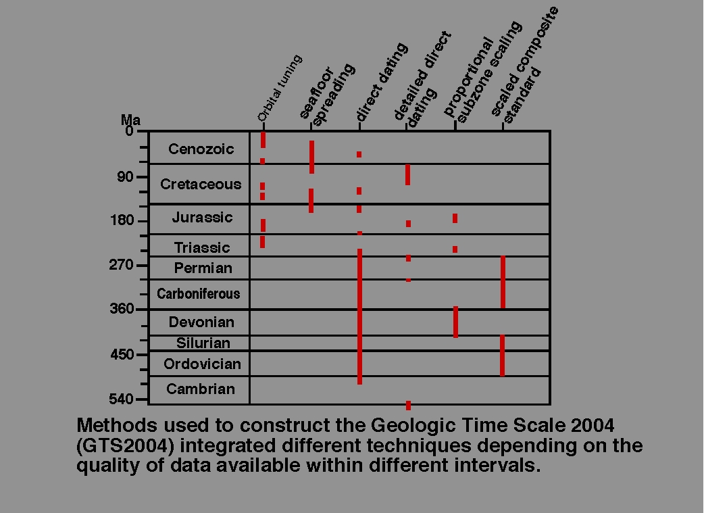

Slide 3
Geochronology is the science of determining the age of rocks, fossils, and sediments
Chronostratigraphy is the branch of stratigraphy that studies the age of rock strata in relation to time

Slide 4
TOOLS
RADIOACTIVE ELEMENTS HAVE A PROVEN
CONSTANT DECAY RATE
RADIOACTIVE ELEMENTS HAVE A PROVEN
CONSTANT HALF-LIFE
NECESSARILY, A DATABLE MATERIAL MUST COME
FROM A CLOSED SYSTEM, CONTAINING BOTH
THE PARENT ISOTOPES AND THEIR DECAY
PRODUCTS

Slide 5
The idea that radioactivity could be used as a
measure of the age of geologic formations
was first suggested in 1905 by a British physicist,
Lord Rutherford. In 1907 Professor B. B. Boltwood,
a radiochemist at Yale University, made the first
attempt to establish a geologic time scale.
So by the time that Barrell (1917) wrote his important
stratigraphy paper, he already had a pretty good idea
of the true age of the Earth and approximately how
long it took some Earth processes to operate.

Slide 6
Chronostratigraphic units are defined as
encompassing all rocks formed within
certain time spans of Earth history
regardless of their compositions or
properties.
SEE REFERENCES-
http://www.tulane.edu/~sanelson/eens211/radiometric_dating.htm

Slide 7
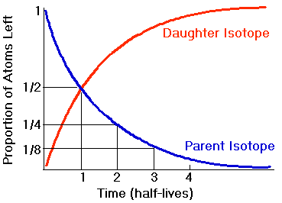
2
3
5
6
Dalrymple, 1991)
http://www.tulane.edu/~sanelson/eens211/radiometric_dating.htm
RADIOACTIVE DECAY: Parent/daughter relationship.

Slide 8
CARBON
The best-known absolute dating technique is
carbon-14 dating. However, this method cannot
be used for materials older than ca. 50,000 years,
because the half-life of ¹⁴C is only 5730 years.
.
THERE ARE 3 ISOTOPES OF CARBON, ¹²C, ¹³C, & ¹⁴C

Slide 9
AGE DATING USING CARBON IS NOT ALWAYS CORRECT
BECAUSE OF WEATHERING AND ORGANIC DECAY
LEADING TO LOSS OF PART OF THE ORIGINAL RADIOACTIVE CARBON
USEFULNESS
LIMITED
¹⁴C IS ONLY FOR WOOD, PEAT, CHARCOAL,
LEATHER, TEXTILES, BONES, SHELLS, & SOMETIMES POTTERY

Slide 10
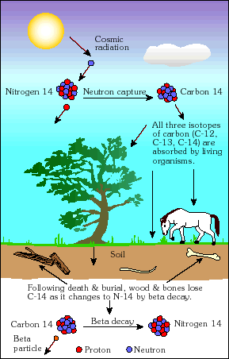
Following death and burial, wood, charcoal and bones
lose C-14 as it changes back to N-14 by beta decay

Slide 11
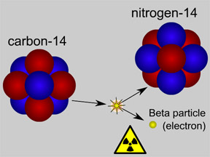
breakdown
carbon-14 (also written as ¹⁴C) has a half-life of 5,730 years

Slide 12
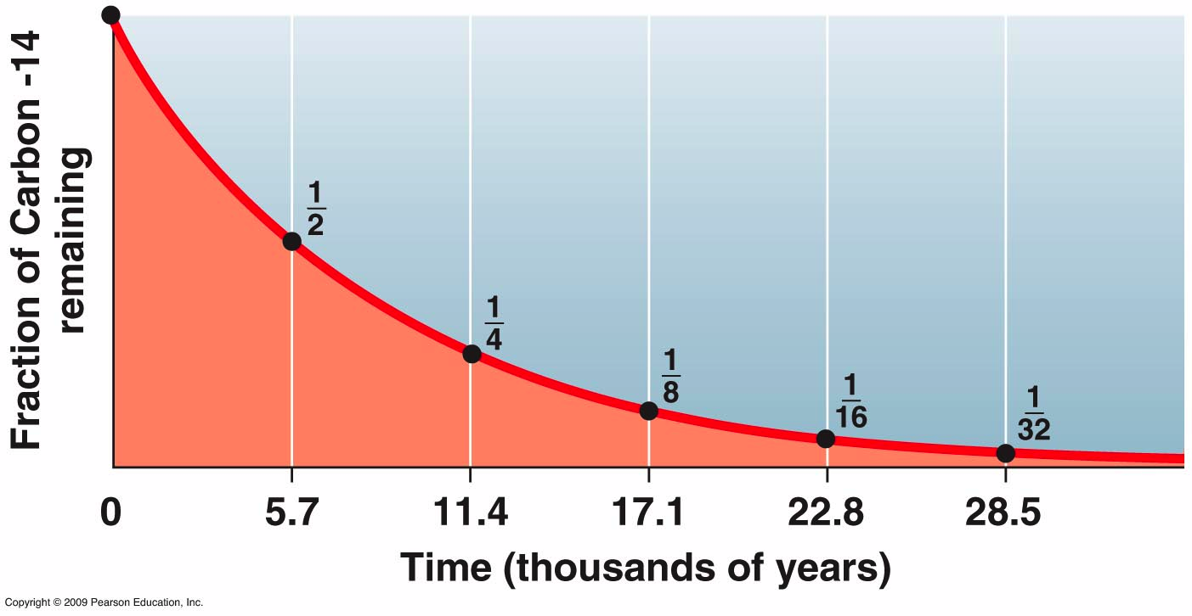
Carbon
With a half life of 5,730 years, not much time remains after
6 half-lives (1.675% remains)

Slide 13
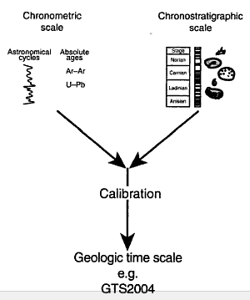
Terminology
* (Geo)Chronometric scale
 Ticking clock; measured in
years before present
 Example: Proterozoic and
Archean stratigraphy is formally
classified chronometrically, so-
○ Base of each eon, era and
period assigned a numerical
age
· * Chronostratigraphic scale
· * Geochronologic scale

Slide 14
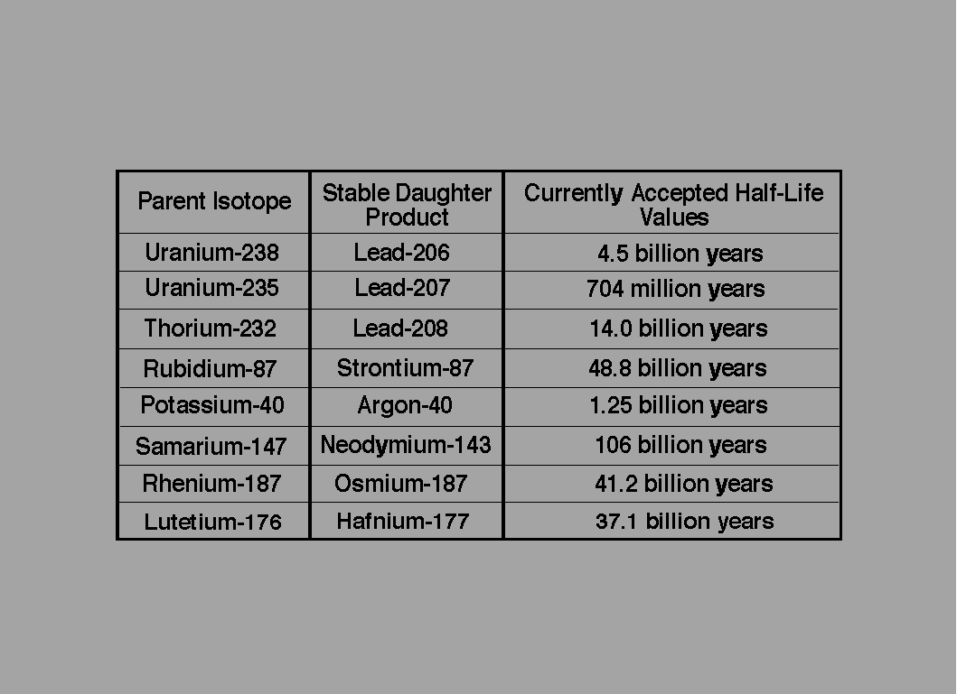

Slide 15
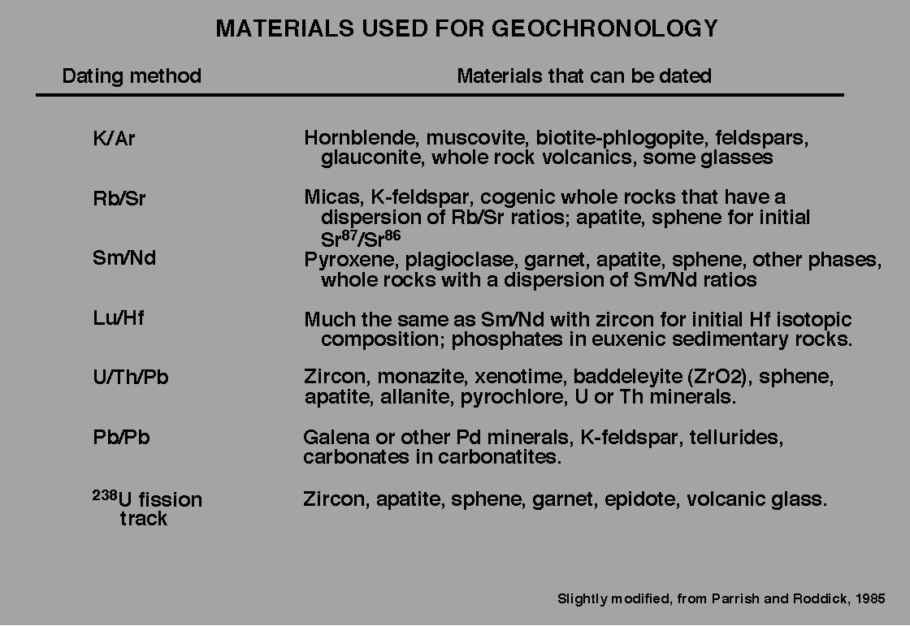

Slide 16
FISSION TRACK DATING
Minerals with trace amounts of ²³⁸U: obsidian, mica,
zircons
Release of energy charged alpha particles
Creates damage trails
Can be done using a microscope
Record begins when rock cools from molten state
Applicable from a few years to several million years

Slide 17
Radiometric dating: sources of error
· "accuracy” [sampling, interpretation, analysis]
 decay constant
 age of standard
 contamination (e.g., atmospheric argon contamination)
 character of sample
 statistics
accuracy determined by reproducibility
The “precision” of the measurement
 isotopic measurement
 interference corrections
 homogeneity of standard

Slide 18
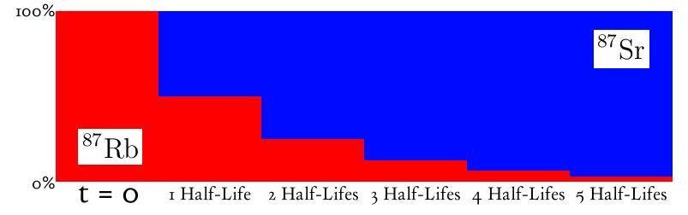
The half-life of Rubidium-87 is 47.5 billion years.
Start with 1000 Rubidium-87 atoms. 47.5 billion years later about one half of them will have decayed into Strontium-87. After one half life you will have about 500 Rubidium-87 atoms and 500 Strontium-87 atoms. In another 47.5 billion years you will have about 250 Rubidium-87 and 750 Strontium-87, and so on.

Slide 19
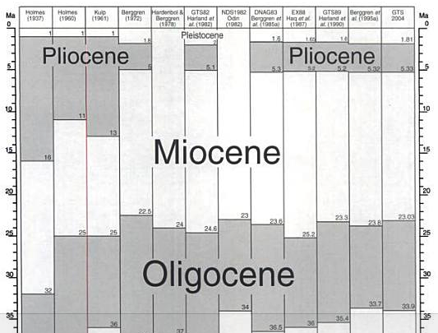
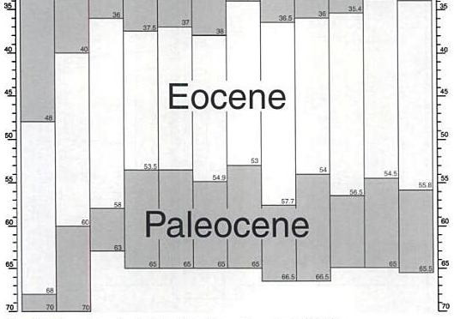
Changes in the
geologic time
scale (Cenozoic)
 (1937-2004)
JUST BECAUSE
OF
CHANGING
MEASUREMENT
ABILITY

Slide 20
Usage Terminology
· (Geo)Chronometric unit
 Direct division of geologic time expressed in years
○ Tyrannosaurus rex lived from 67 to 65.5 Ma
· Chronostratigraphic unit
 Geological material
○ Fossils of the genus Tyrannosaurus have
been found in the Upper Cretaceous Series
· Geochronologic unit
 A period of time in the geological time scale
○ Tyrannosaurus rex lived during the Late Cretaceous
Epoch

