Slide 1
Regional Framework and Controls on Jurassic Evaporite and Carbonate Systems of the Arabian Plate
CHRISTOPHER G. ST.C. KENDALL
University of S. Carolina
kendall@sc.edu

Slide 2
Acknowledgments
I extend my thanks & appreciation to:
University of South Carolina
&
E.A.G.E.
for helping make this presentation possible
Kendall - Jurassic Evaporite and Carbonate Systems of Arabian Plate

Slide 3
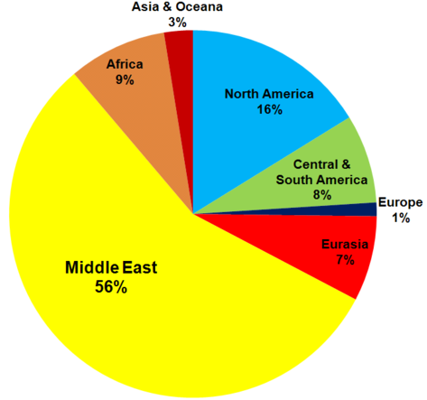
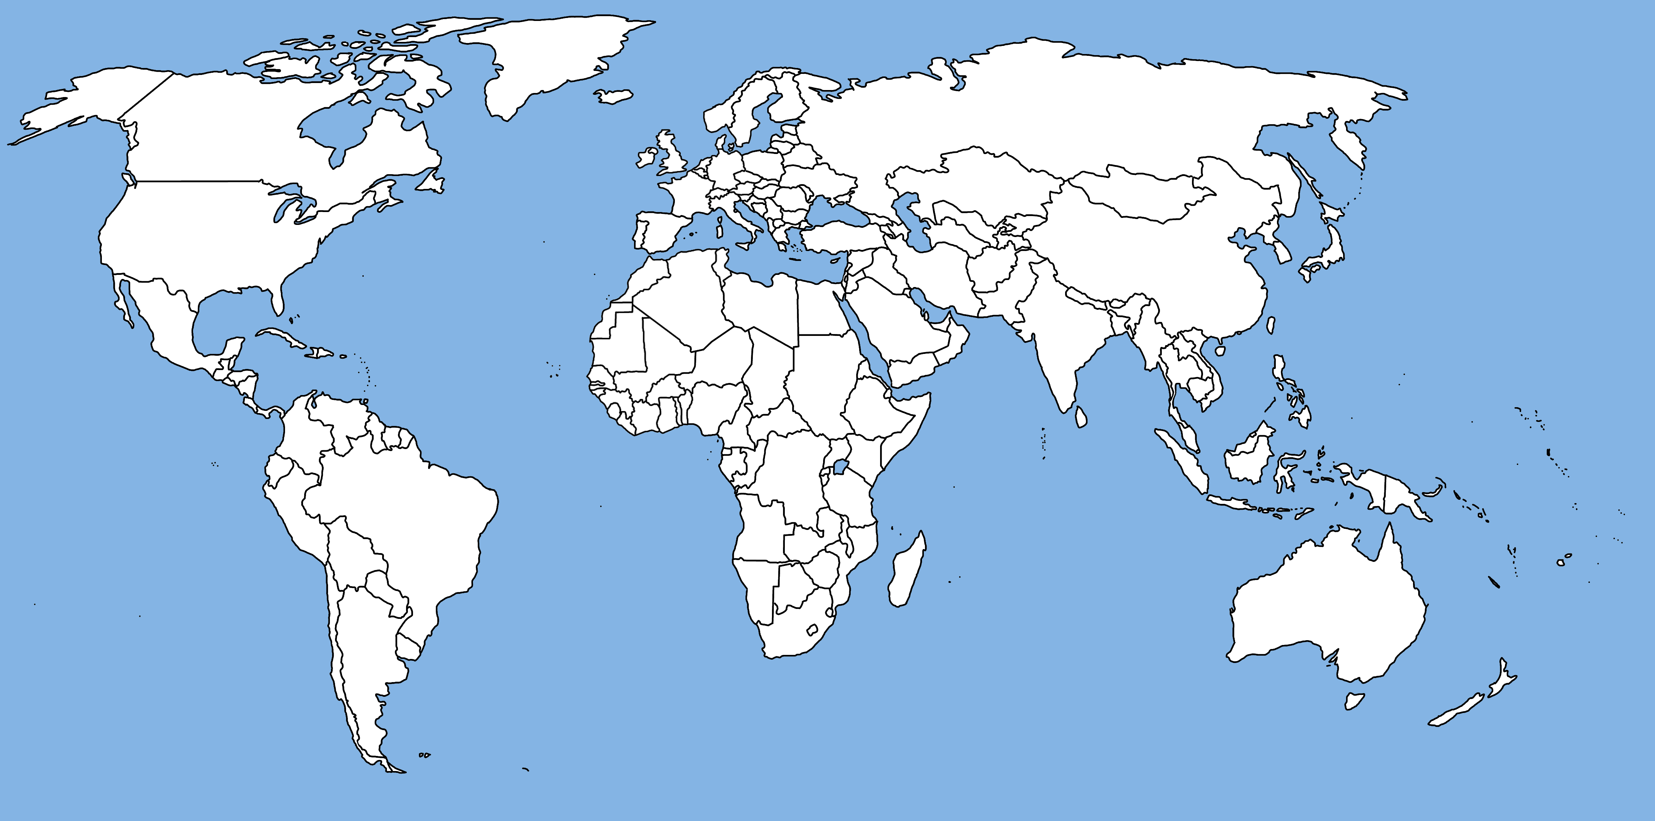
South Tethyan Margin
Northeastern flank of Gondwanaland from Arabian Plate through Zagros & Taurus Mtns, Levant & N Africa
Kendall - Jurassic Evaporite and Carbonate Systems of Arabian Plate

Slide 4
Presentation Outline
Carbonate/Evaporite Hydrocarbon Reserves
Tie between Carbonate/Evaporite Settings
  Climate
  Basin Phase (extension, compression, or barred)
  Sea Level
Carbonate/ Evaporite Play Geometries
Summary & Conclusions
Evaporite
Settings
Evolving Basins
& Plates
Carbonate
Plays
Basin Phase Evolution =
Plate Tectonic Setting +
Subsidence Mechanism
Talk based on Proven Plays from Commercial Databases (e.g., C & C Reservoirs, IHS Energy, USGS Assessments)

Slide 5
Significance of Carbonates & Evaporites
5
DISCOVERED CONVENTIONAL
Proven Conventional Plays with Discovered
Reserves - Reported (764,000 MBOE)
4
56%World Total Reserves in Carbonates
56% Total Reserves in Carbonates
3
World
Total (1)
64%
Total
Reserves
Trillions BOE
36%
2
Total in
Carbonate
Fields (2)
1
4.1
Carbonate
Fraction
Carbonate Play Association with Evaporite Seal: N = 31
2.3
Carbonate Play Association with No Evaporite Seal: N = 45
0
Weber & Sarg, 2005
Unconventional Plays may double current conventional reserves
(1) USGS World Assessment (2000)
(2) hMobil CATT Study (1999)
“Conventional Plays”
Database captured 33% of total discovered reserves in carbonates
41% of plays exhibit an evaporite seal
64% of discovered reserves trapped under an evaporite seal
So evaporites are important?

Slide 6
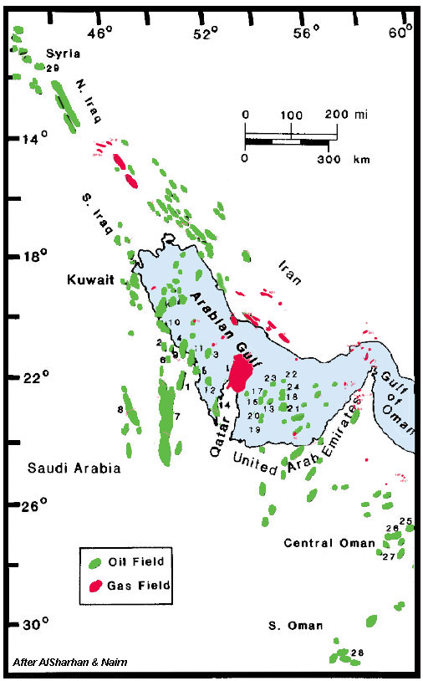
Most are carbonate plays that accumulated beneath evaporite seals in inter-plate isolated restricted basins, shale forming a major seal in the Cretaceous
Location of Oil & Gas Fields of Arabian Gulf
-
Reservoirs
are
Younger
to East
Tertiary
Cretaceous
Jurassic
{
{
Paleozoic

Slide 7
Controls Carbonate Platform Architectural Elements
Evolving
Paleogeography, Basins &
Plates
Climate
Eustasy
Carbonate/ Evaporite
Settings
Carbonate
Play Geometry

Slide 8
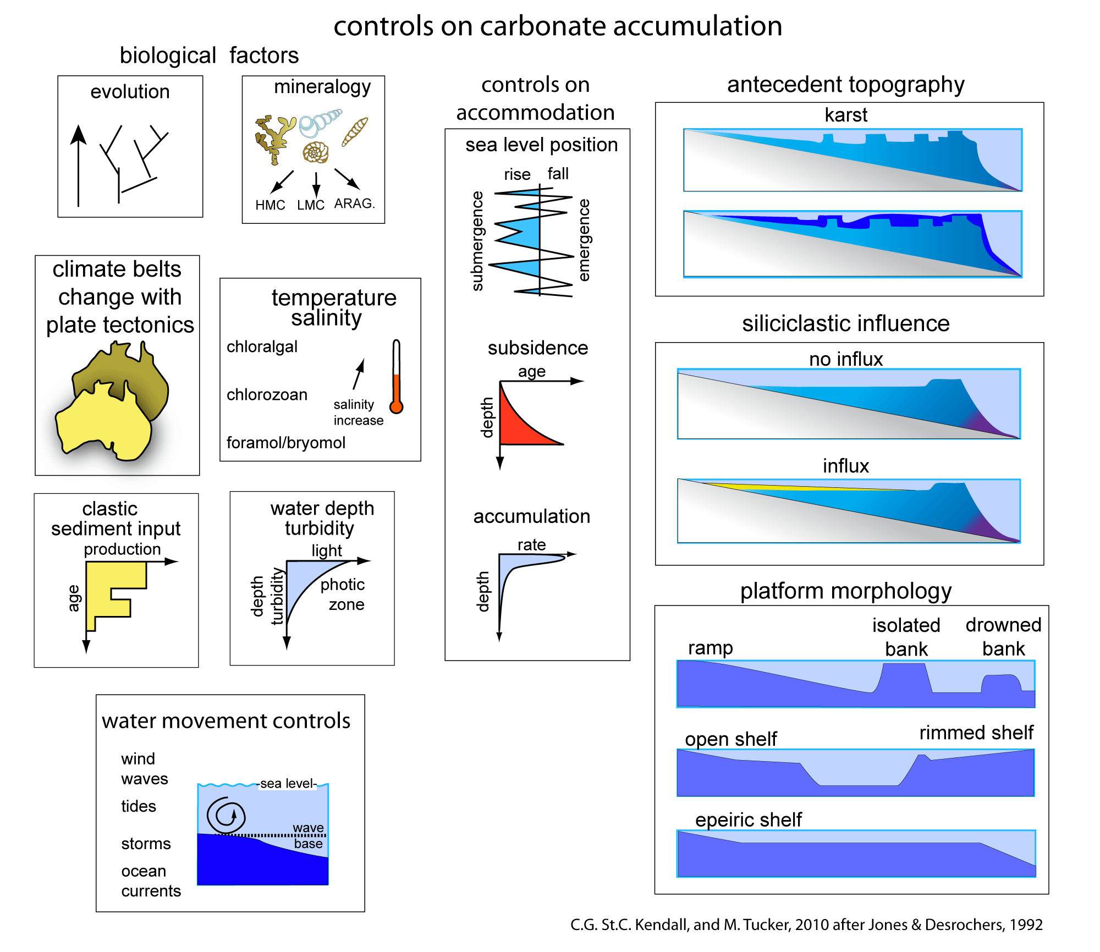
Controls on Carbonate Accumulation

Slide 9
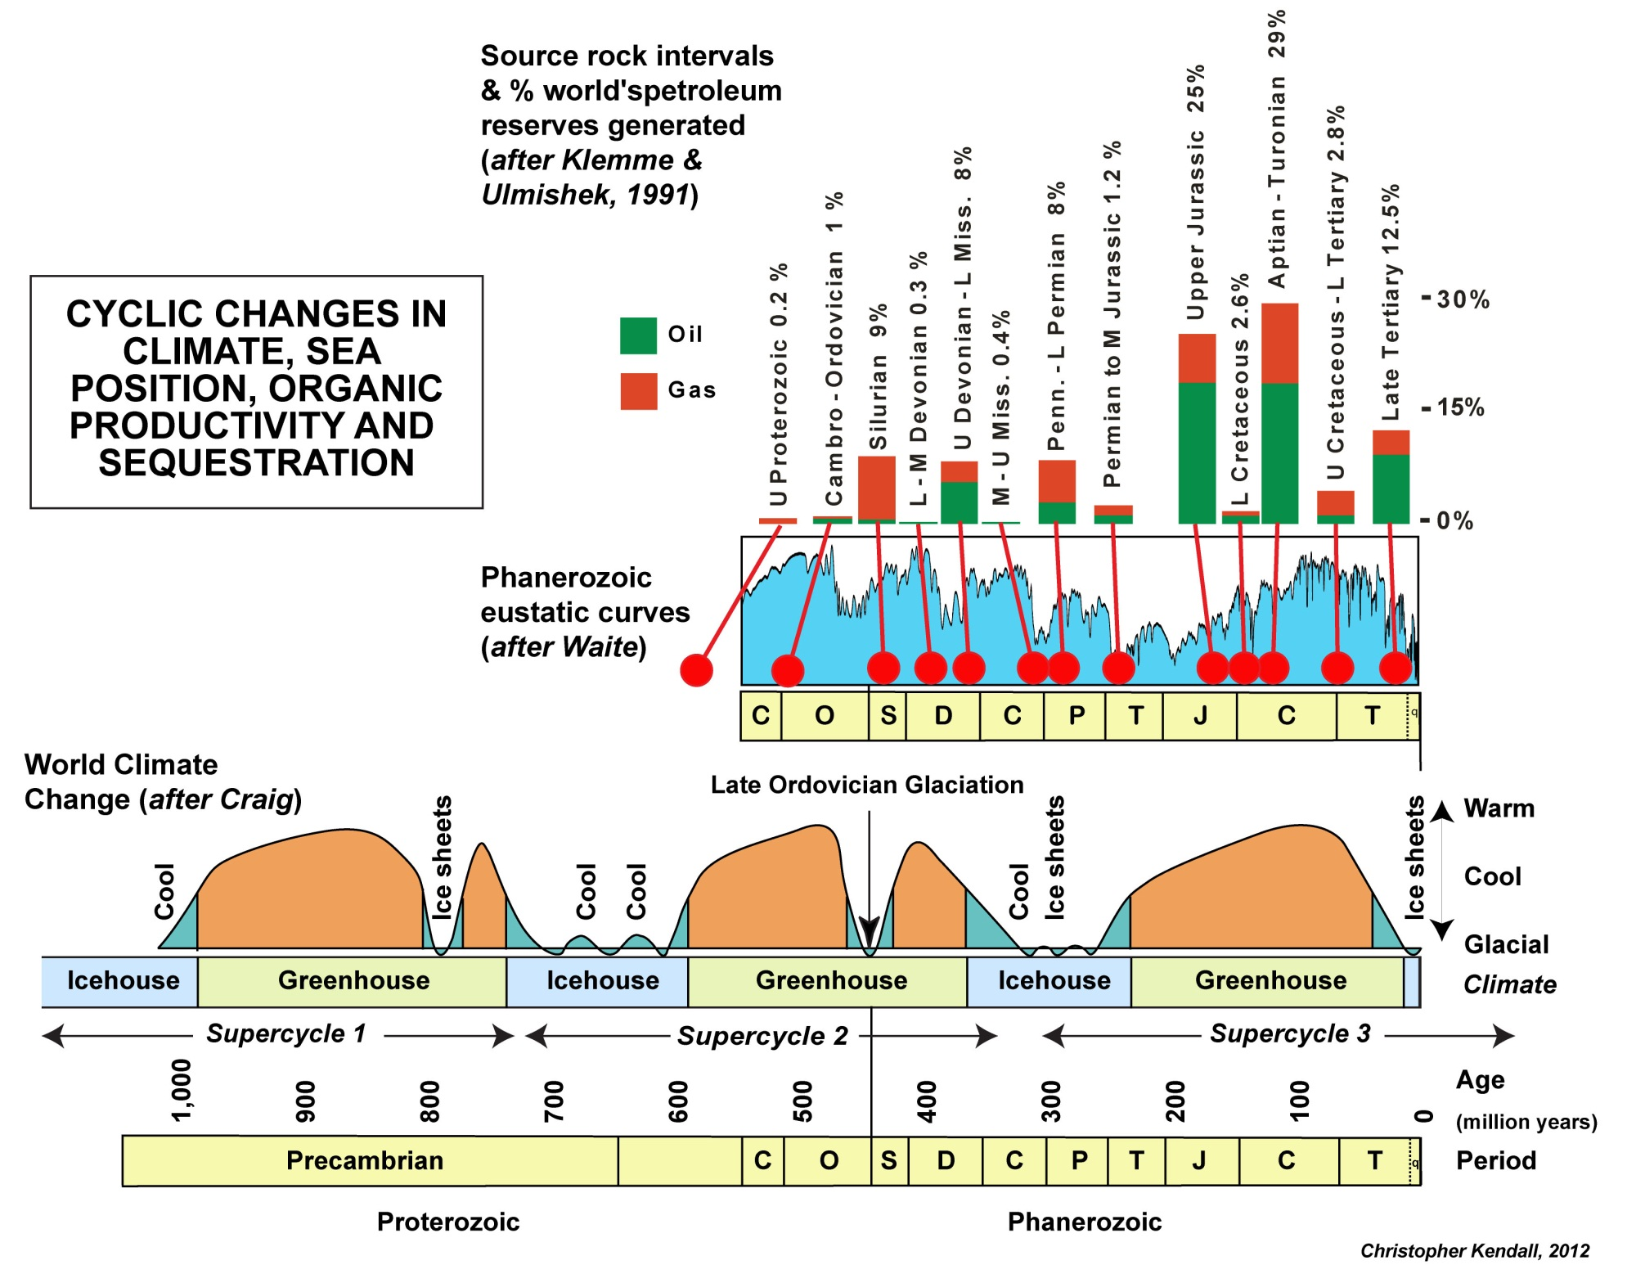
Source Rock Potential

Slide 10
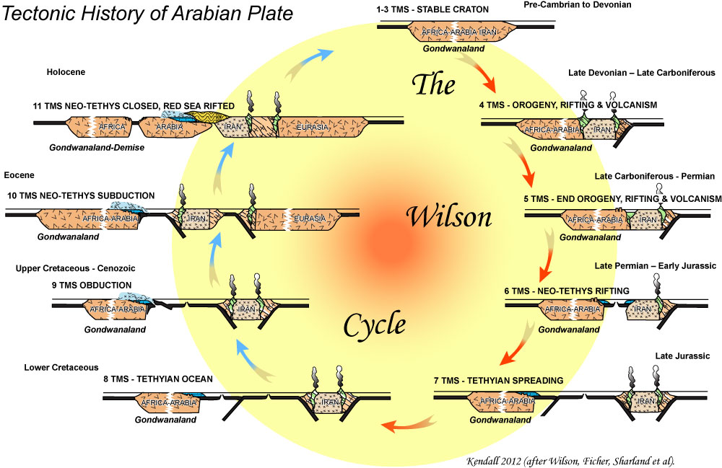
Kendall - Jurassic Evaporite and Carbonate Systems of Arabian Plate

Slide 11
Paleozoic Sediments
Paleozoic landward dominantly siliciclastic continental to fluvio-deltaic & glacial sediments while seaward shales & carbonates more common
Oil fields probably sourced from organic rich mfs events
These same organic rich sediments associated with reservoir quality rocks high grade the hydrocarbon potential of these rocks
Kendall - Jurassic Evaporite and Carbonate Systems of Arabian Plate

Slide 12
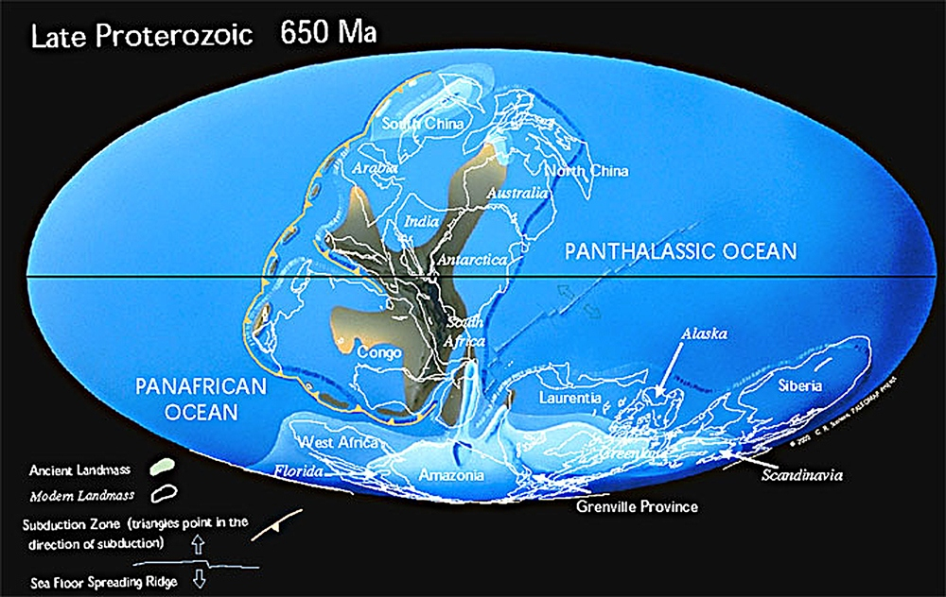
Pre-Cambrian
Salt Basin
Windward Margin
After Christopher Scotese
Kendall - Jurassic Evaporite and Carbonate Systems of Arabian Plate

Slide 13
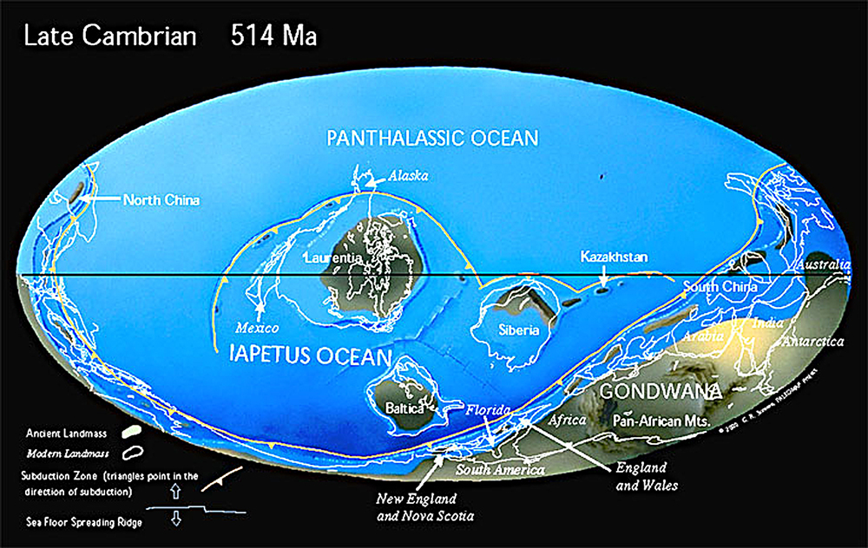
Cambrian
Windward Margin
After Christopher Scotese
Kendall - Jurassic Evaporite and Carbonate Systems of Arabian Plate

Slide 14
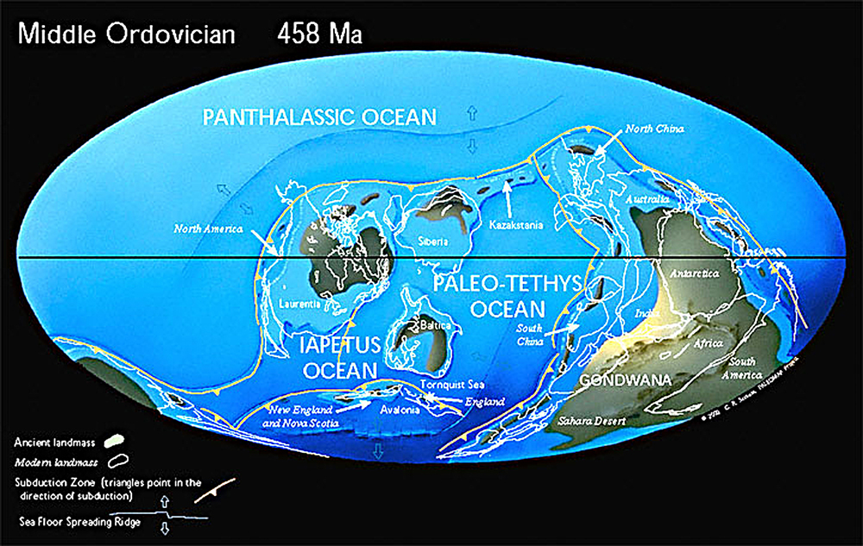
Ordovician
Windward Margin
After Christopher Scotese
Kendall - Jurassic Evaporite and Carbonate Systems of Arabian Plate

Slide 15
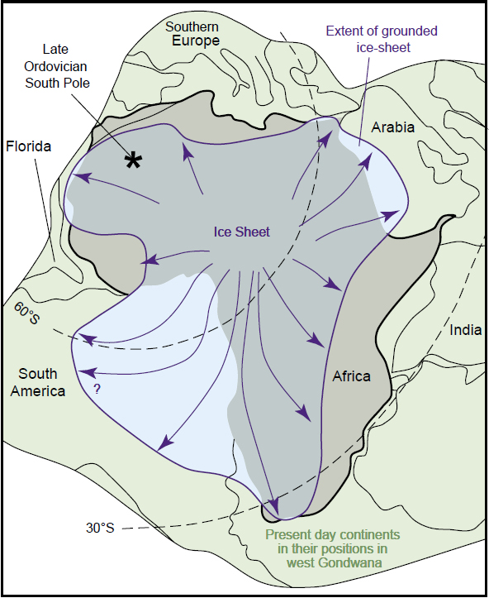
Ordovician Glaciation
Blue arrows indicate direction of ice sheet advance
(after Scotese et al., 1999; Sutcliffe et al., 2000; Le Heron, et al, 2004)
Kendall - Jurassic Evaporite and Carbonate Systems of Arabian Plate

Slide 16
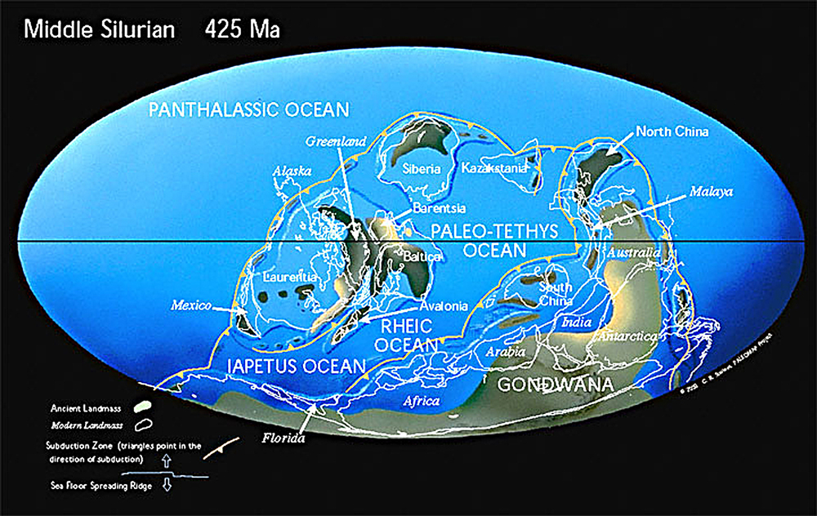
Silurian
Windward Margin
After Christopher Scotese
Kendall - Jurassic Evaporite and Carbonate Systems of Arabian Plate

Slide 17
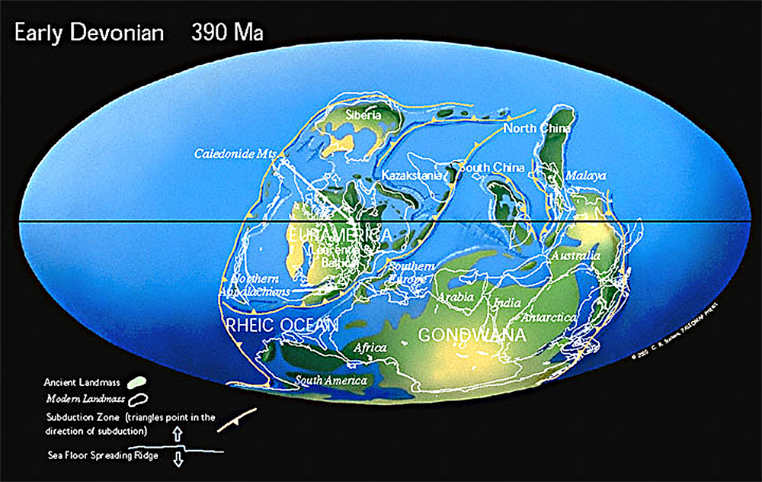
Devonian
Collisionn Margin
After Christopher Scotese
Kendall - Jurassic Evaporite and Carbonate Systems of Arabian Plate

Slide 18
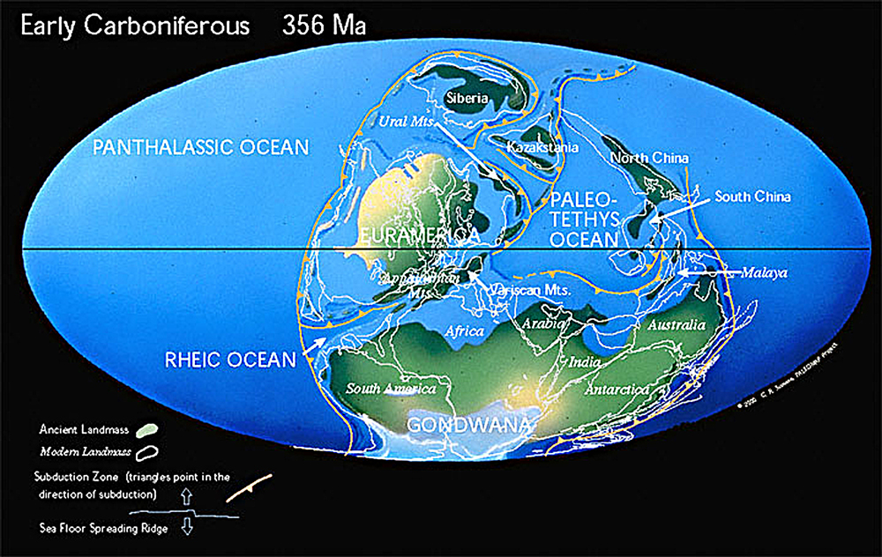
Early Carboniferous
Collisionn Margin
After Christopher Scotese
Kendall - Jurassic Evaporite and Carbonate Systems of Arabian Plate

Slide 19
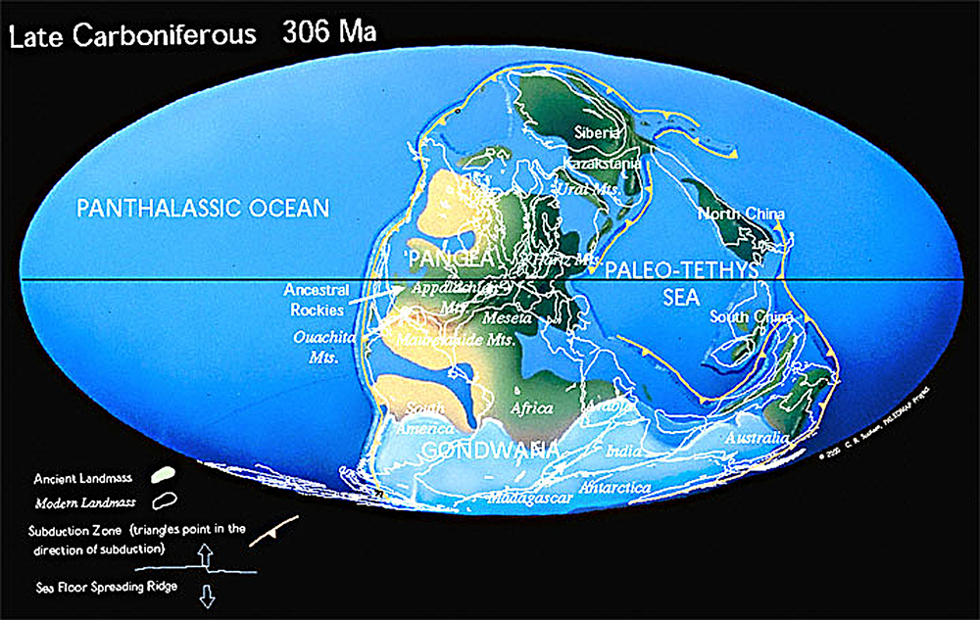
Late Carboniferous
Collisionn Margin
After Christopher Scotese
Kendall - Jurassic Evaporite and Carbonate Systems of Arabian Plate

Slide 20
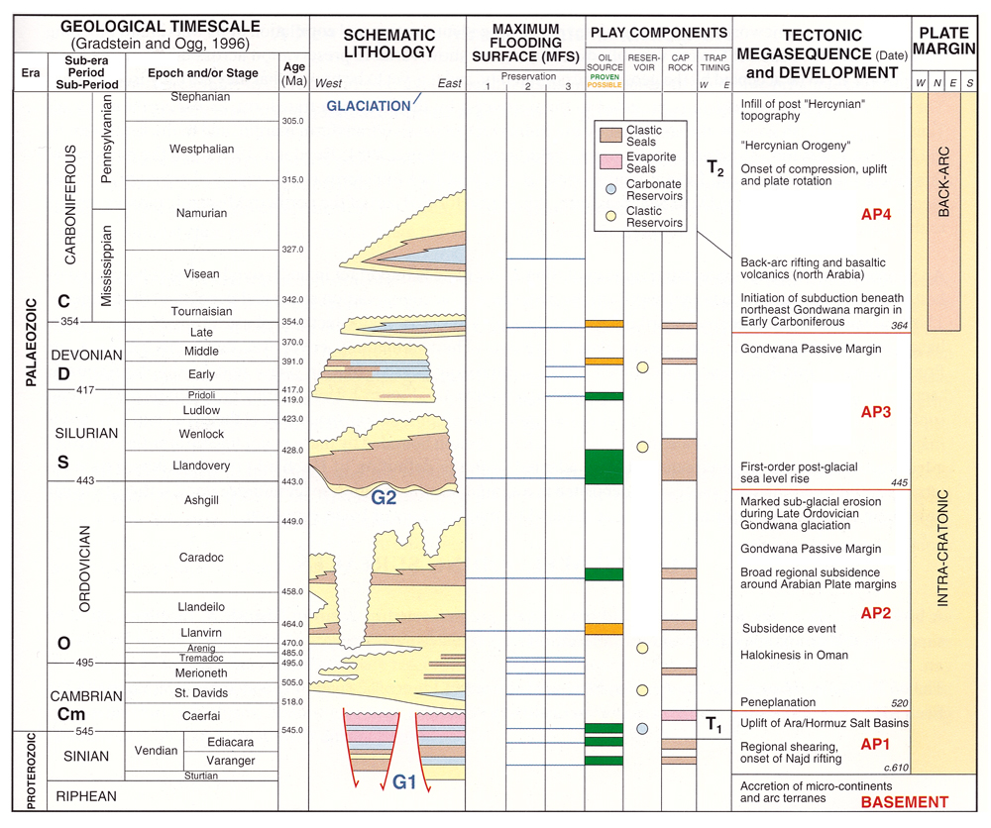
After Sharland et al, 2001

Slide 21
Paleozoic Sediments
Paleozoic landward dominantly siliciclastic continental to fluvio-deltaic & glacial sediments while seaward shales & carbonates more common
Oil fields probably sourced from organic rich mfs events
These same organic rich sediments associated with reservoir quality rocks high grade the hydrocarbon potential of these rocks
Kendall - Jurassic Evaporite and Carbonate Systems of Arabian Plate

Slide 22
Plate tectonics & hydrocarbons Permian, Jurassic & Cretaceous examples
Mesozoic deposition in tropical settings on the lea shore of the extensional passive Tethyian margin favored organic sequestration
Late Cretaceous to Tertiary was a foreland basin flanking the Zagros and Taurus uplift.
Deposition on North African plate occurred in tropical settings, and followed an extensional passive margin
Late Cretaceous it changed to a dominantly compressional margin with localized wrench margins.
Kendall - Jurassic Evaporite and Carbonate Systems of Arabian Plate

Slide 23
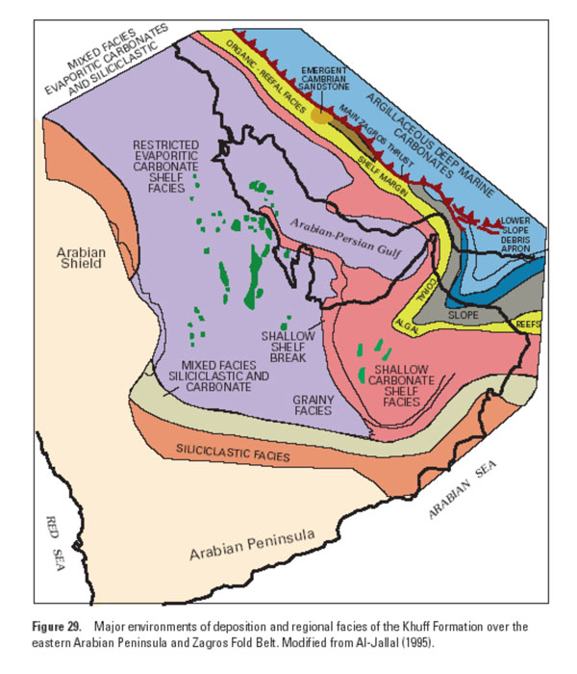
Tethyan Margin
Permian Khuff
Saudi Arabia
Kuwait, Iran
& UAE
Gondwanaland
Notes:
23

Slide 24
Evaporites - Tectonic Phase, & Source, Reservoir, & Seal, & Sea Level
Major carbonate/evaporite successions from arid tropics adjacent to continental plate margins at start of extensional & end of compressional Wilsonian phases of plate motion & lee of structural & depositional barriers on trailing margins
Juxtapose source, reservoir, & seal, favoring hydrocarbon exploration & exploitation
Geometries of hydrocarbon prone carbonate/evaporite successions are determined by position of base level change
Evidence comes from plate motion cycles of Arabian Gulf, Central Asia, Atlantic, Cordilleran & Appalachian Mountains
Kendall - Jurassic Evaporite and Carbonate Systems of Arabian Plate

Slide 25
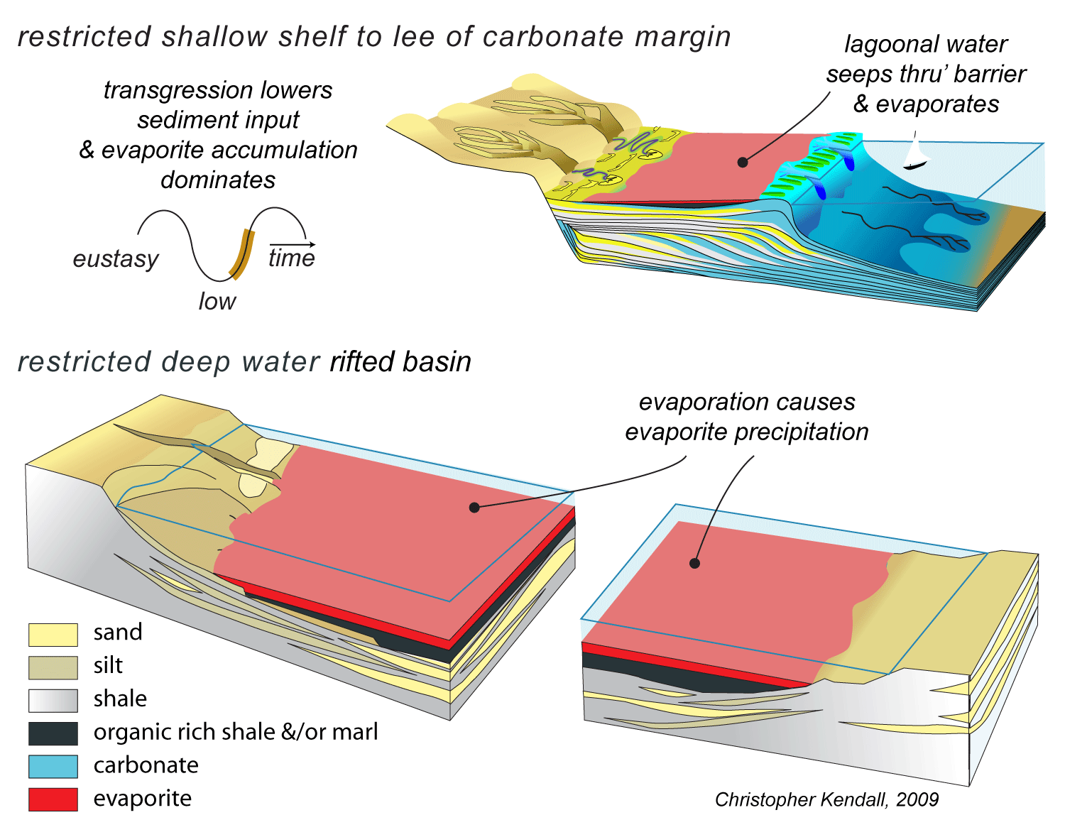
restricted basin evaporites
Kendall - Jurassic Evaporite and Carbonate Systems of Arabian Plate

Slide 26
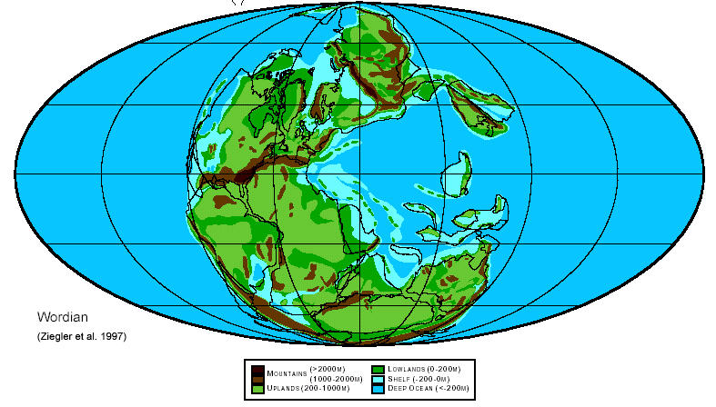
Permian - Structural Barred Basin - Arabian Gulf
Permian Khuff
Saudi Arabia
Kuwait, Iran
& UAE
confined
seaway
structural &
depositional
barrier over
exotic
terrains
lea shore
SOUTH
TETHYS
SWEET
SPOT
arid-tropical air system
some shadow from adjacent continents
juxtaposed source seal and reservoir
Kendall - Jurassic Evaporite and Carbonate Systems of Arabian Plate

Slide 27
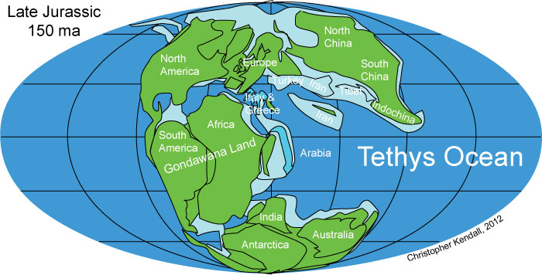
Example of Barred Basin Mesozoic - Arabian Gulf
Upper Jurassic
Saudi Arabia
Kuwait, Iran
& UAE
confined
seaway
structural &
depositional
barrier over
faulted margin
horst blocks
lea shore
SOUTH
TETHYS
SWEET
SPOT
arid-tropical air system
some shadow from adjacent continents
juxtaposed source seal and reservoir
Kendall - Jurassic Evaporite and Carbonate Systems of Arabian Plate

Slide 28
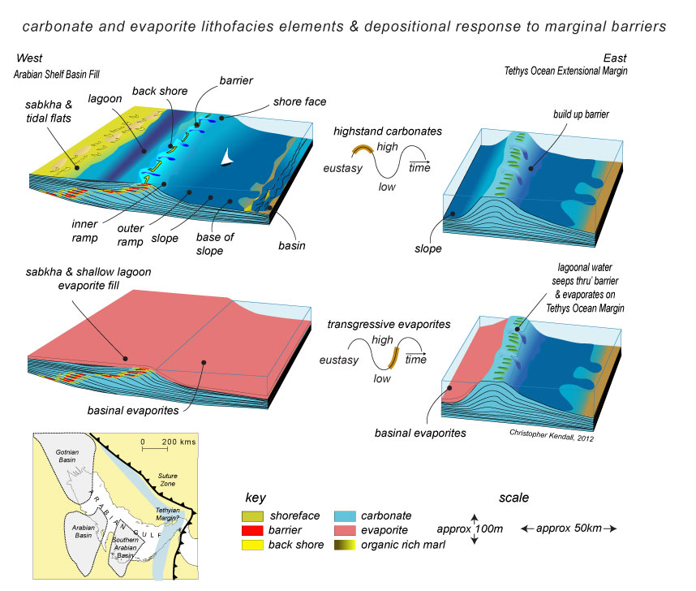

Slide 29
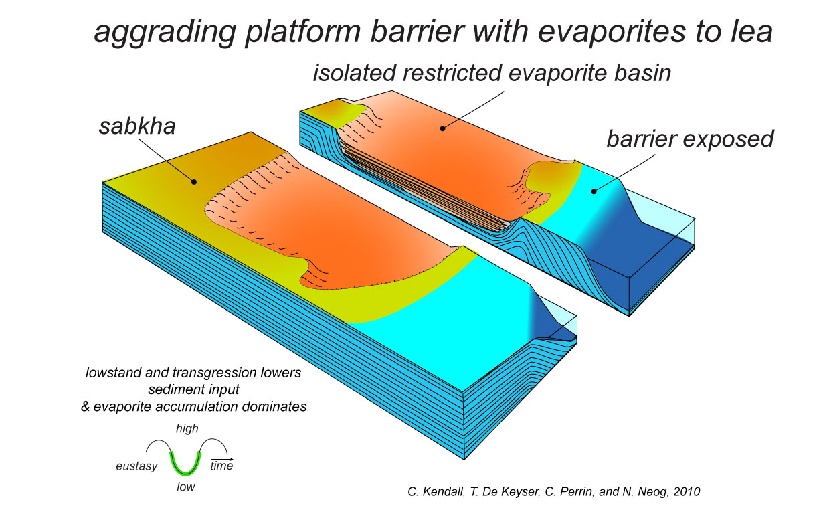
low stand evaporites

Slide 30
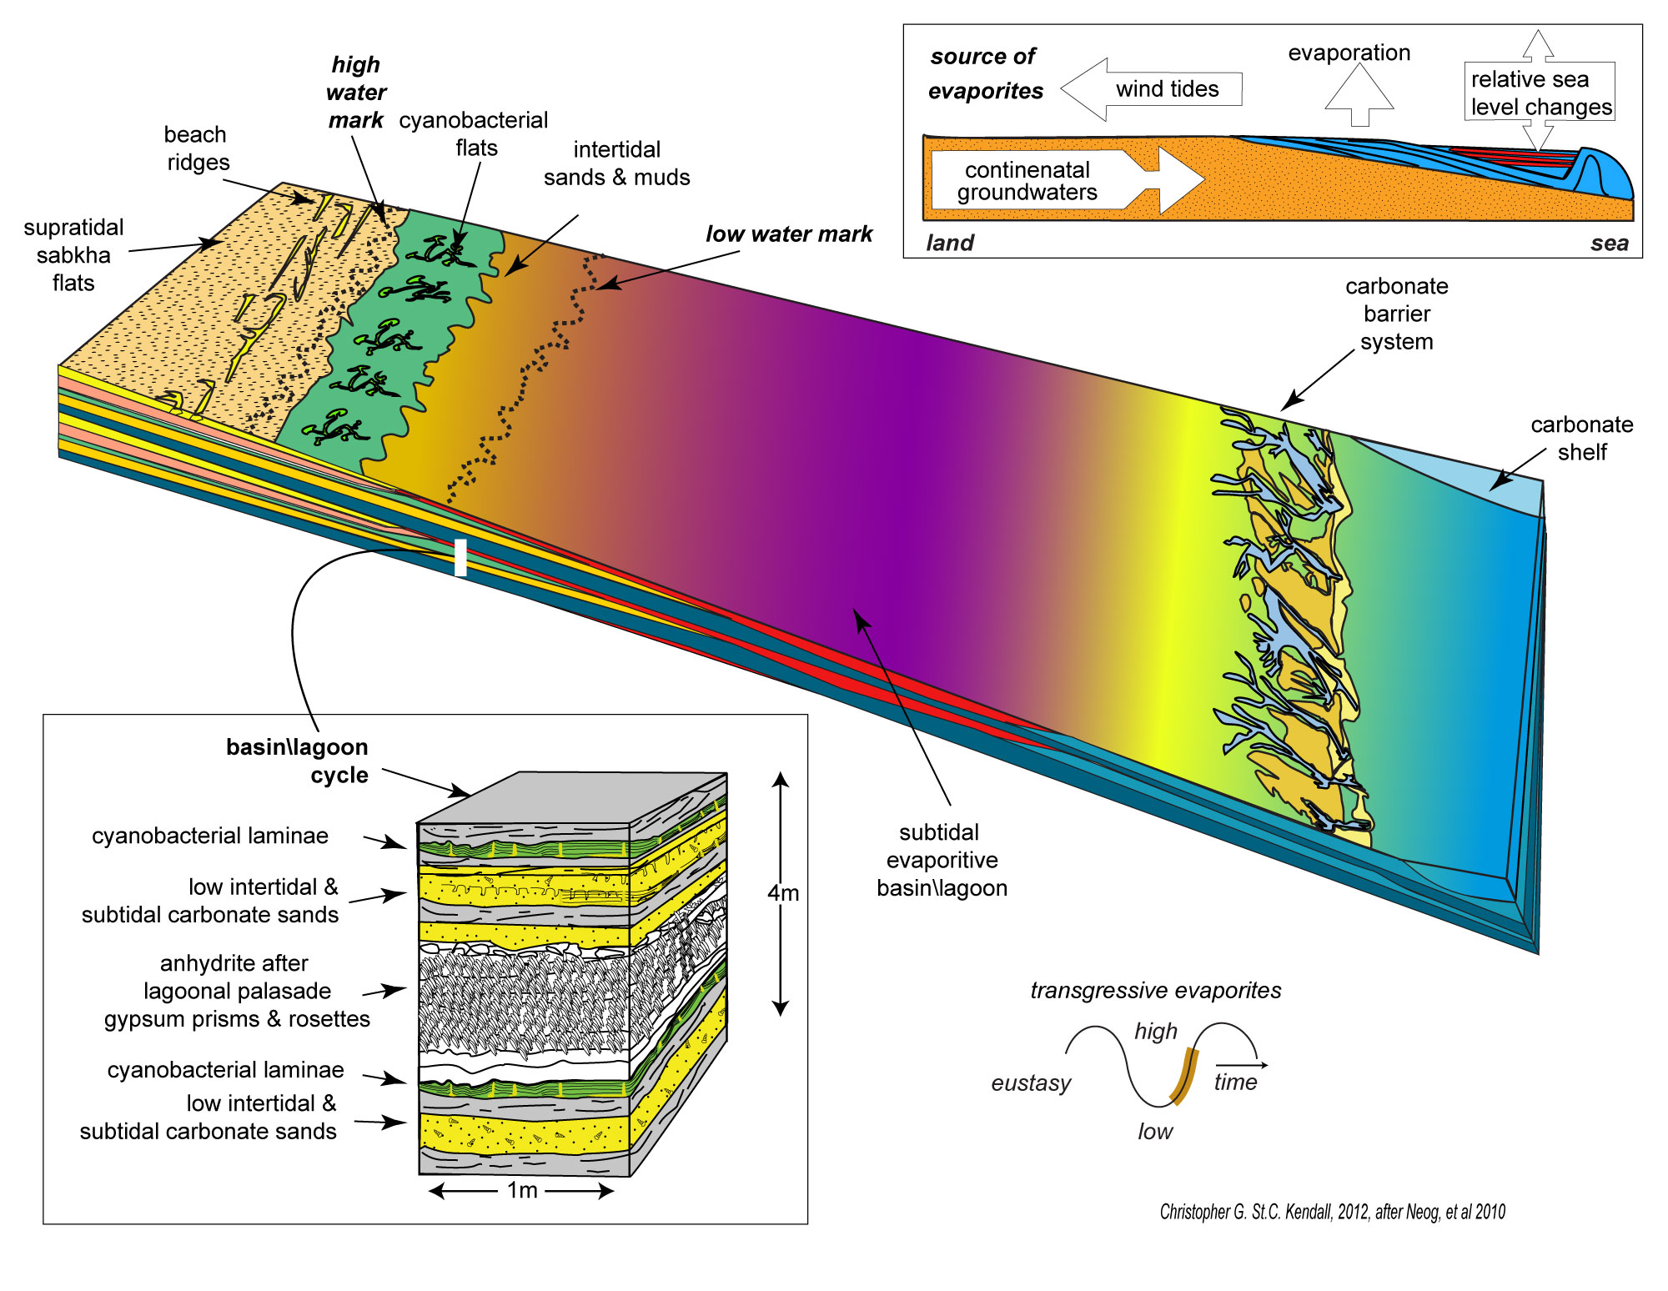
transgressive evaporites

Slide 31
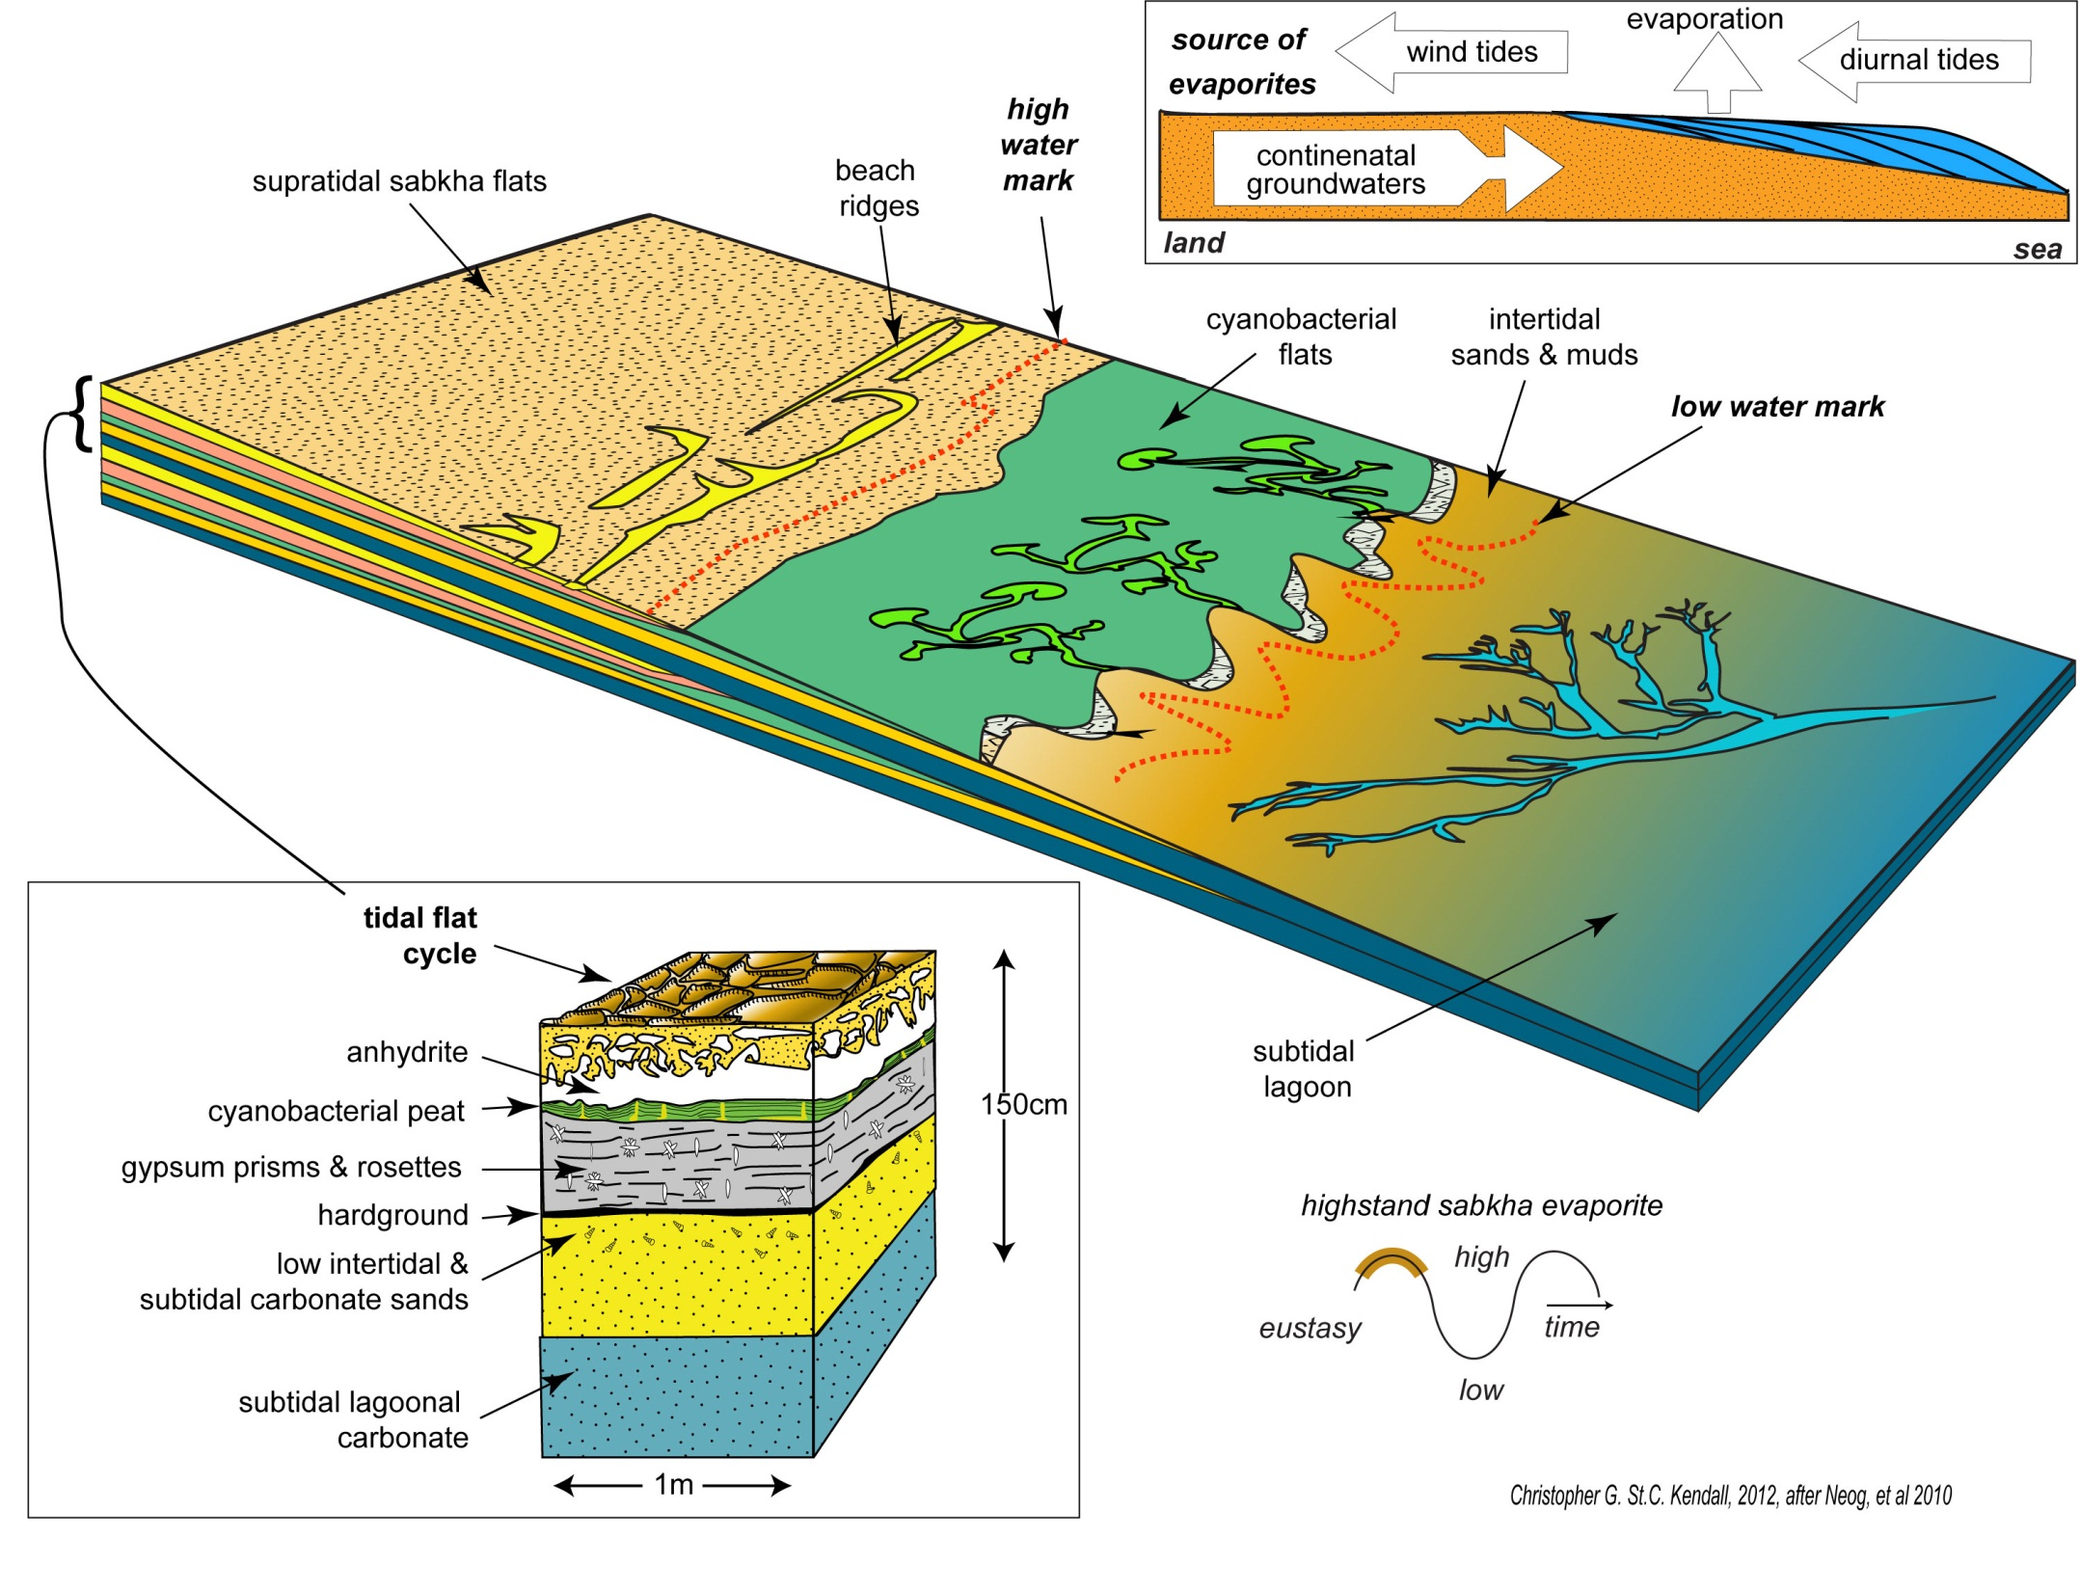
high stand evaporites

Slide 32
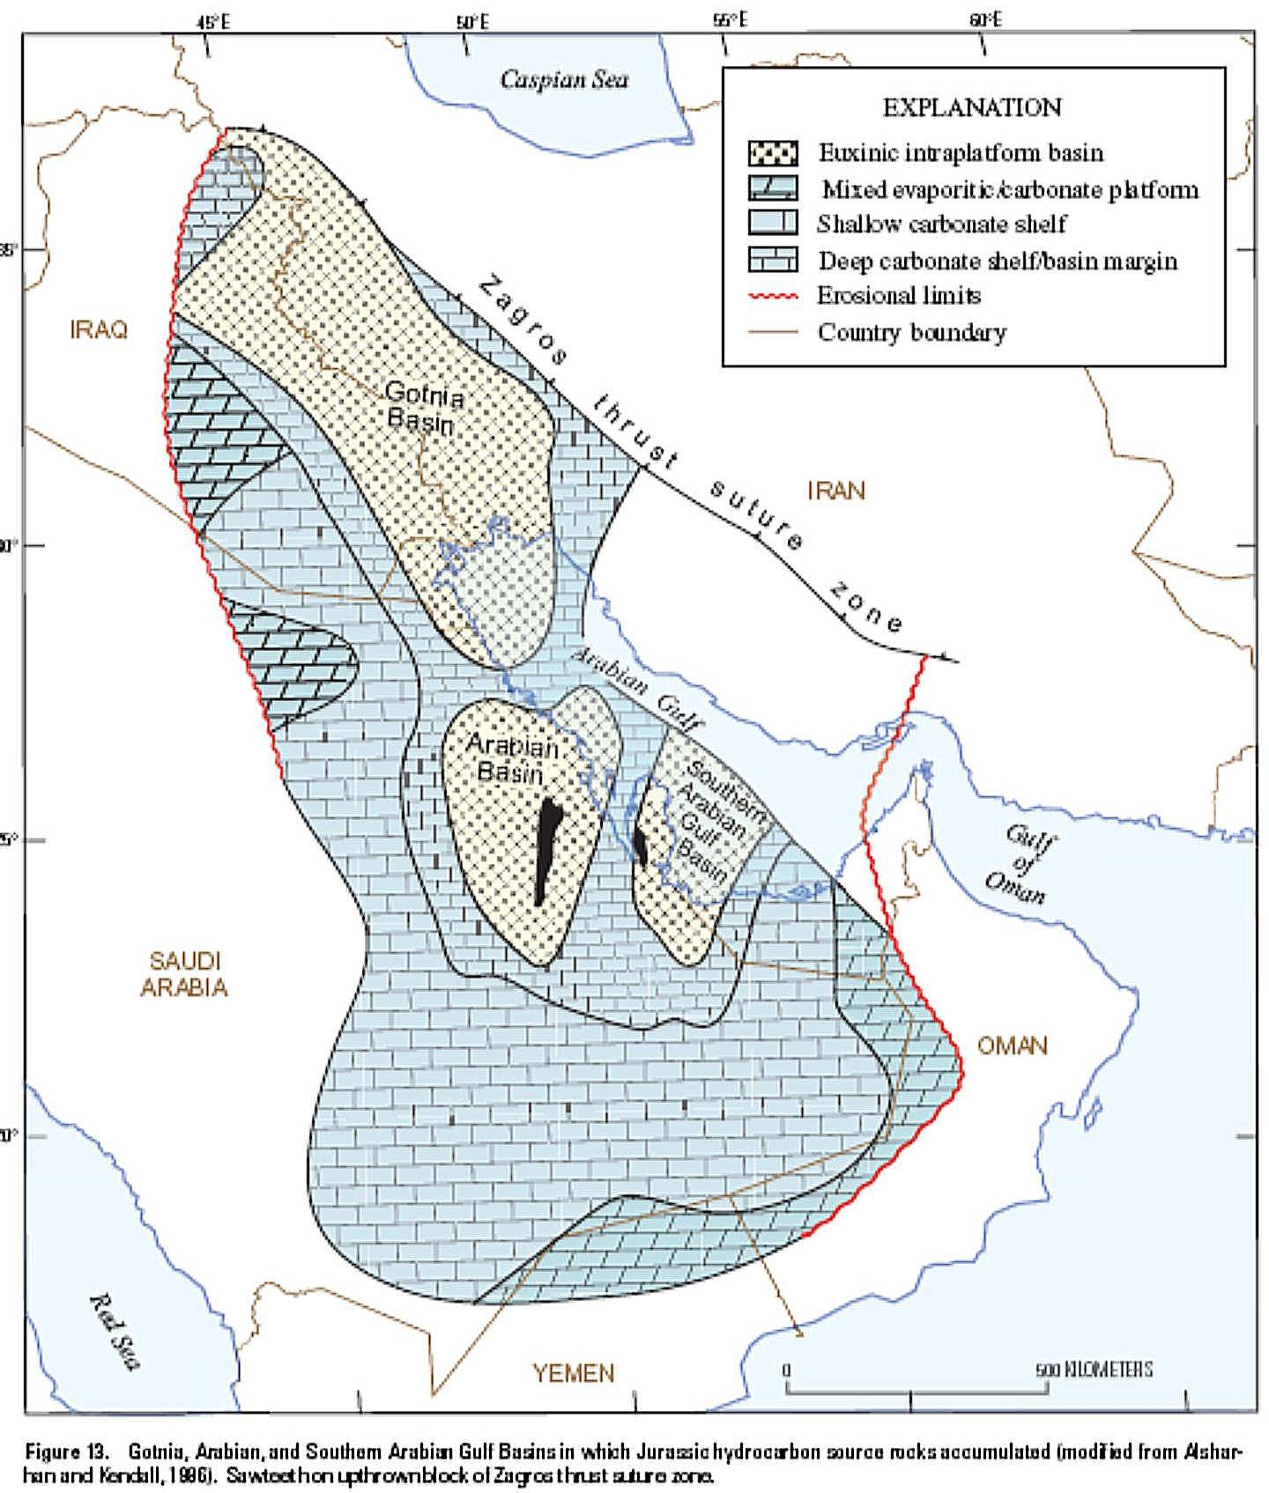
Restricted Basins Isolated by Build Up Barriers
Organic Rich Fill
Arabian Gulf Jurassic
Gotnia Basin
South Arabian Basin
Arabian Basin
After Fox & Albrandt,2002

Slide 33
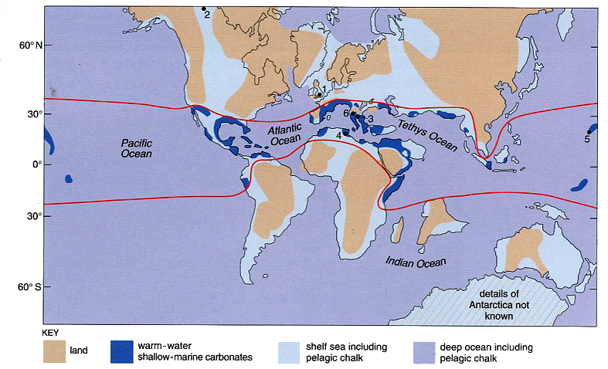
Cretaceous Paleogeography
Cretaceous
Saudi Arabia
Kuwait, Iran
& UAE
confined seaway
SOUTH
TETHYS
SWEET
SPOT
lea shore
humid-tropical air system
some shadow from adjacent continents
juxtaposed source seal and reservoir
After Peter Skelton

Slide 34
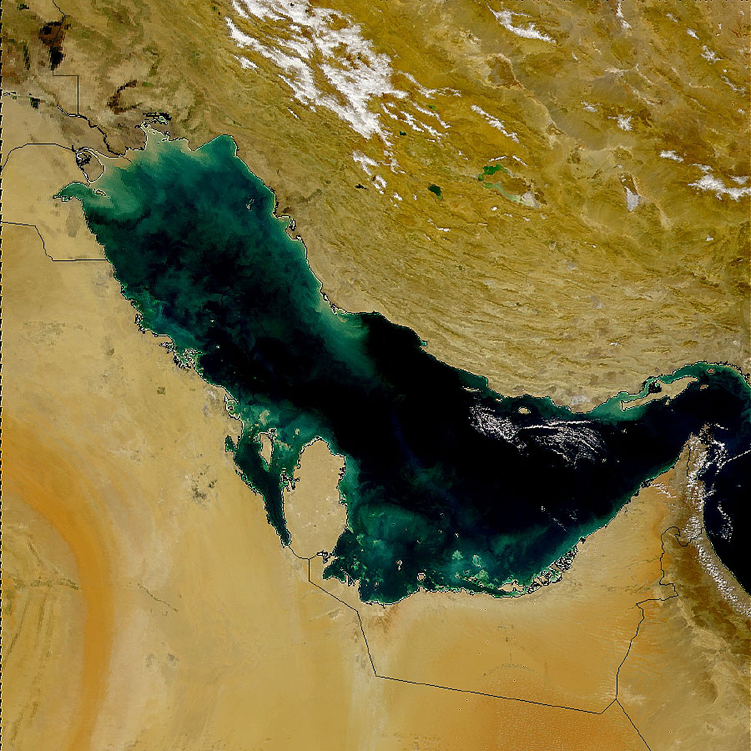
Collision Margin Evaporites
regional
drainage
into basin
restricted
entrance
to sea
isolated linear
belt of interior
drainage
SWEET
SPOT!
arid tropics air system
juxtaposed source
seal & reservoir
wide envelope of surrounding continents

Slide 35
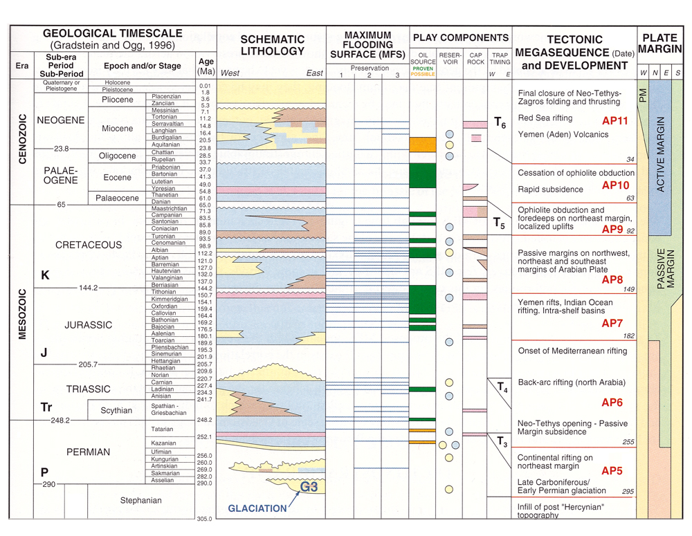
After Sharland et al, 2001

Slide 36
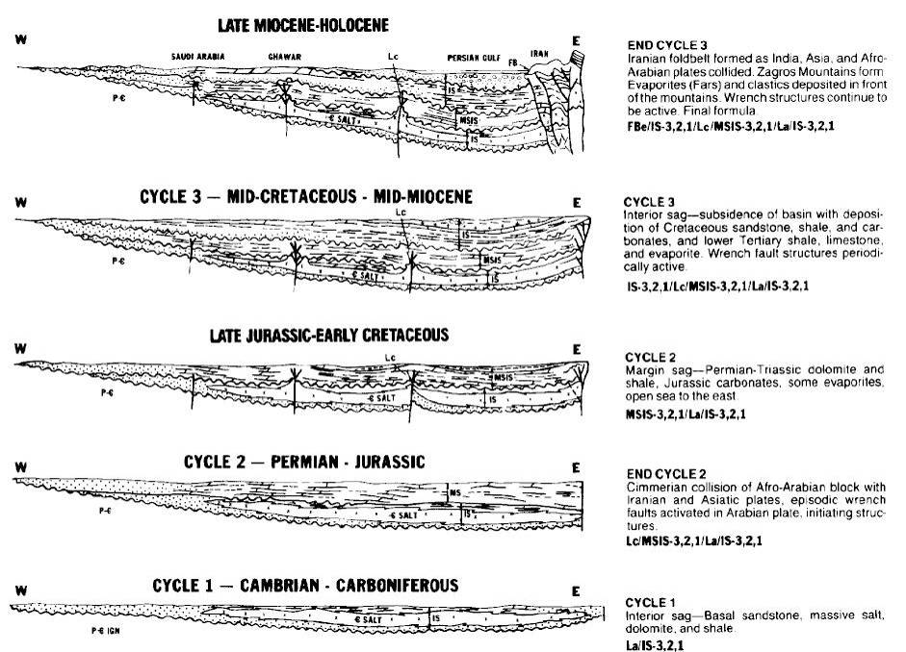
Evolution of Arabian Shield - Tectonics
Foreland Basin
Compression &
Foreland Basin
Extensional margin
Extensional margin
Interior Sag

Slide 37
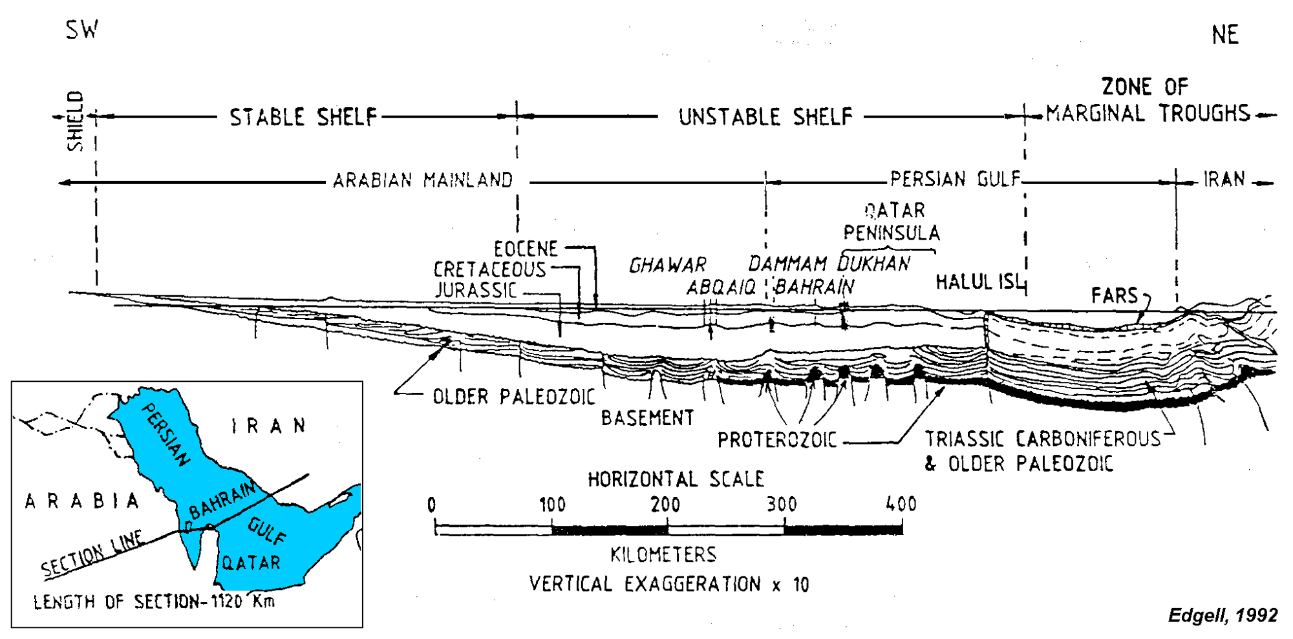
Geologic Cross-Section - Arabian Gulf
Accommodation produced by low frequency tectonic subsidence modulated by higher frequency eustatic changes in sea level and varying rates of sediment accumulation

Slide 38
Geologic Cross-Section - Arabian Gulf
Relatively flat-lying assemblages of Paleozoic, Mesozoic through Cenozoic interbedded carbonates, evaporites and clastic horizons

Slide 39
Geologic Cross-Section - Arabian Gulf
Paleozoic landward dominantly siliciclastic-continental to fluvio-deltaic & glacial while seaward shales & carbonates

Slide 40
Geologic Cross-Section - Arabian Gulf
Mesozoic exposed areas updip to west over stable shelf while dominantly carbonate on shelf and intraplate basins eastward on “unstable” shelf

Slide 41
Geologic Cross-Section - Arabian Gulf
Oil fields are younger from west to east, Paleozoic stratigraphy caps Precambrian in almost all Southern Tethys with exceptions that include the Burgan Arch (Kuwait), or Sirte Basin (Libya)

Slide 42
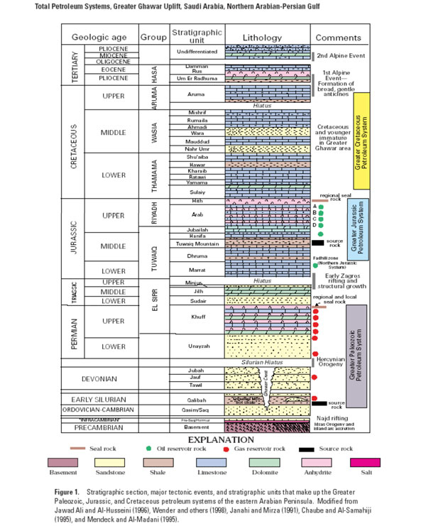
Oil
Mesozoic Oil & Paleozoic Gas
Gas
Jurassic Evaporite and Carbonate Systems of Arabian Plate

Slide 43
Controls on the Petroleum Systems of the Southern Tethys
Petroleum Systems function of:-
Plate position
Malenkovitch driven climate, eustasy and oceanography
Organic productivity & preservation
Sediment character
Structural and thermal history
Many of these factors dependent on others
Kendall - Jurassic Evaporite and Carbonate Systems of Arabian Plate

Slide 44
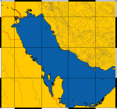
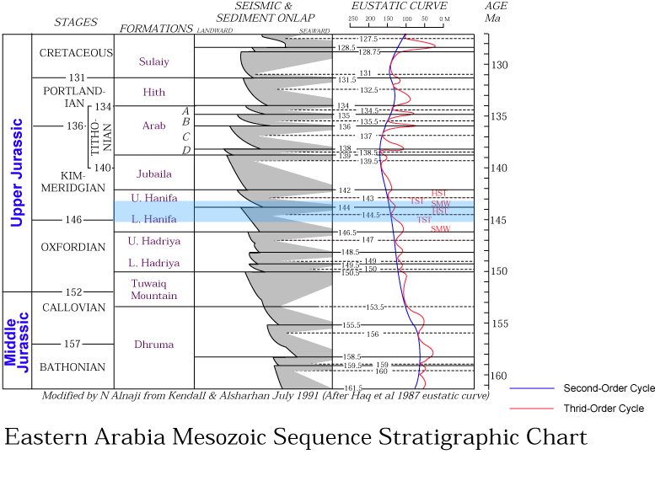
The Hanifa Formation
Stratigraphic Framework
Each formation was deposited as a complete 3rd order sequence
Seal
Reservoir
Source
Notes:
This chart shows the third order eustatic cycles (red) super-imposed on the lithostratigrahic section.
Each formation corresponds to a complete 3rd order cycle.
The Hanifa Formation (blue highlight) is positioned in the transgressive limb of the 2nd order eustatic cycle (blue line).

Slide 45
Carbonate/Evaporites Plays & Sequence Stratigraphy
Downdip restricted playas, salinas & basin evaporites (upper surface coincides with sea level position of the lowstand (LST) & following transgressive (TST) system tracts
Updip supratidal sabkha evaporite cycles (upper bounding surface preserved in regressive coastlines matching sea level position of late high stand (HST) system tract

Slide 46
Major Evaporite Settings
Continental
Evaporites
Basin-Center Evaporites
Platform Evaporites
Shallow to
Deeper Basin
Subaqueous Evaporative Lagoon
Sabkha, Salina,
Mudflat
Mean Sea Level
Platform (Commonly product of LST & TST)
  < 50 m thick evaporite intervals, commonly < 5 m thick evaporite beds inter-bedded with thin to thick carbonate intervals
  Shallow water (Evaporitive Lagoon) & subaerial (Sabkha, Salina, Mudflat) evaporites landward of barrier or sill
  Open marine sediments deposited seaward of sill
Basin-Center (Commonly product of LST & TST)
  Thick evaporites deposited across whole basin (> 50 m thick evaporite intervals)
  Shallow to deep water evaporites occur in many different settings (shelf, slope, basin)
Continental (Playa Lakes) (not discussed here)
Discovered Reserves for Proven Carbonate Plays
Total = 490,000 MBOE
Discovered Reserves for Proven Evaporite Plays
Total = 485,884 MBOE
52%
48%
Basin
Center
Platform

Slide 47
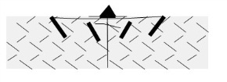
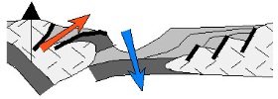


Evaporite Setting Plays & Basin Phase Evolution
Plays Occur in Passive Margin Settings
25% of Plays Do Not Evolve to Foreland Phase
Stratigraphic Traps are Important
Source, Reservoir, Seal Likely in Drift Phase
>90% Source Rocks Carbonate in Origin
Source Rocks in Close Proximity to Reservoir
Play Elements & Tectonic Evolution Pathway for Passive Margin Settings
Rift
Foreland
Sag
Drift
Kendall - Jurassic Evaporite and Carbonate Systems of Arabian Plate

Slide 48
Conclusions
Hydrocarbons trapped in fields in relatively horizontal Paleozoic, Mesozoic through Cenozoic sediments of Tethys southern margin
Fields can be analyzed and characterized in terms of Wilsonian cycles of plate drift that control:
  Low frequency Tectonic movement
  2nd and 3rd order eustatic Malenkovitch driven changes
  Sediment supply and organic matter sequestration
Analysis of South Tethys margin high-grade evaporite-carbonate hydrocarbon plays with great potential are abundant

Slide 49
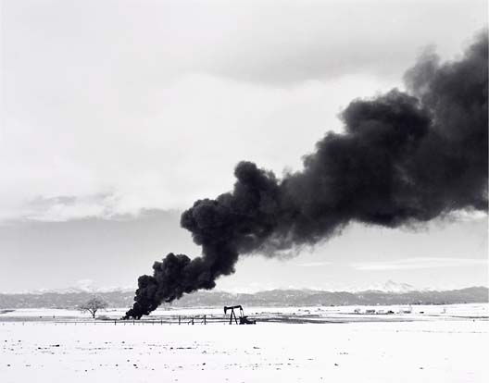
Conclusions
Now let’s
find oil!

Slide 50
Middle East - Approximate Reserves
Crude Oil(BB) Natural Gas (TCF)
Saudi Arabia 263.5 bbls 204.5 Tcf
Iraq 112.0 bbls 109.0 Tcf
UAE 97.8 bbls 212.0 Tcf
Kuwait 96.5 bbls 52.7 Tcf
Iran 89.7 bbls 812.3 Tcf
Oman 5.3 bbls 28.4 Tcf
Yemen 4.0 bbls 16.9 Tcf
Qatar 3.7 bbls 300.0 Tcf
Syria 2.5 bbls 8.5 Tcf
Bahrain 0.1 bbls 3.9 Tcf
Most in carbonate plays beneath evaporite seals

Slide 51
Climate, Eustasy, & Source Rock Potential

Slide 52
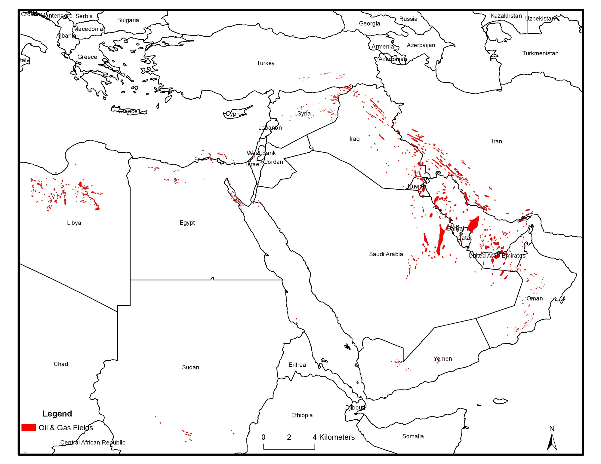
Arabian Gulf fields become
younger
to east
Tertiary
Cretaceous
Jurassic
Paleozoic
Most Arabian Gulf fields are carbonate plays beneath evaporite seals in restricted basins juxtaposing source, seal and reservoirs

Slide 53
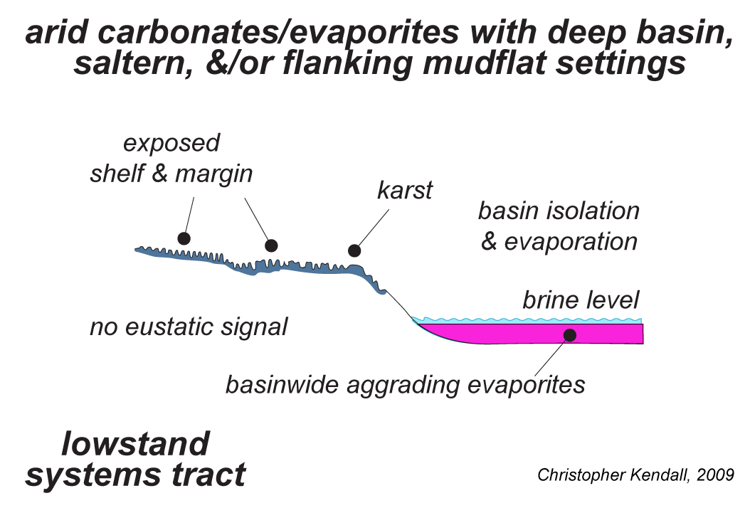
Low Stand Evaporite Signals
sequence
boundary

Slide 54
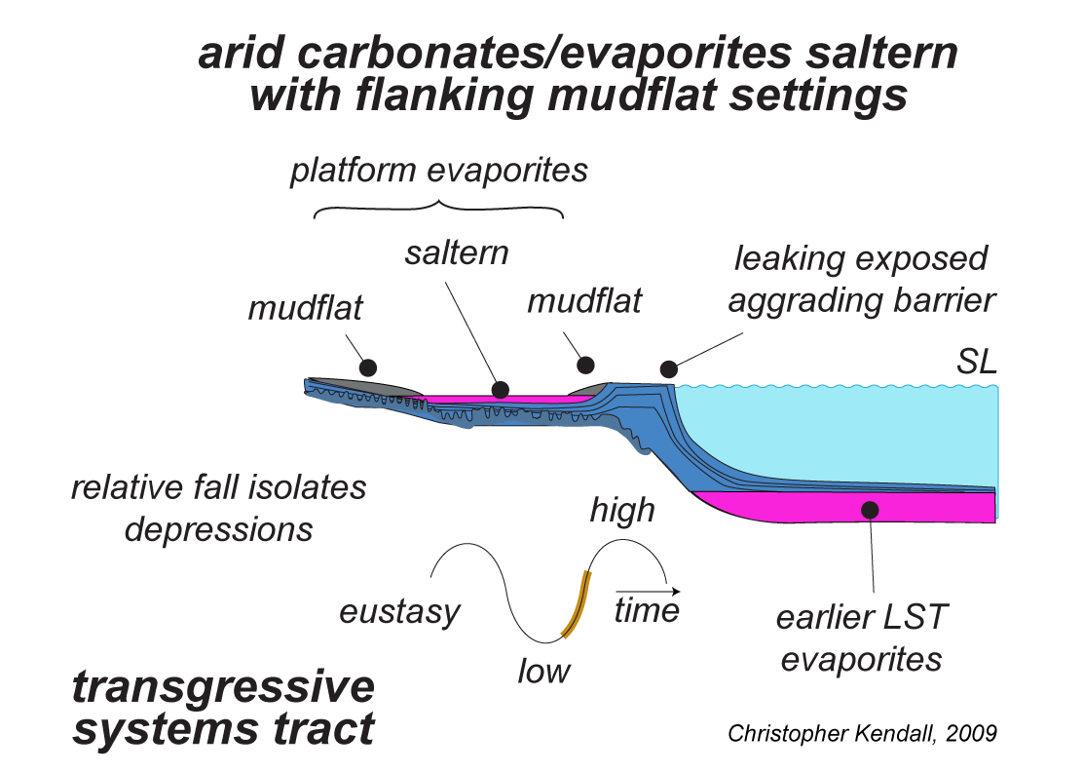
Transgressive Evaporite Signals
transgressive
surface

Slide 55
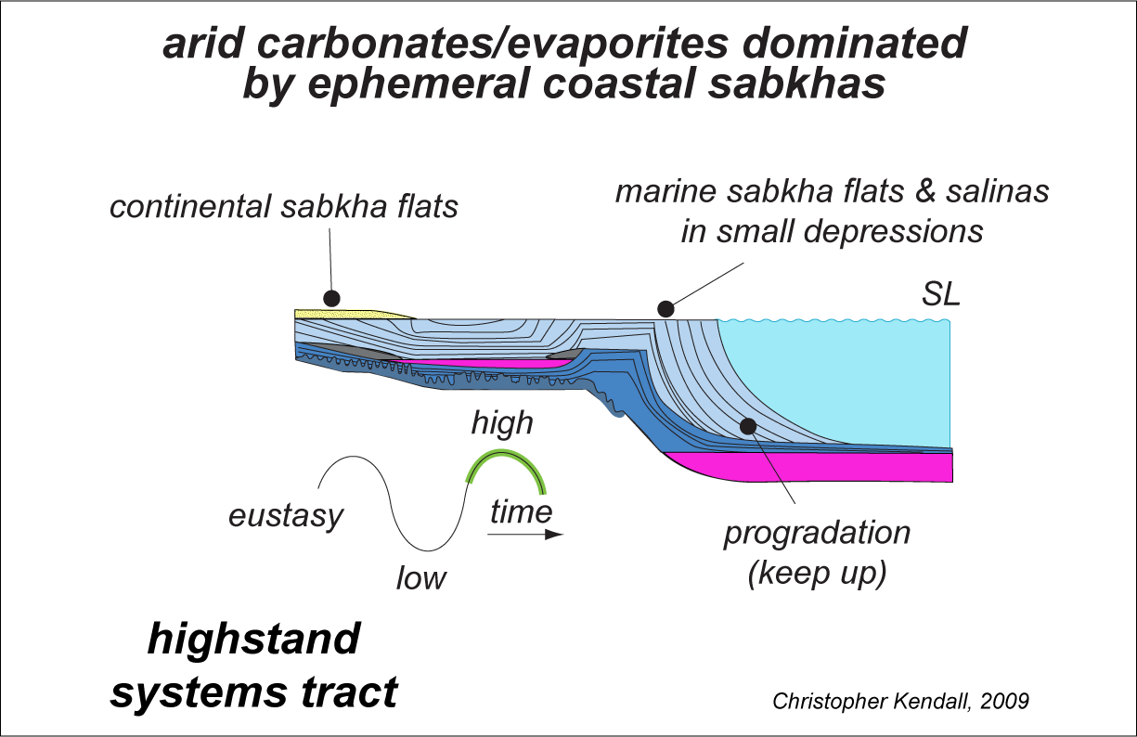
High Stand Evaporite Signals
maximum
flooding
surface

Slide 56
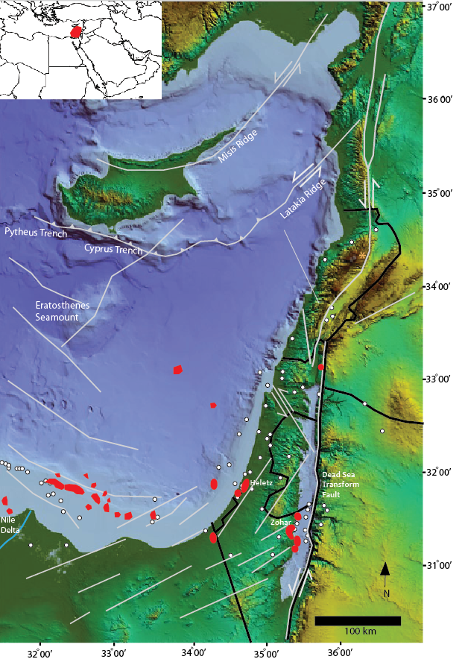
Previous discoveries in Levantine Basin - zero
Undiscovered reserves – recent & exciting discovery in lower Miocene subsalt at Tamar of 5 tcfs gas in the Levantine basin
Great implications for offshore all of North Africa

Slide 57
Conclusions
South Tethys margin is the world’s premier hydrocarbon producing area, best in the Middle East, good in Africa and promising in the Levant, Syria and Turkey
Analysis of South Tethys margin suggests hydrocarbon plays have great potential and are abundant and similar to current fields

Slide 58
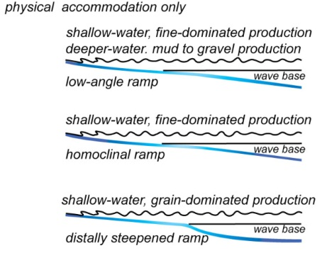
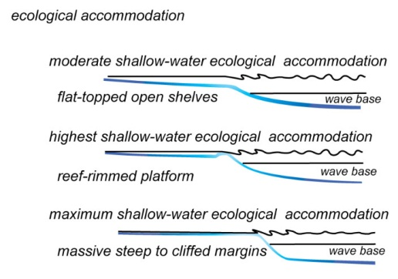
Carbonate Platform Accommodation
physical accommodation only
ecological accommodation

Slide 59
Evaporite Setting Plays & Basin Phase Evolution
N = 9 Plays
Play Elements & Tectonic Evolution Pathway for Passive Margin Settings
TECTONIC PHASE FOR PLATFORM-SUBAQUEOUS
SALTERN EVAPORITE SETTINGS
Rift
Sag
Drift
Foreland
Post-Seal
Peten
Arabian Platform
Timan-Pechora
Angara-Lena
Gulf Basin
Seal
CI
Passive Margin
EX
Rift
Reservoir
Sag
Source
Post-Seal
Foreland
Seal
Continental Interior
Pelagian
Reservoir
Drift
Source
Plays Occur in Passive Margin Settings
25% of Plays Do Not Evolve to Foreland Phase
Stratigraphic Traps are Important
Source, Reservoir, Seal Likely in Drift Phase
>90% Source Rocks Carbonate in Origin
Source Rocks in Close Proximity to Reservoir
Post-Seal
Seal
Back-Arc
Reservoir
~
~
~
Source
~
~
~
Dominant Occurrence
Minor Occurrence

Slide 60
Evaporite Play Settings & Basin Phase Evolution
N = 13 Plays
Play Elements & Tectonic Evolution Pathway for Continental Interior Settings
TECTONIC PHASE FOR BASIN CENTER-SHALLOW
MARINE SHALLOW BASIN EVAPORITE SETTINGS
Rift
Sag
Drift
Foreland
Post-Seal
Seal
Zagros Fold Belt
Passive Margin
Rift
Reservoir
Source
Sag
Post-Seal
Gulf Suez
Michigan
Oman Salt
European Permian
Williston
Dnepr/Donets
Pripyat
Paradox
Foreland
Seal
Continental Interior
Reservoir
Plays in Continental Interior Settings
40% of Plays Do Not Evolve to Foreland Phase
Stratigraphic Traps Important
Source, Reservoir, Seal Possible in ALL Phases
>90% Source Rocks Carbonate in Origin
Source Rocks in Close Proximity to Reservoir
Source
Post-Seal
Seal
Amu Darya
Western Canada
Back-Arc
Reservoir
Source
Dominant Occurrence
Minor Occurrence

Slide 61
Summary & Conclusions
One can predict Carbonate Play Opportunities in Evaporite Basins from an understanding of Basin Phase Evolution and Evaporite Setting
The opportunities occur in:
Land Detached Isolated Platforms in Basin-Center Evaporite Settings in Arc-Related and Passive Margin Settings that Evolve to the Foreland Basin Phase
Isolated buildups in Platform Evaporite Settings in Passive Margin Settings That May or May Not Evolve to the Foreland Basin Phase
The Exploration potential of Carbonate Plays in Evaporite Basin is good. However where the “prospects” are located is the ever evolving objectives tied to access to prospective acreage and a drilling program!
~
~
~
~
~

