Slide 1
History of Stratigraphy
Greeks and Romans
  Recognized world was ever changing
  and thought of it as eternal
Fall of Rome and Rise of Church
  Developed idea of world based on a literal
  interpretation of bible
    Attributed variations to Noah’s flood
      e.g., seashells high in Italian Apennines (near Florence)
        Either Noah’s flood brought them or God’s mystery

Slide 2
Renaissance and age of Reason
  Began to move away from extreme views
  and began to develop scientific principles
  Da Vinci (1452- 1519)
    Suggested that fossils in the Apennines were caused
    by rivers that had carried the shells down from
    the Alps
    Later envisioned uplifted shorelines

Slide 3

Da Vinci’s Insight
In 1500 C.E. Da Vinci recognized that fossil shells in the layered rocks represented ancient marine life.
Observed that many fossil rich layers were separated by unfossiliferous layers thereby repudiating the concept of one flood.
Had the idea that seasonal events responsible

Slide 4
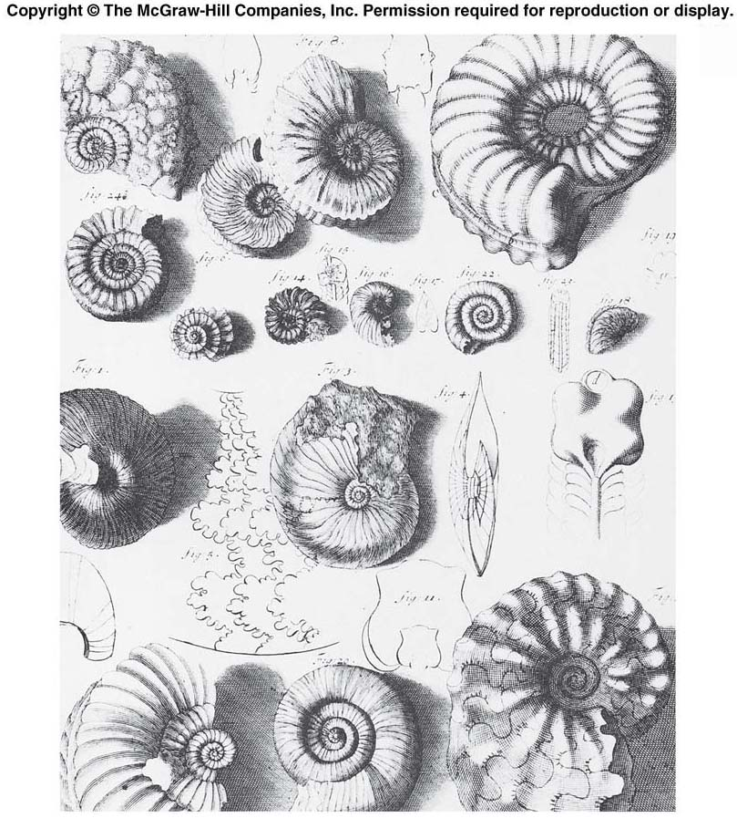

Slide 5
Nicolaus Steno
  Niels Stensen (1638-1686)
    famous for ” Stenos’ laws”
  Worked in Italy (Tuscany)
    First to suggest IN PRINT that rocks enclosing fossils had at one time been soft
    Sharks’ teeth convinced him of fossil origins
      Noticed living sharks had teeth identical to ‘tonguestones’
      Petrified tongues of dragons and snakes
    Realized shark’s teeth were deposited in soft mud, which encased the teeth and then hardened

Slide 6
Steno: Principle of Original Horizontality
Steno: Principle of Superposition
Steno: Principle of Lateral Continuity

Slide 7
William Smith, Father of Stratigraphy
1796 wrote “wonderful order and regularity with which nature has disposed of these singular productions [fossils] and assigned to each its class and peculiar stratum”
1815 Publication of the 1st geologic map of England intended for the development of canals, quarries and mines as well as natural resources

Slide 8
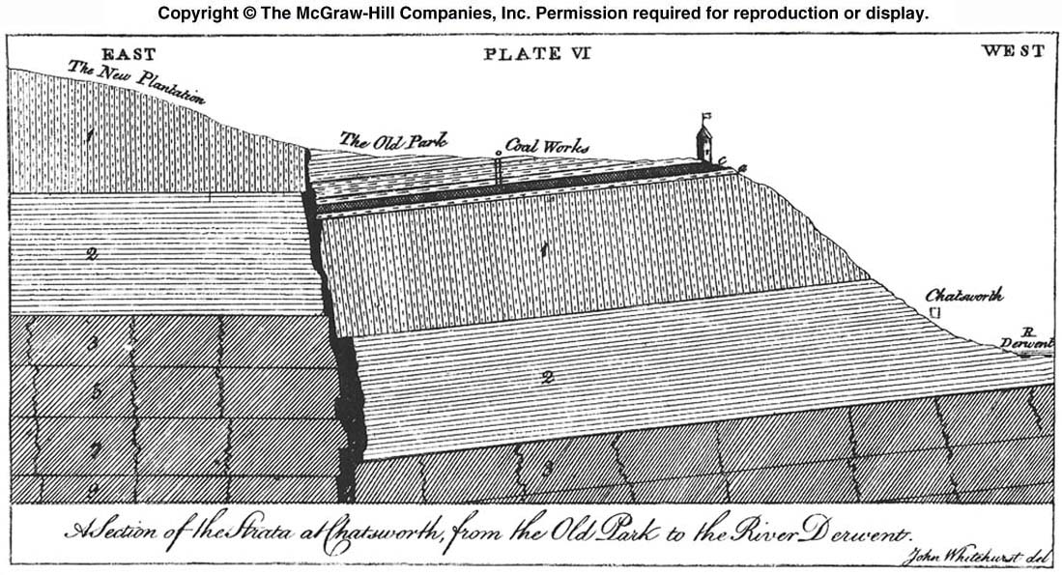

Slide 9
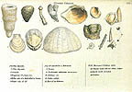
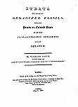
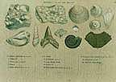

Slide 10
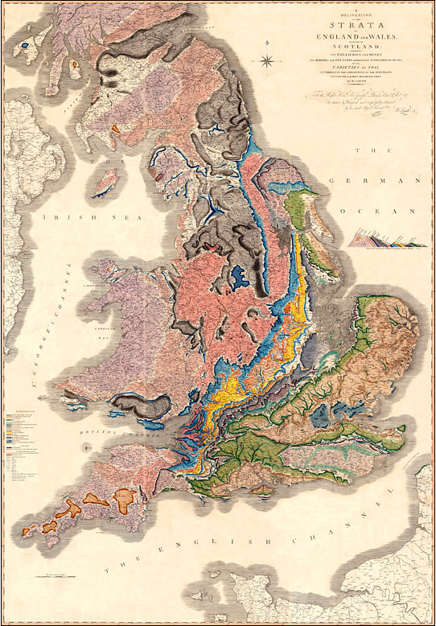

Slide 11
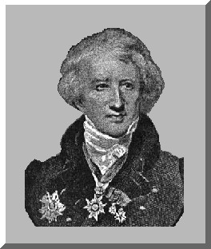
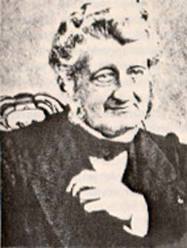
Georges Cuvier and Alexandre Brongniart Paris Basin
Development of geologic map of Paris Basin
The strata of the Paris Basin were close to horizontal.
As of 1811, Cuvier and Brongniart employed fossils but only in the few instances where more obvious evidences of sequence were absent.
The title of their work was Géographie Minéralogique: they meant the distribution of "external" characteristics of the mineral and fossil contents, shapes, colors, and textures of the strata within the Paris basin.
Today this is lithology. They determined the order of the strata from their superposition, their lithology and by tracing them across the basin

Slide 12
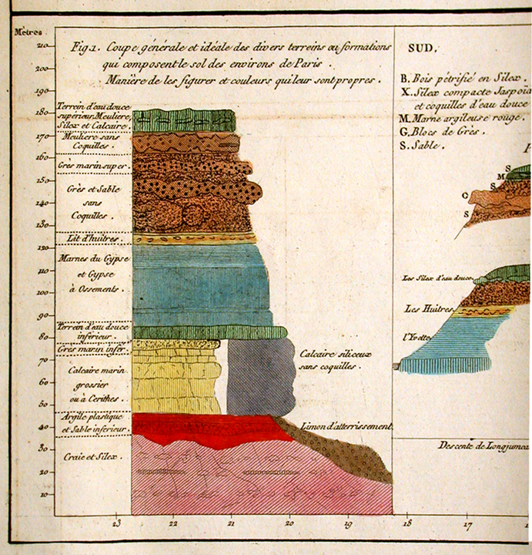

Slide 13
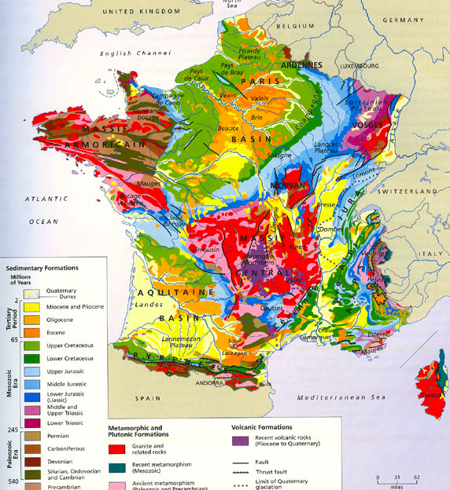

Slide 14


Slide 15
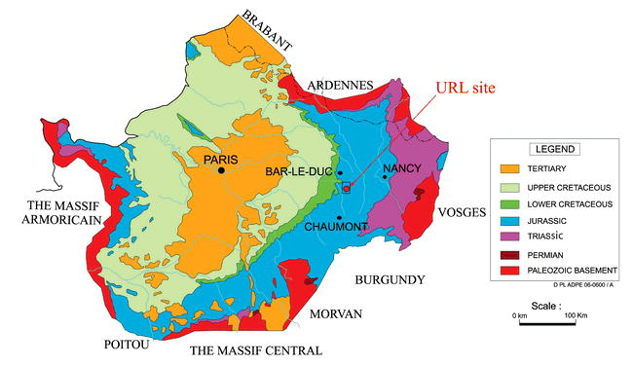

Slide 16
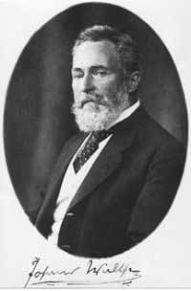
Walther’s Law
Named after Johannes Walther
(1860 – 1937), noted a fundamental relationship between the
vertical and lateral distribution of facies.
facies that occur in conformable
vertical successions of strata
also occur in laterally adjacent
environments

Slide 17
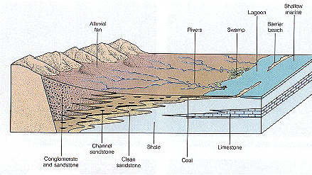
Concept of
Sedimentary Facies
Sedimentary Facies refers to all of the characteristics of a particular rock unit.
The characteristics of the rock unit come from the depositional environment.

Slide 18
Subdivision of the Rock Record
Lithostratigraphy –
  Study of the physical relationship among rock units;
    There is no time connotation other than superposition
    Physical properties and stratigraphic position relative to other lithostratigraphic units

