Slide 1
Holocene Carbonates “The Bahamas!!”
Christopher G. St.C. Kendall
803 – 312 1569
kendall@geol.sc.edu

Slide 2
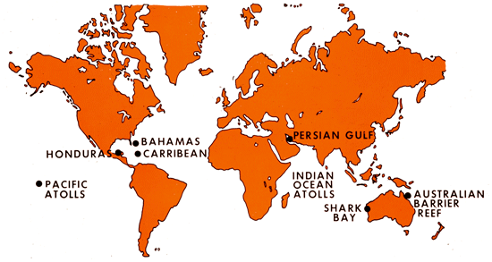
Modern Carbonate Accumulation
TROPICS
TEMPERATE OCEANS
Kendall Diagram

Slide 3
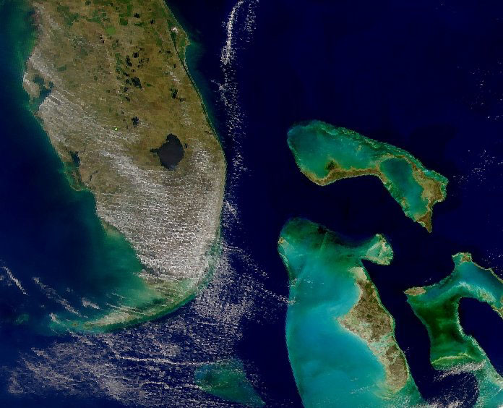
Bahamian Banks
Andros Island
Nasa Photo

Slide 4
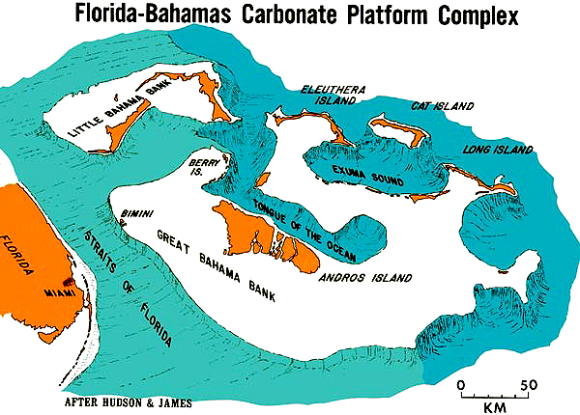
Florida and Bahamian Banks

Slide 5
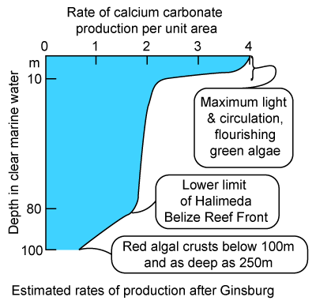
Carbonate Production with Depth

Slide 6
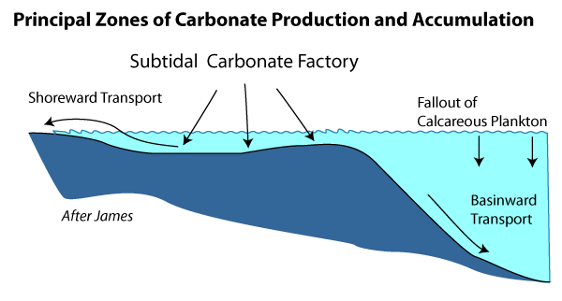
Bahamian Bank Settings & Carbonates

Slide 7
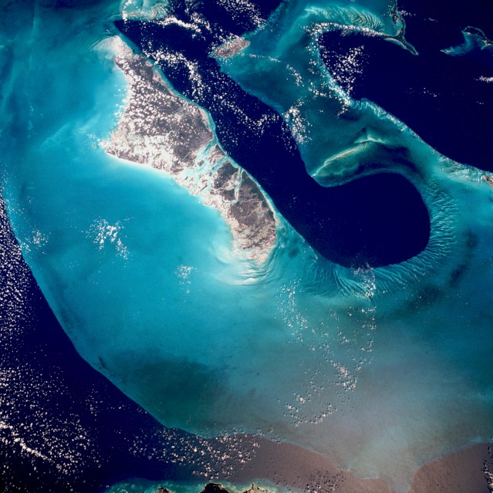
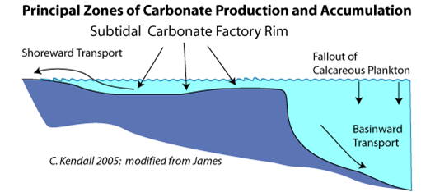
Bahamian Banks
Basin
Open
Shelf
Rim
Restricted
Shelf

Slide 8
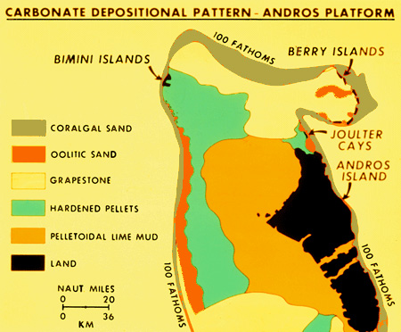
Bahamian Banks – Facies Belts
Kendall Diagram

Slide 9
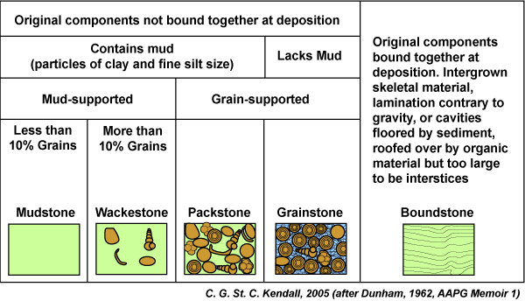
Carbonate Classification – Dunham

Slide 10
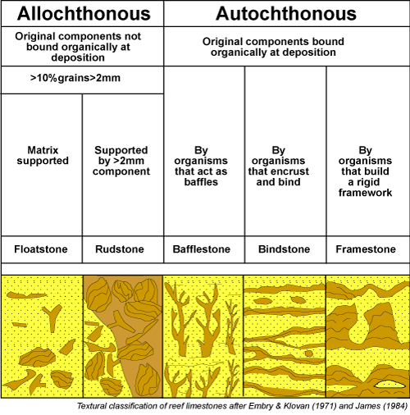
Carbonate Classification – Embry

Slide 11
Carbonate Classification – Folk

Slide 12
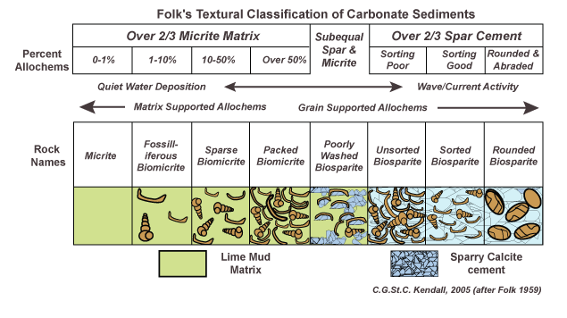
Carbonate Classification – Folk

Slide 13
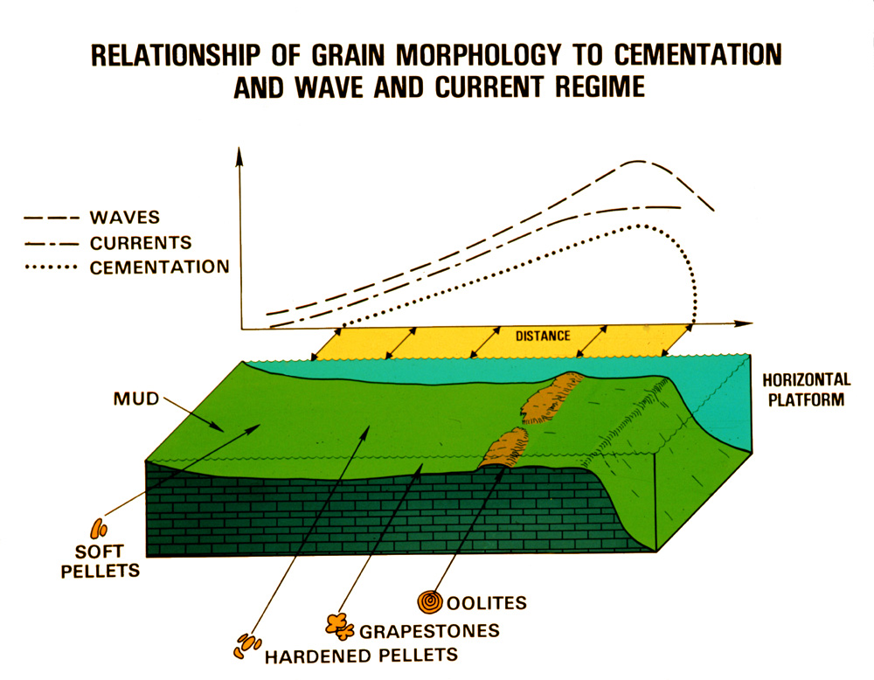
Carbonate Allochems – Bahamas
Kendall Diagram

Slide 14
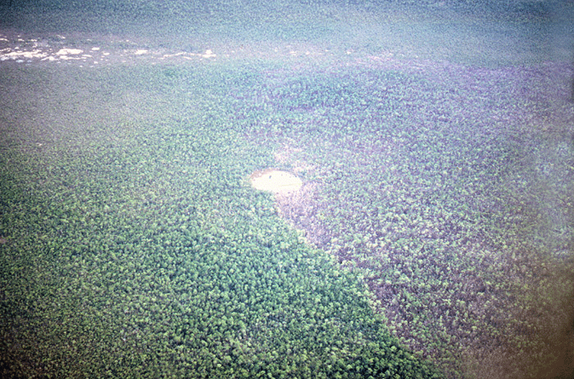
Andros West Side – Blue Hole
Blue Hole
Kendall Photo

Slide 15
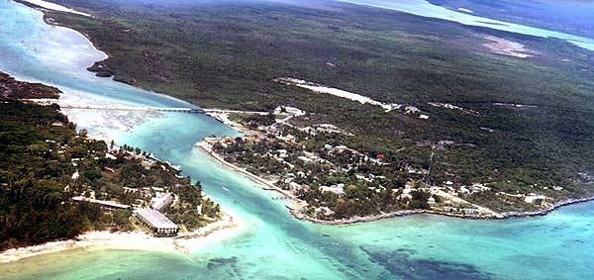
Andros North Island – Creek Margin
Kendall Photo
Fresh Creek

Slide 16
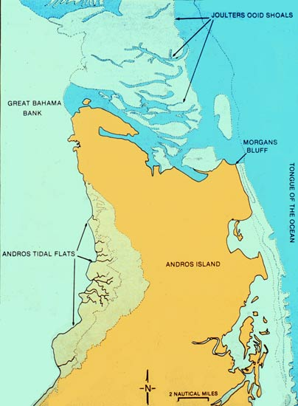
North Andros Island – Bahamas

Slide 17
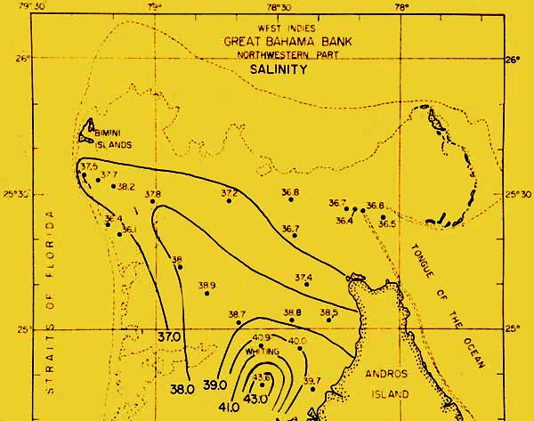
North of Andros Island – Bahamas
Cloud, 1962

Slide 18
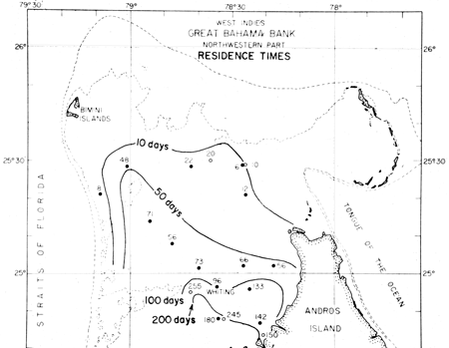
North of Andros Island – Bahamas
Cloud, 1962

Slide 19
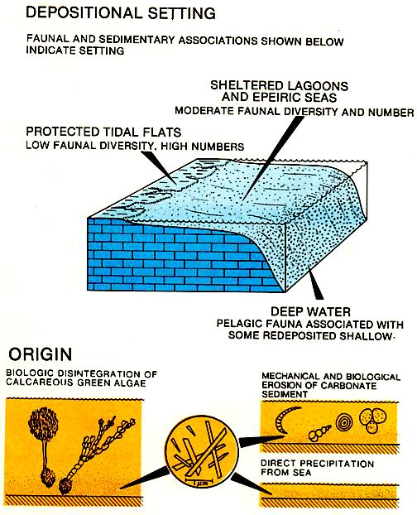
Lime Mud or Micrite
Kendall Diagram

Slide 20
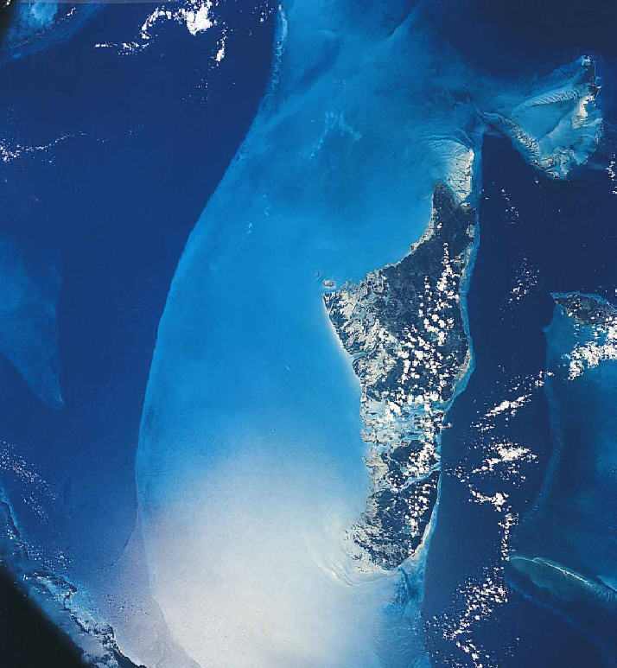
Lime Mud – Whitings off Andros
Whiting
Whiting
Nasa Photo

Slide 21
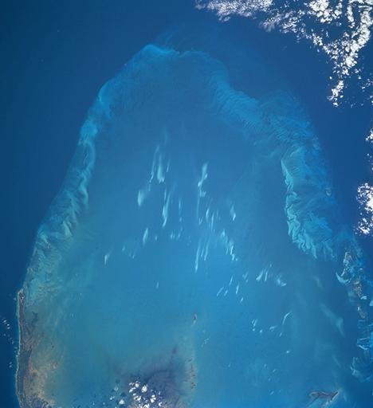
Lime Mud – Whitings off Andros
Whiting
Whiting
Nasa Photo

Slide 22
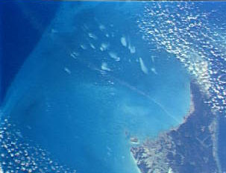
Lime Mud – Whitings off Andros
Nasa Photo

Slide 23
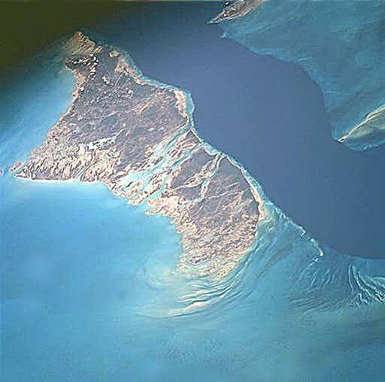
West Andros
Andros Island
Nasa Photo

Slide 24
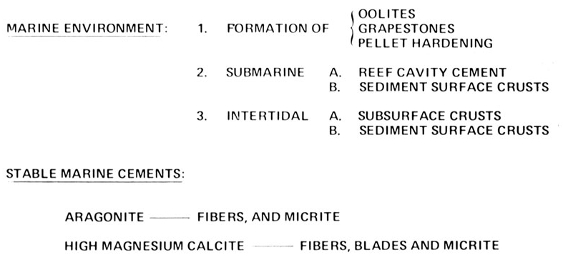
Cementation During Sedimentation
Kendall Diagram

Slide 25
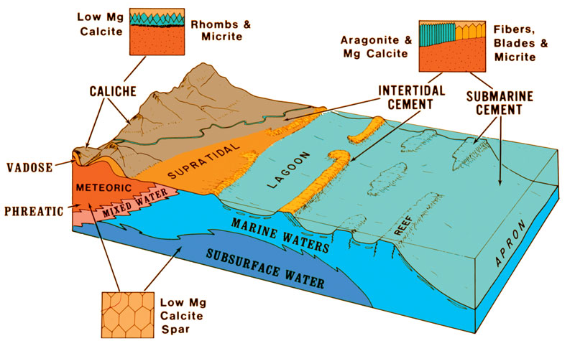
Holocene Calcium Carbonate Cement
Kendall Diagram

Slide 26
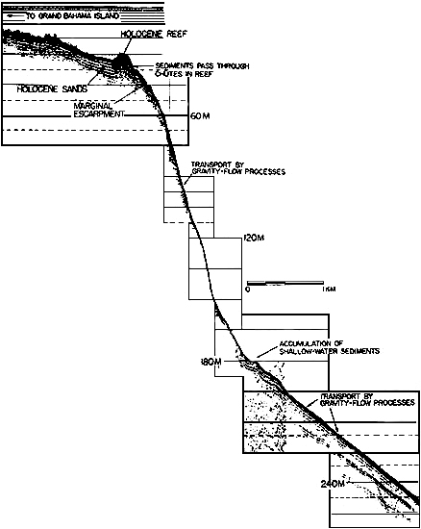
Bahamian Margin Submarine Slope

Slide 27
Bahamian Margin Submarine Slope

Slide 28
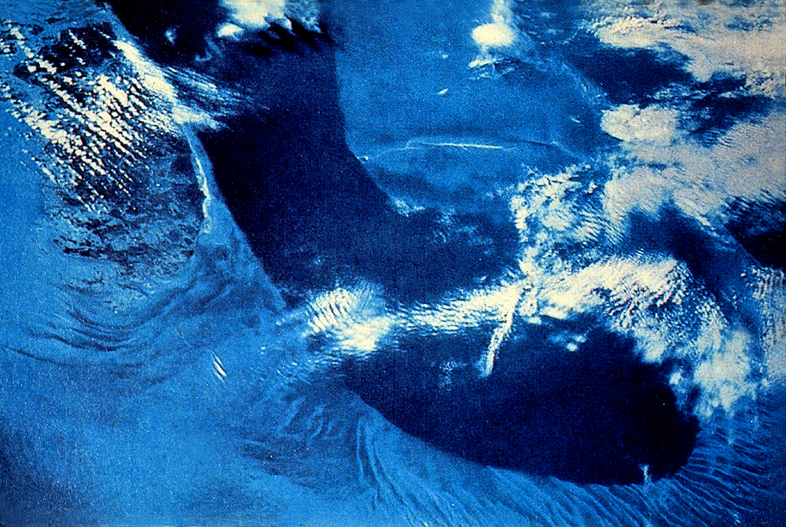
Tongue of the Ocean - Bahamas
Nasa Photo

Slide 29
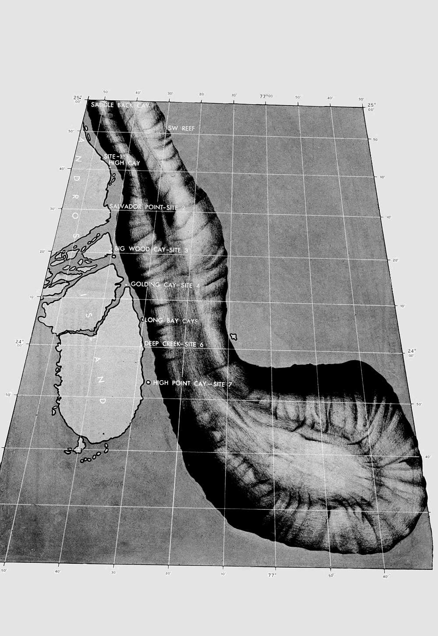
Bahamian Margin Submarine Slope

Slide 30
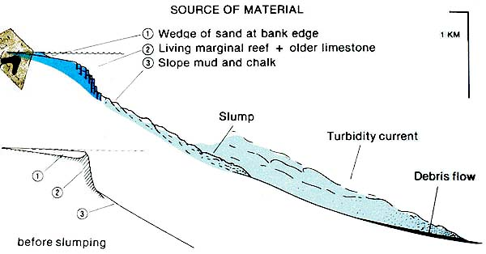
Bahamian Margin Submarine Slope

Slide 31
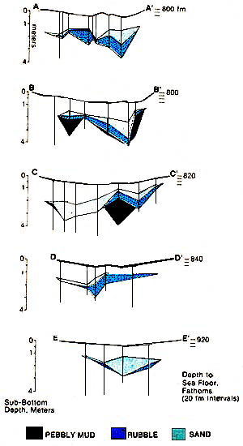
Bahamian Margin Submarine Slope
Crevello and Schlager 1980

Slide 32
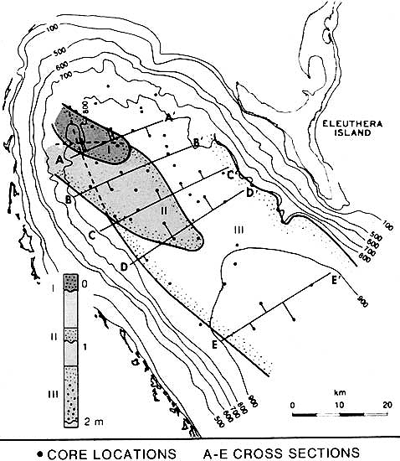
Bahamian Margin Submarine Slope
Crevello and Schlager 1980

Slide 33
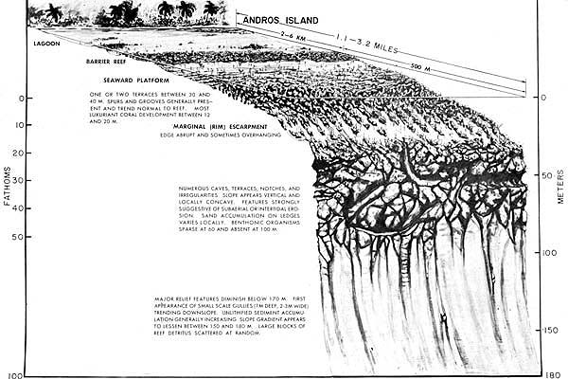
Bahamian Margin Submarine Slope

Slide 34
Joulters Margin & Tongue of Ocean
Tongue of Ocean
Joulters Keys
Ooid Shoals

Slide 35
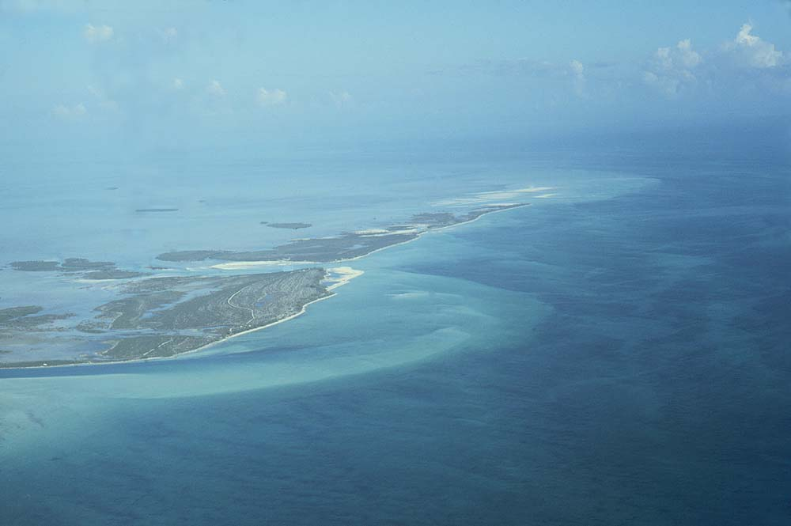
Joulters Margin Ebb Deltas
Joulters Keys
Ooid Shoals
Kendall Photo

Slide 36
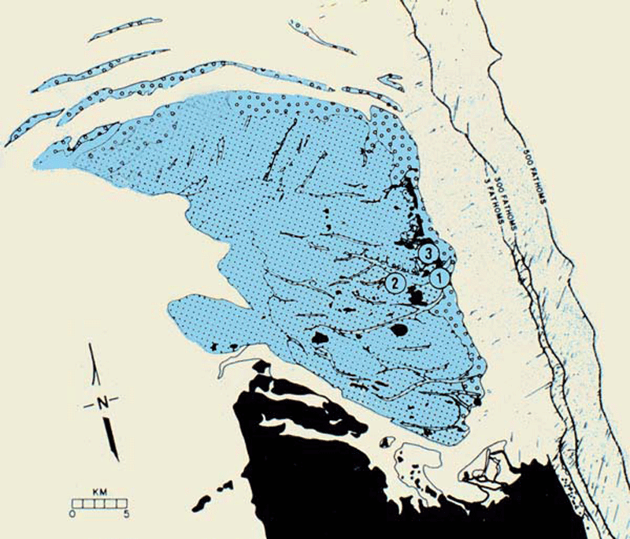
Joulters Shoals
After Harris, 2009

Slide 37
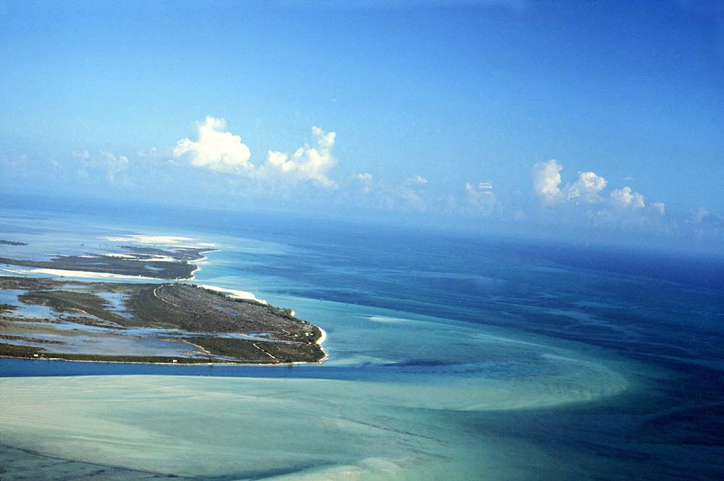
Joulters Margin Ebb Deltas
Accreting Beaches
Mangrove Flats
Coral Reefs
Ooid Ebb Tidal Delta
Kendall Photo

Slide 38
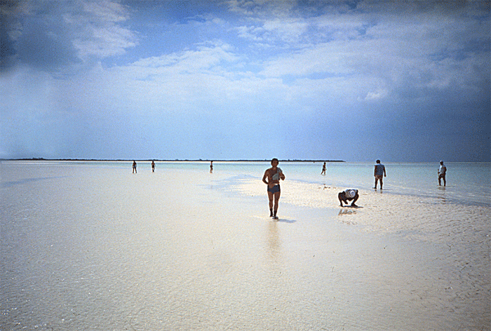
Joulters Ebb Delta Shoals
Ooid Sand Flats
Kendall Photo

Slide 39
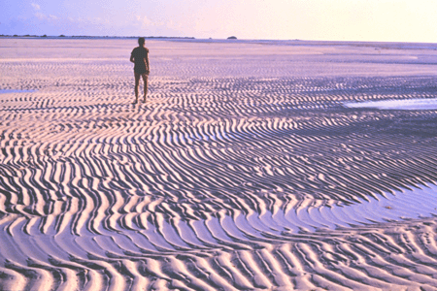
South of Joulters Cay – Bahamas
Kendall Photo

Slide 40
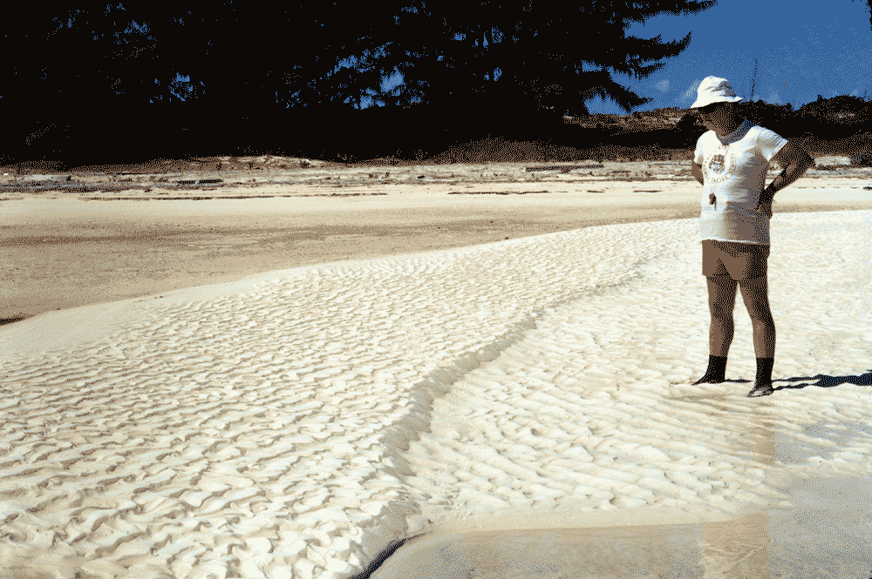
Joulters Cays – South Island
Ooid Sands
Kendall Photo

Slide 41
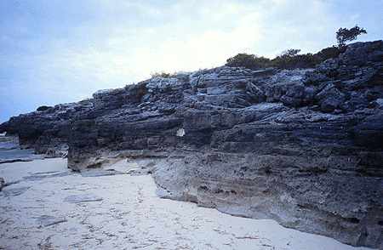
Joulters Late Holocene – Ooids
Kendall Photo

Slide 42
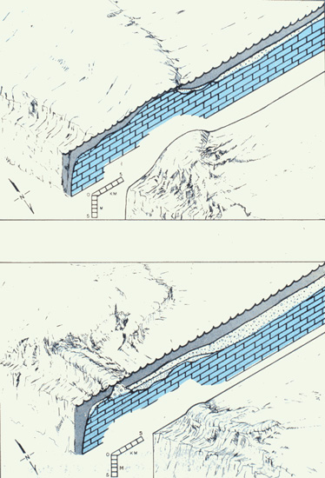
Joulters Late Holocene – Ooids
After Harris, 2009

Slide 43
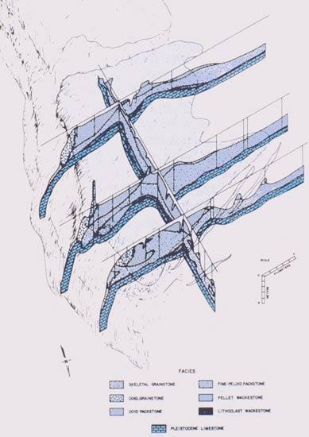
Joulters Late Holocene – Ooids
After Harris, 2009

Slide 44
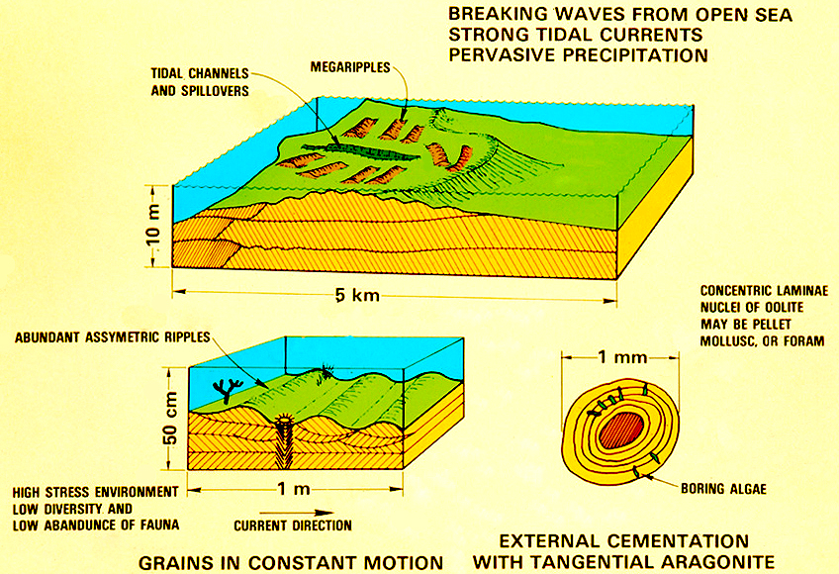
Depo. Setting – Bahamian Ooids
Kendall Diagram

Slide 45
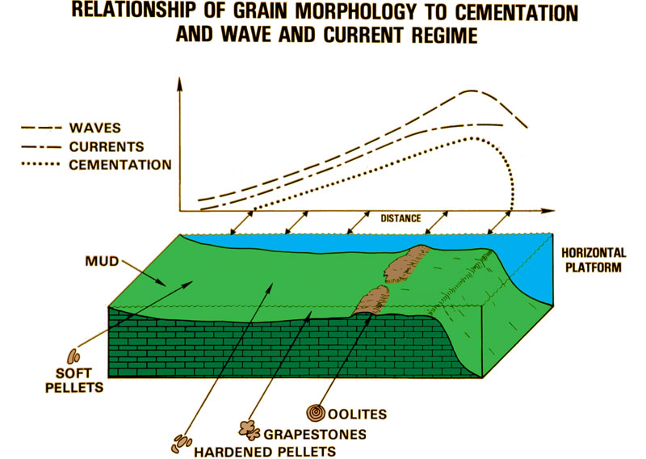
Joulters Carbonate Allochems
Kendall Diagram

Slide 46
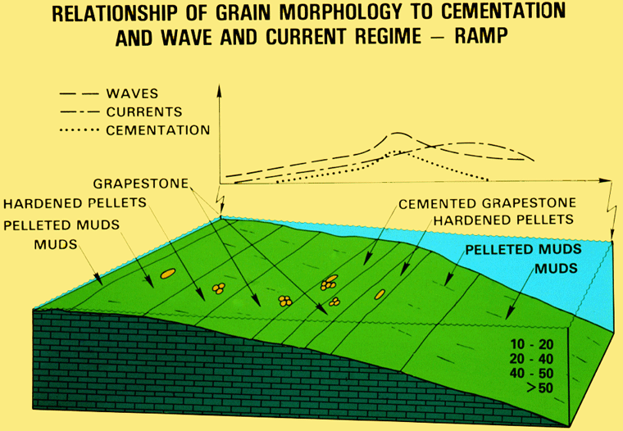
Carbonate Allochems – Bahamas
Kendall Diagram

Slide 47
Ooid Morphology and Settings
Kendall Diagram

Slide 48
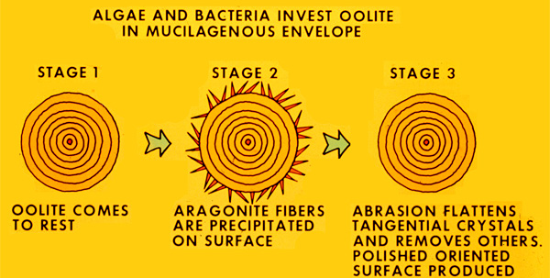
Ooid Formation
Kendall Diagram

Slide 49
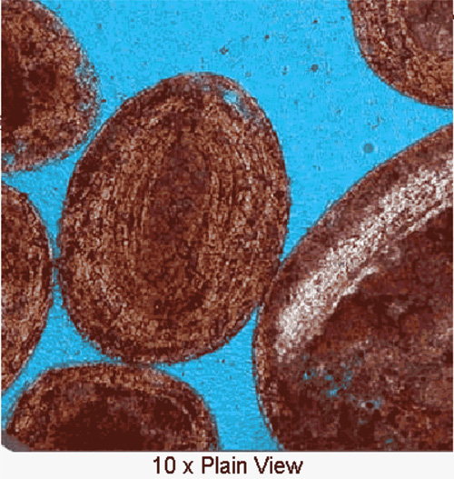
Aragonite Ooids - Bahamas

Slide 50
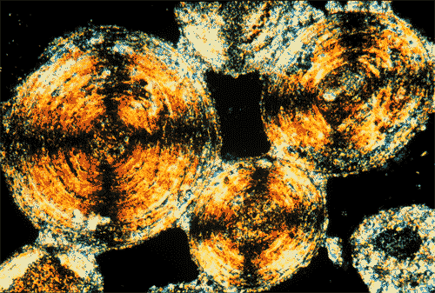
Aragonite Ooids
After Scholle, 2003

Slide 51
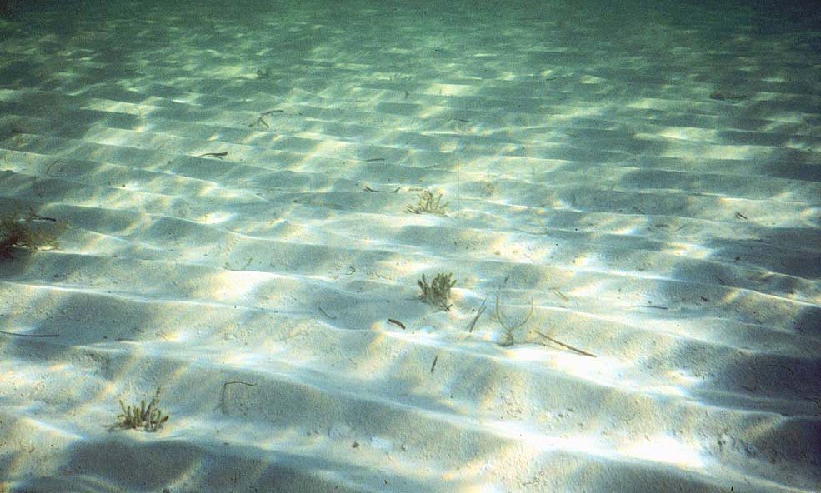
Joulters Cays – Wave Ripples
Ooid Sand Ripples
Kendall Photo

Slide 52
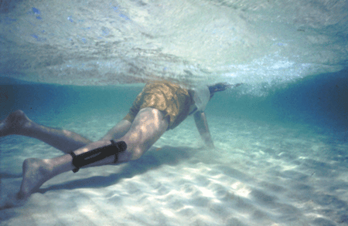
Joulters Cays – Wave Ripples
Kendall Photo

Slide 53
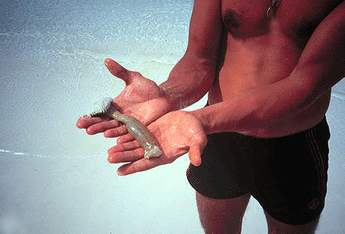
Joulters Burrowing Anemone
Kendall Photo

Slide 54
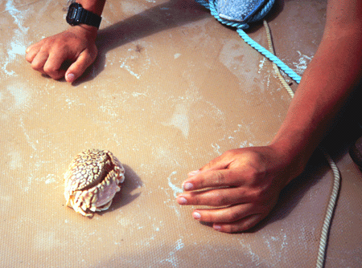
Joulters Burrowing Crab
Kendall Photo

Slide 55
Joulters Ooids
Kendall Photo

Slide 56
Bahamian Facies Relationships
Kendall Diagram

Slide 57
Joulters Cemented Beach Ridges
Kendall Photo

Slide 58
Joulters Barrier Beach Ridges
Kendall Photo

Slide 59
Joulters Ebb Delta Ooid Shoals
Kendall Photo

Slide 60
Bimini Ooid Shoal - Bahamas
Kendall Photo

Slide 61
Joulters Northern Spit Shoal
Kendall Photo

Slide 62
Joulters Late Holocene – Ooids
After Harris, 2009

Slide 63
Bahamas Ichnology – Burrows
Callianassa

Slide 64
Joulters Backbarrier Flats
Tidal Flats with Mangroves
& Cyanobacteria
Kendall Photo

Slide 65
Joulters Back-Barrier Flats
Kendall Photo

Slide 66
Joulters Backbarrier Flats
Kendall Photo

Slide 67
Joulters Backbarrier Flats-Scytomenia
Kendall Photo

Slide 68
Freshwater Cementation - Joulters
Kendall Photo

Slide 69
Freshwater Cementation - Joulters
Kendall Photo

Slide 70
Freshwater Cementation - Joulters
Kendall Diagram

Slide 71
Freshwater Cementation - Joulters
Meniscus Cement
Kendall Photo

Slide 72
Freshwater Cementation - Joulters
Kendall Photo

Slide 73
Joulters – Air Bubbles in Beach
Kendall Photo

Slide 74
Joulters Cays – Back Barrier Shoals
Kendall Photo

Slide 75
Loose Grapestones - Setting
Kendall Diagram

Slide 76
Grapestone Depo. Setting - Joulters
Kendall Photo

Slide 77
Grapestone Depo. Setting - Joulters
Kendall Photo

Slide 78
Tidal Channel - Joulters
Kendall Photo

Slide 79
Tidal Channel Stromatolites - Joulters
Kendall Photo

Slide 80
Loose Grapestones - Setting
Kendall Photo

Slide 81
Green Calcareous Algae of Bahamas
Kendall Photo

Slide 82
Grapestone Calc. Algae & Mounds
Kendall Photo

Slide 83
Callianssa Mound & Calc. Algae
Kendall Photo

Slide 84
Callianssa Burrows – Joulters Cays
Kendall Photo

Slide 85
Grapestones – Chubb Cay
Kendall Photo

Slide 86
Grapestone Setting – Chubb Cay
Kendall Photo

Slide 87
Grapestone Generation
Kendall Diagram

Slide 88
Grapestone & Crust Depo. Setting
Kendall Diagram

Slide 89
Grapestone Setting – West of Joulters
Kendall Photo

Slide 90
Grapestone Setting – West of Joulters
Kendall Photo

Slide 91
Grapestone Setting – West of Joulters
Kendall Photo

Slide 92
Hardened Pellets – West of Joulters
Kendall Diagram

Slide 93
Hardened Pellet Generation
Kendall Diagram

Slide 94
Excreted Soft Pellet Setting
Kendall Diagram

Slide 95
Excreted Soft Pellet Setting
Kendall Photo

Slide 96
Excreted Soft Pellet Setting
Kendall Photo

Slide 97
Lime Mud Generation and Setting
Kendall Diagram

Slide 98
Lime Mud Generation and Setting
Kendall Photo

Slide 99
Lime Mud Generation and Setting
Kendall Photo

Slide 100
Andros Reef Tract
Kendall Photo

Slide 101
Andros Reef Tract – Faunal Association

Slide 102
Mamma Rhoda Acropora Reef
Kendall Photo

Slide 103
Mamma Rhoda Acropora Reef
Kendall Photo

Slide 104
Mamma Rhoda Acropora Reef
Kendall Photo

Slide 105
Mamma Rhoda Acropora Reef
Kendall Photo

Slide 106
Mamma Rhoda Acropora Reef
Kendall Photo

Slide 107
Andros Reef Tract - Acropora Palamata
Kendall Photo

Slide 108
Andros Reef Tract - Acropora Palmata
Kendall Photo

Slide 109
Andros Reef Tract - Acropora Cervicornis
Kendall Photo

Slide 110
Andros Reef Tract – Early Cement
Kendall Photo

Slide 111
Andros Reef Front - Montastrea
Kendall Photo

Slide 112
Andros Reef - Diploria
Kendall Photo

Slide 113
Andros Patch – Millepora & Agaricia
Kendall Photo

Slide 114
Andros Reef - Diploria Labyrinthiformis
Kendall Photo

Slide 115
Patch Reefs – Boring in Corals
N P James 1969

Slide 116
Andros Reef Front – Montastrea Pillar
Kendall Photo

Slide 117
Andros Patch – Porites & Montastrea
Kendall Photo

Slide 118
Andros Patch – Agaricia
Kendall Photo

Slide 119
Andros Reef – Agaricea & Millepora
Kendall Photo

Slide 120
Andros Reef - Diploria Labyrinthiformis
Kendall Photo

Slide 121
Andros Patch Reef - Diploria Head
Kendall Photo

Slide 122
Andros Reef – Back Reef Patches
Kendall Photo

Slide 123
Patch Reefs – Mode of Colonization
N P James 1969

Slide 124
Andros Reef Tract – Early Cement
Kendall Photo

Slide 125
Andros Patch – Diploria & Montastrea
Kendall Photo

Slide 126
Andros Patch – Diploria & Montastrea
Kendall Photo

Slide 127
Andros Patch – Diploria & Montastrea
Kendall Photo

Slide 128
Andros Patch Reef – Sea Grasses
Kendall Photo

Slide 129
Andros Patch Reef – Diadema Urchins
Kendall Photo

Slide 130
Andros Patch - Near Shore
Kendall Photo

Slide 131
Staniard Creek North Andros
Kendall Photo

Slide 132
Staniard Creek North Andros
Kendall Photo

Slide 133
Staniard Creek North Andros
Kendall Photo

Slide 134
Staniard Creek North Andros
Kendall Photo

Slide 135
Staniard Creek North Andros
Kendall Photo

Slide 136
Staniard Creek – Intraclast Origin
Kendall Diagram

Slide 137
Staniard Creek North Andros
Kendall Photo

Slide 138
Staniard Creek North Andros
Kendall Photo

Slide 139
Staniard Creek North Andros
Kendall Photo

Slide 140
Staniard Creek North Andros
Kendall Photo

Slide 141
Staniard Creek North Andros
Kendall Photo

Slide 142
Staniard Creek North Andros
Kendall Photo

Slide 143
Lee Stocking Island & Barrie Terre
Nasa Photo

Slide 144
Lee Stocking Island South End
Kendall Photo

Slide 145
Lee Stocking – Stromatolites – Dill
Kendall Photo

Slide 146
Lee Stocking Stromatolites
Kendall Photo
Stromatolites
on
Pleistocene
Base
Surrounded
by
Ooids

Slide 147
Lee Stocking Stromatolites
Kendall Photo
Stromatolites
on
Pleistocene
Base
Surrounded
by
Ooids

Slide 148
Lee Stocking Stromatolites
Stromatolite
Cross Section
-
From
Lee Stocking
Tidal
Channel
Kendall Photo

Slide 149
West Side of Andros Island
Map of
Tidal
Channel
and
Ponds
Conrad Geblein

Slide 150
West Side of Andros Island
Kendall Photo

Slide 151
Depositional Setting – Lime Mud
Kendall Diagram

Slide 152
Three Creeks Flats – West Side Andros
Map of
Tidal
Channel
and
Ponds
Conrad Geblein

Slide 153
Three Creeks Flats – West Side Andros
Kendall Photo

Slide 154
West Side of Andros Island
Kendall Photo

Slide 155
West Side of Andros Island
Conrad Geblein

Slide 156
West Side of Andros Island
Conrad Geblein

Slide 157
West Side of Andros Island
Kendall Photo

Slide 158
West Side of Andros Island
Kendall Photo

Slide 159
West Side of Andros Island
Kendall Photo

Slide 160
West Side of Andros Island
Kendall Photo

Slide 161
West Andros Island – Goose Creek
Kendall Photo

Slide 162
West Andros Island – Goose Creek
Kendall Photo

Slide 163
West Andros Island – Goose Creek
Kendall Photo

Slide 164
West Andros Island – Goose Creek
Kendall Photo

Slide 165
West Andros Island – Goose Creek
Kendall Photo

Slide 166
West Andros Island – Goose Creek
Kendall Photo

Slide 167
West Andros Island – Goose Creek
Kendall Photo

Slide 168
West Andros Island – Goose Creek
Kendall Photo

Slide 169
West Andros Island – Goose Creek
Kendall Photo

Slide 170
West Andros Island – Goose Creek

Slide 171
West Andros Island – Goose Creek
Kendall Photo

Slide 172
West Andros – Creek Levee
Conrad Geblein

Slide 173
West Andros – Brackish Marsh
Conrad Geblein

Slide 174
West Andros Island – Goose Creek
Kendall Photo

Slide 175
West Andros Island – Pond Fill
Noel James

Slide 176
West Andros Island – Goose Creek
Kendall Photo

Slide 177
West Andros Island – Goose Creek
Kendall Photo

Slide 178
West Andros Island – Goose Creek
Kendall Photo

Slide 179
West Andros – Pond Fill
Conrad Geblein

Slide 180
West Andros – Pond Fill
Conrad Geblein

Slide 181
West Andros – Pond Mud Fight!
Kendall Photo

Slide 182
Barrie Terre – Exumas Cay
Kendall Photo

Slide 183
Barrie Terre – Exumas Cay
Kendall Photo

Slide 184
Barrie Terre – Exumas Cay
Kendall Photo

Slide 185
Barrie Terre – Exumas Cay
Kendall Photo

Slide 186
East Andros – Pleistocene Reef
Kendall Photo

Slide 187
East Andros – Pleistocene Reef
Kendall Photo

Slide 188
East Andros – Pleistocene Reef
Kendall Photo

Slide 189
East Andros – Pleistocene Reef
Kendall Photo

Slide 190
Providence Island – Pleistocene
Conrad Geblein

Slide 191
Providence Island – Pleistocene
Conrad Geblein

Slide 192
Providence Island – Clifton Pier
Kendall Photo

Slide 193
Providence Island – Clifton Pier
Kendall Photo

Slide 194
Providence Island – Pleistocene
Kendall Photo

Slide 195
Providence Island – Clifton Pier
Kendall Photo
Providence Island – Pleistocene

Slide 196
Providence Island – Pleistocene
Kendall Photo

Slide 197
Providence Island – Pleistocene
Kendall Photo

Slide 198
Providence Island – Pleistocene
Kendall Photo

Slide 199
Providence Island – Pleistocene
Kendall Photo

Slide 200
Providence Island – Pleistocene
Kendall Photo

Slide 201
Florida Platform

Slide 202
Florida Platform

