Slide 1
Sequence Stratigraphy
“Sedimentary Facies, Elements, Hierarchy & Architecture”
Christopher G. St.C. Kendall
803 – 312 1569
kendall@geol.sc.edu
David Barbeau

Slide 2
Lecture Series Overview
Purpose of Sequence Stratigraphy
Depositional Sequence Vail et al 1971 seen in Movies of Clastic Cycle and Depositional Systems
Data for Sequence Stratigraphy
Surfaces and Geometries
Sequence Stratigraphy Defined
Book Cliffs – Prograding Cretaceous Shoreline
Sequence Stratigraphy Methodology: Surfaces, Walther, and Steno
Carbonate and Clastic Systems

Slide 3
Sedimentary Rocks & Minerals
Detrital/Siliciclastic Sedimentary Rocks
  Quartzarenite (quartz rich)
  Arkoses (feldspar rich)
  Litharenite (rock fragment rich)
Carbonate sedimentary rocks
  Limestone
  Dolomite
Other sedimentary rocks
  Evaporites
  Phosphates
  Organic-rich sedimentary rocks
  Cherts
  Volcaniclastic rocks

Slide 4
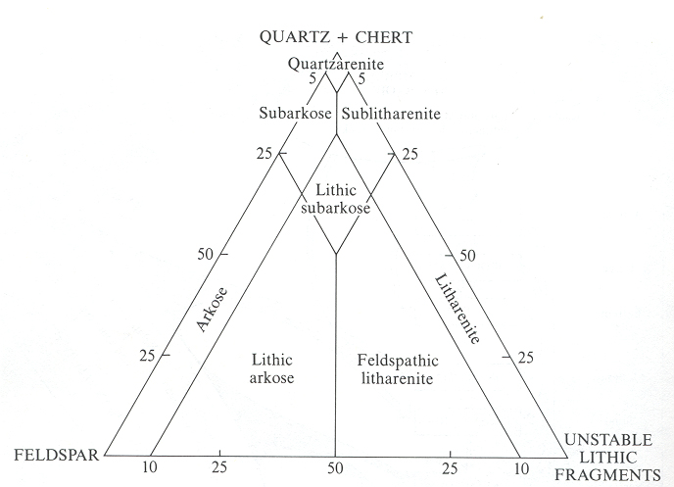
Siliciclastic Sedimentary Rocks: Sandstones

Slide 5
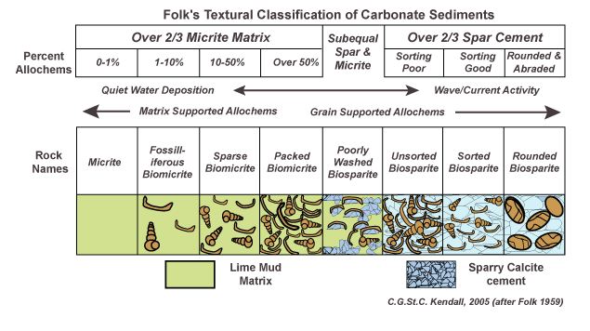
Carbonate Sedimentary Rocks

Slide 6
Transport Mechanisms
By fluid flow
  Traction: grain rolling/sliding along substrate
  Saltation: grain hopping along substrate
  Suspension: ‘permanent’ grain entrainment
By gravity flow
  Grain flow: cohesionless sediment movement
  Debris flow: viscous sediment movement
  Liquefied flow: over-pressured interstitial fluid movement
  Density flow: slurry movement driven by differential density

Slide 7
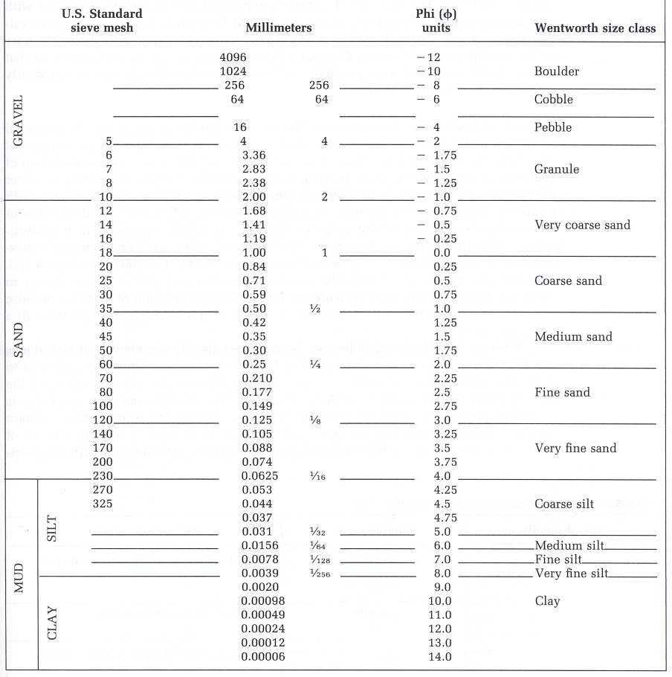
Detrital Sediments & Sedimentary Rocks
gravel
&
conglomerate
sand
&
sandstone
clay, silt
&
mudstone

Slide 8
Detrital Sediments & Sedimentary Rocks
gravity flows
fluid flows
gravel
&
conglomerate
fluid flows
gravity flows
sand
&
sandstone
suspension & flocculation
gravity flows
clay, silt
&
mudstone

Slide 9
Current Erosion/Transport & Grain Size
Hjulstrom & Sundborg showed a critical current velocity is required to move sediment of a specific grain size for a fixed water depth
Sediment entrainment is also found to be dependent on sediment cohesion and consolidation

Slide 10
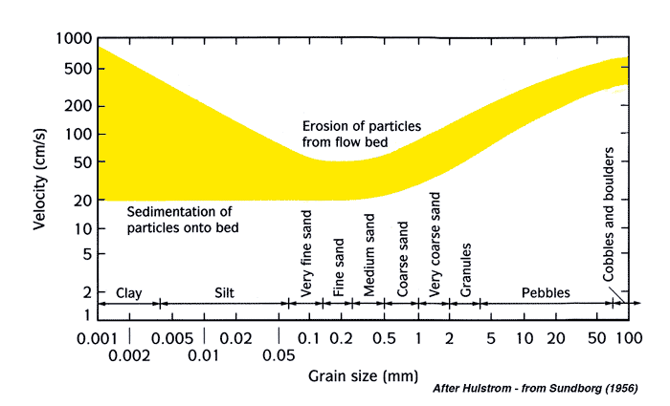
Current Erosion/Transport & Grain Size
Particle Entrainment: Hjulström’s Diagram
description of flow competence

Slide 11
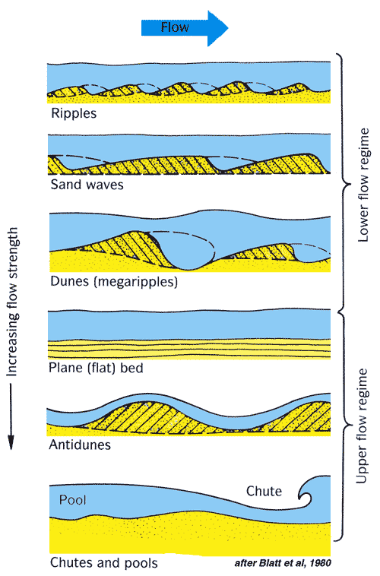
Flow Regimes

Slide 12
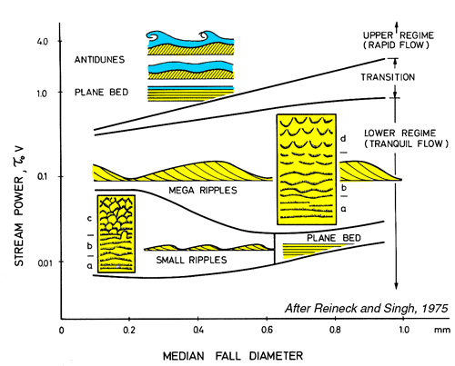
Flow Regimes

Slide 13
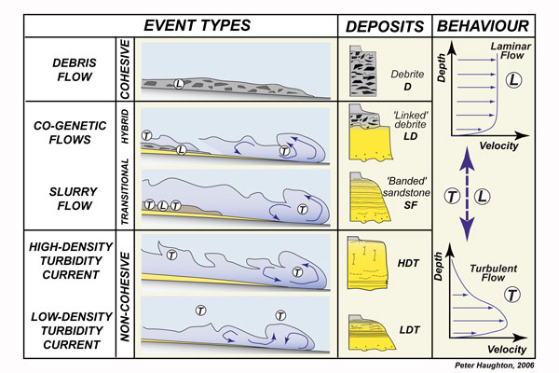
Gravity Flows

Slide 14
Sedimentary Rocks
Detrital/Siliciclastic Sedimentary Rocks
  conglomerates & breccias
  sandstones
  mudstones
Carbonate Sedimentary Rocks
  carbonates
Other Sedimentary Rocks
  evaporites
  phosphates
  organic-rich sedimentary rocks
  cherts
  volcaniclastic rocks
Sedimentary
Structures
-
In All These

Slide 15
Sedimentary Structures
Sedimentary structures are features found within the sedimentary section, and/or on, and/or between, bedding plane surfaces subdividing that section
Related to scale and hierarchy of features they occur in, whether in sediments that have confined (as in a channel) or unconfined settings (as on a shelf), & associated but similar sized structures
Sedimentary structures provide critical versus general clues to depositional setting

Slide 16
Primary Sedimentary Structures
Plane Bedding
Bedforms generated by Unidirectional Currents
Bedforms generated by Multidirectional flow
  Currents
  Waves
Graded & Imbricate Bedding
Bedding Plane Structures

Slide 17
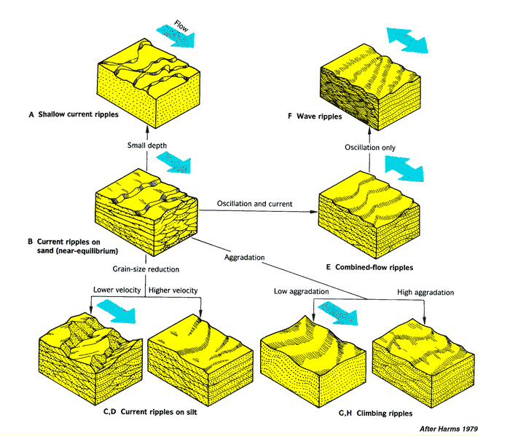
Bedforms & Asymmetric Current Ripples
Unidirectional Current Ripples

Slide 18
Bedforms
–
Unidirectional Current Ripples
- increasing Flow
Velocities
Current Structures

Slide 19
Allen’s Classification of Ripples
Based on plan view shape, with increasing complexity tied to shallower water & higher velocities:-
Straight
Sinuous
Catenary
Linguoid
Lunate

Slide 20
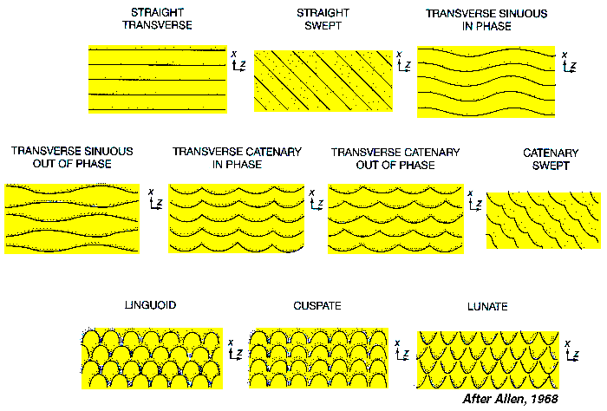
Transverse Ripples

Slide 21
Primary Sedimentary Structures
Plane Bedding
Bedforms generated by Unidirectional Currents
Bedforms generated by Multidirectional flow
  Currents
  Waves
Graded & Imbricate Bedding
Bedding Plane Structures

Slide 22
Bedforms & Asymmetric Current Ripples
Wave Generated Ripples

Slide 23
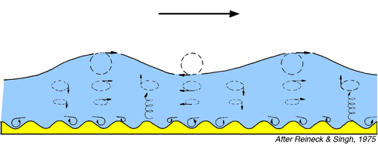
Generation of Wave Ripples
Water movement during generation of wave ripples. Note that the orbital movement of water is flattening close to sediment surface and well developed symmetrical shapes form at this surface

Slide 24
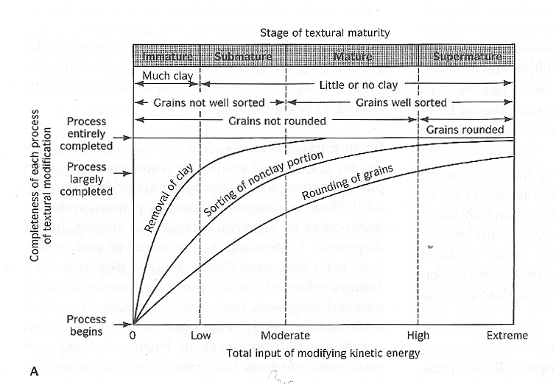
Maturity

Slide 25
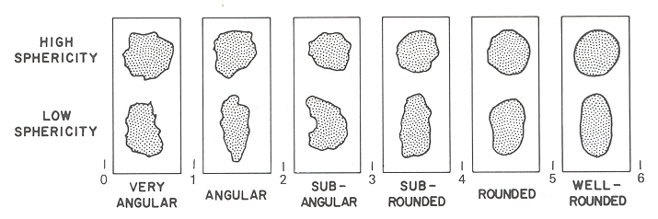
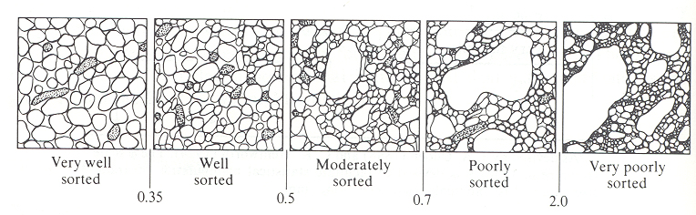
Siliciclastic Sedimentary Rocks: Sandstones

Slide 26
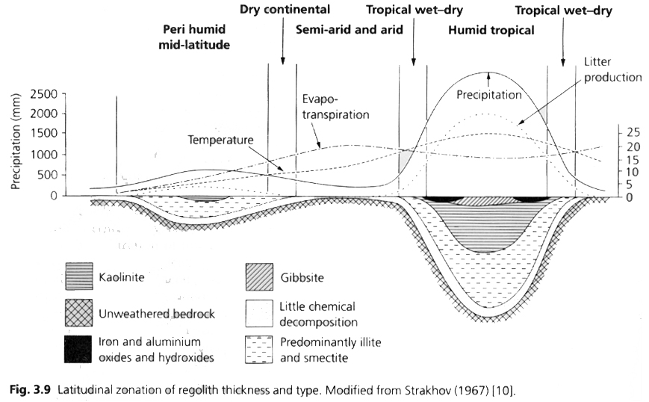
Climate

Slide 27
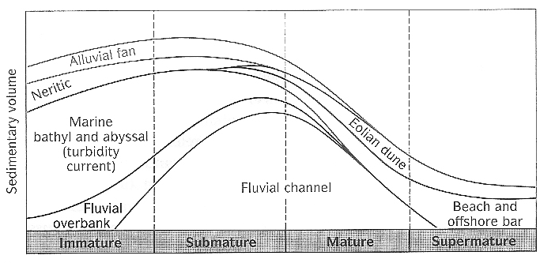
Maturity

Slide 28
Ichnofacies
Ichnofacies is concept devised by Adolph Seilacher of Tubingen University!
It is a paleontological tool that analyses assemblages of trace fossils to interpret ancient depositional settings & sedimentary facies.
Ichnofacies were defined as archetypal and recurring assemblages related to bathymetry, but water depth is only one facet of ichnofacies and they are also sensitive to sediment dynamics, coherence, water salinity, oxygen levels and predation
Ichnofacies are named after one distinctive trace fossil that is commonly (but not necessarily) present in the assemblage.
Ichnofacies have been related to contemporaneous trace fossils in modern settings

Slide 29
Ichnology of Sedimentary Section
http://research.eas.ualberta.ca/ichnology/
Trypanites - Rocky Coast
Teredolites – Peat or Xylic Substrate
Glossifungites - Semi Consolidated Substrate
Psilonichnus – Sandy Backshore
Skolithos - Sandy Shore
Cruziana – Sublittoral Zone
Zoophycos – Bathyal Zone
Nereites – Abyssal Zone
Substrate
Controlled
Softground

Slide 30
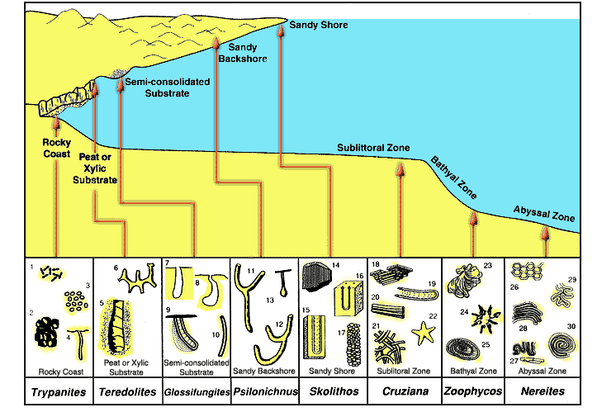
Distribution of Common Marine Ichnofacies
Adolph Seilacher of Tubingen University

Slide 31
Sedimentary rocks are the product of the creation, transport, deposition, and diagenesis of detritus and solutes derived from pre-existing rocks.
Sedimentary Geology

Slide 32
Sedimentary rocks are the product of the creation, transport, deposition, and diagenesis of detritus and solutes derived from pre-existing rocks.
Sedimentary Geology

Slide 33
Sedimentary Geology
Sediment:
Sedimentary rock:
Sedimentology:
Strata:
Stratigraphy:
Basin:

Slide 34
Sedimentary Geology
Sediment: unconsolidated* material that is produced on earth’s surface by the disaggregation of pre-existing rocks
Sedimentary rock: a consolidated body formed from sediments or solutes that are transported and deposited by gravity, biologic activity, or a fluid and then lithified by the combined effects of compaction and cementation
Sedimentology: the study of the production, transport, and deposition of sediment
* some exceptions apply

Slide 35
Sedimentary Geology
Strata: layers of (usually sedimentary) rock
Stratigraphy:
  The description, study, and/or application of the composition of layered (usually sedimentary) rocks
  A succession of layered rocks; e.g., The stratigraphy of South Carolina
Basin:
  A region of potential sediment accumulation generally caused by subsidence
  The largest possible body of related and once-contiguous* strata; e.g., The Appalachian Basin
* some exceptions apply

Slide 36
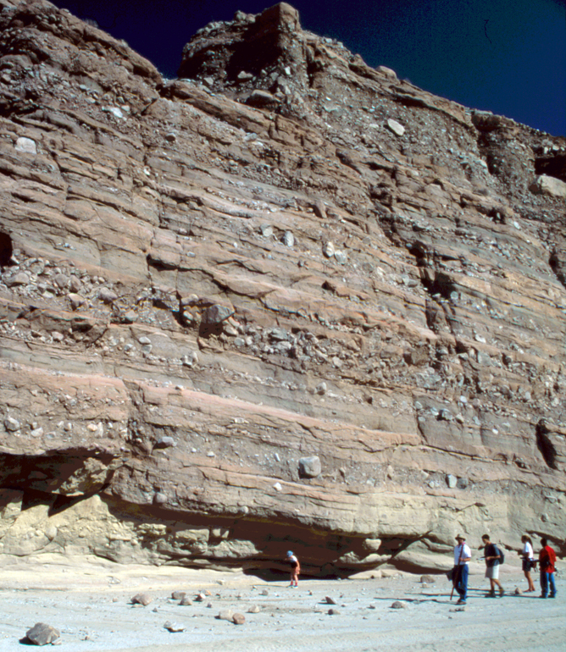
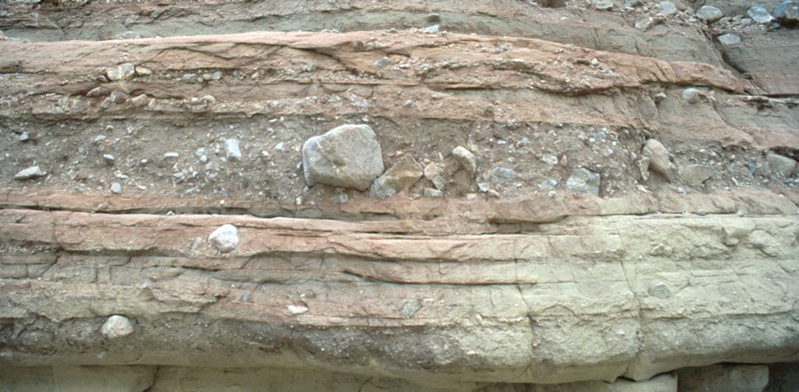
Sedimentary Geology
Miocene alluvial fan, Salton Trough
Images by Dave Barbeau

Slide 37
Sedimentary Geology
Miocene alluvial fan, Salton Trough
sediment
Images by Dave Barbeau

Slide 38
Sedimentary Geology
Miocene alluvial fan, Salton Trough
stratum or bed
strata or succession of beds
Images by Dave Barbeau

Slide 39
Sedimentary Geology
Miocene alluvial fan, Salton Trough
succession
or
stratigraphy
or
strata
Images by Dave Barbeau

Slide 40
Sedimentary Geology
Miocene alluvial fan, Salton Trough
students studying stratigraphy
Images by Dave Barbeau

Slide 41
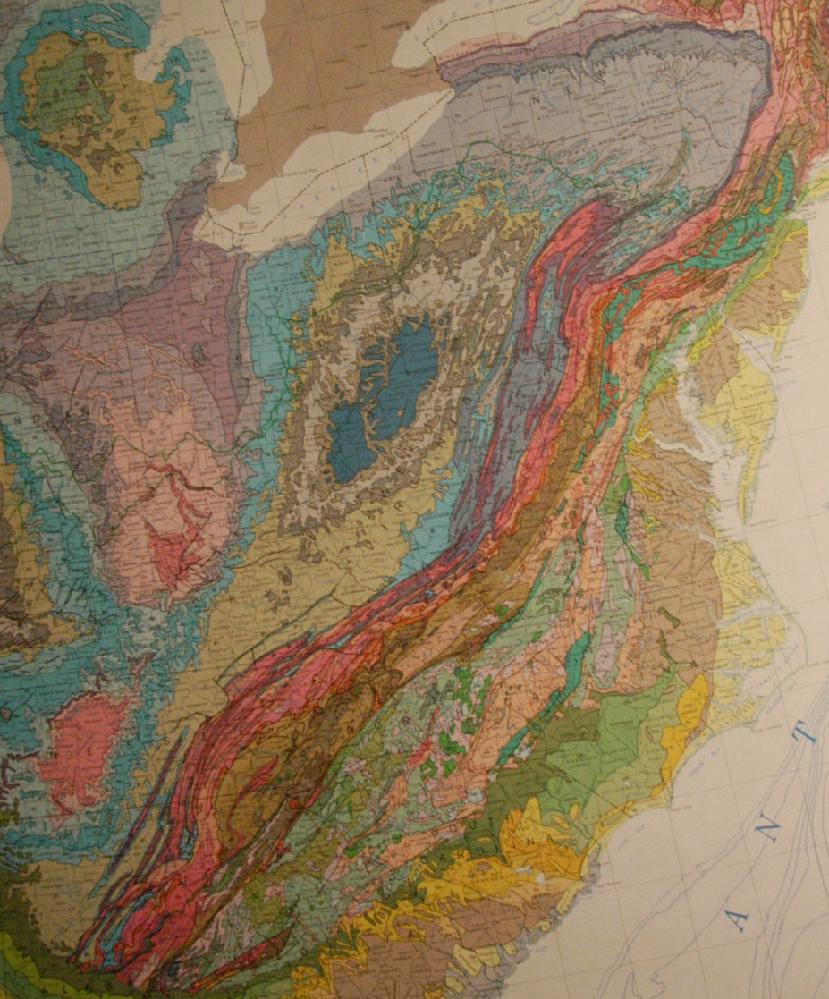
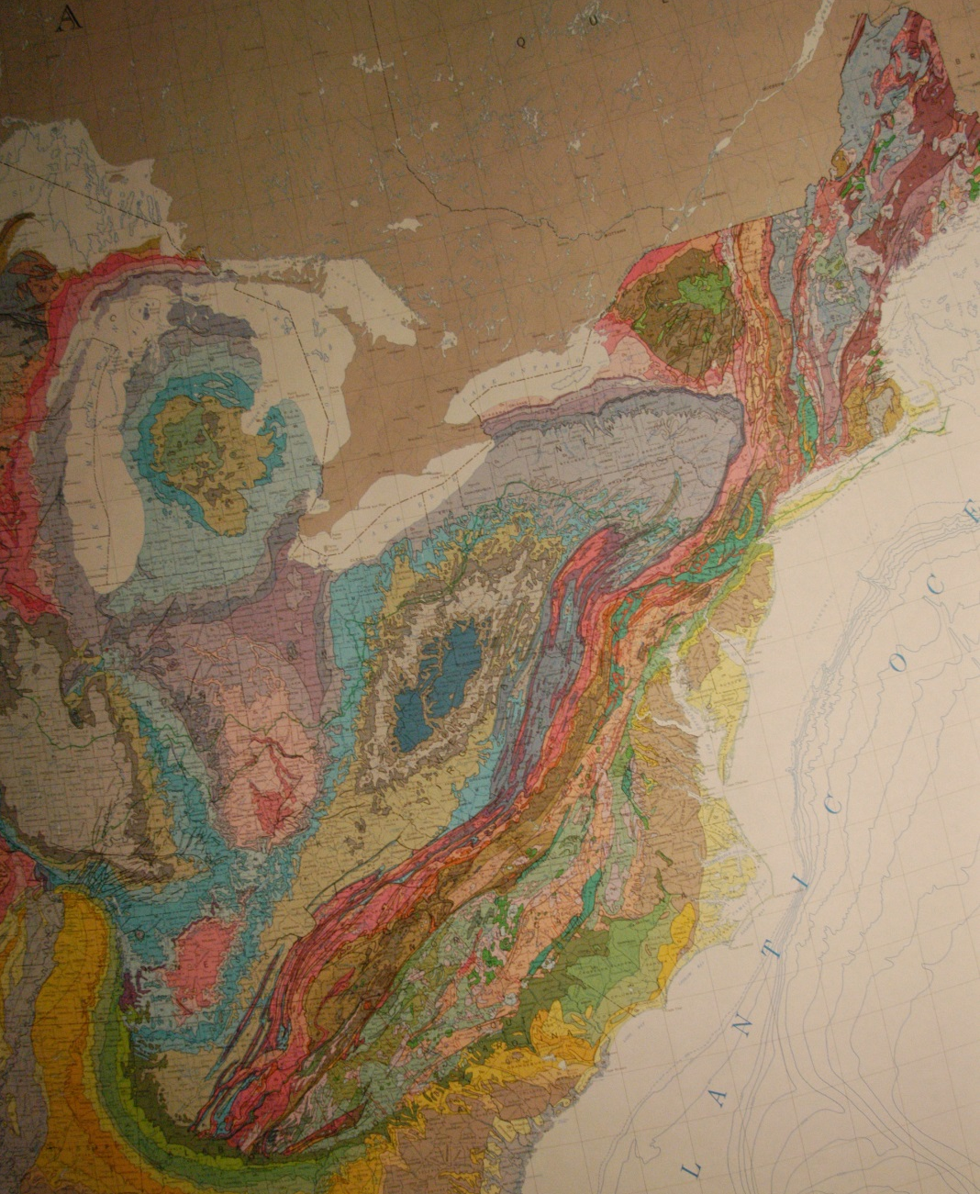
Sedimentary Geology

Slide 42
Sedimentary Geology
basins

Slide 43
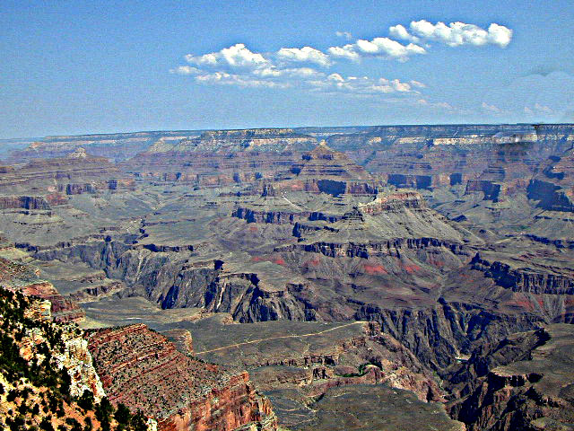
Sedimentary Geology
Succession of strata deposited in several basins

Slide 44
Definitions
Faciere: to send, to put, to place, to make
→ Facies: outward appearance, sight, form, shape
Facies: the face; the general aspect of any group of organisms or of rocks (webster’s 1945)
Facies: a rock distinguished from others by its appearance or composition (www.Dictionary.Com)

Slide 45
Definitions
Faciere: to send, to put, to place, to make
→ Facies: outward appearance, sight, form, shape
Facies: the face; the general aspect of any group of organisms or of rocks (webster’s 1945)
Facies: a rock distinguished from others by its appearance or composition (www.Dictionary.Com)

Slide 46
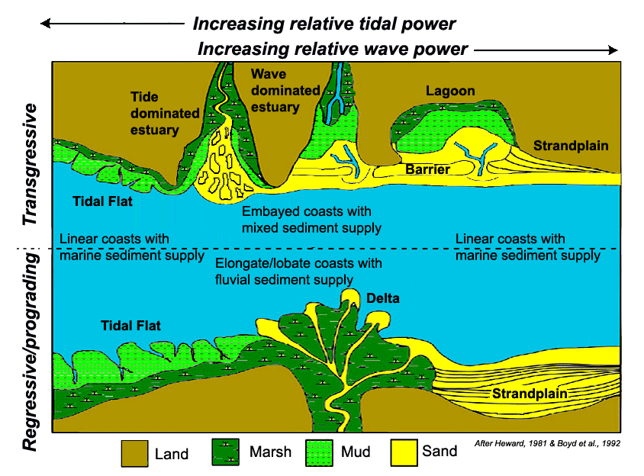
Coastal Character

Slide 47
Characteristics of Beach Systems
Sediments coarsen upward from marine shales
Linear sand bodies parallel to basin margin, serrated margins landward
Result of a mix of waves and tidal currents
Facies
  Subdivided erosion surfaces formed during
    Falls in base level
      Local channels
    Rising in base level
  Well sorted and rounded pure quartz arenites common
  Sedimentary facies & structures
    Offshore hummocky wavy bedding
    Nearshore cut and fill
    Gently seaward dipping thin parallel beds
  Geometric Elements
    Open linear sheets and lenses parallel to shore - Barrier Islands
    Confined incised channels - Tidal Channels
    Stacked amalgamated lobes - Flood & Ebb Deltas
    En-echelon landward dipping discontinuous sheets - Storm Washover
    Discontinuous horizontal sheets parallel to shore - Back Barrier Lagoon
  Fauna & flora
    Marine fauna at base of units
    Terrestrial flora at crest of units

Slide 48
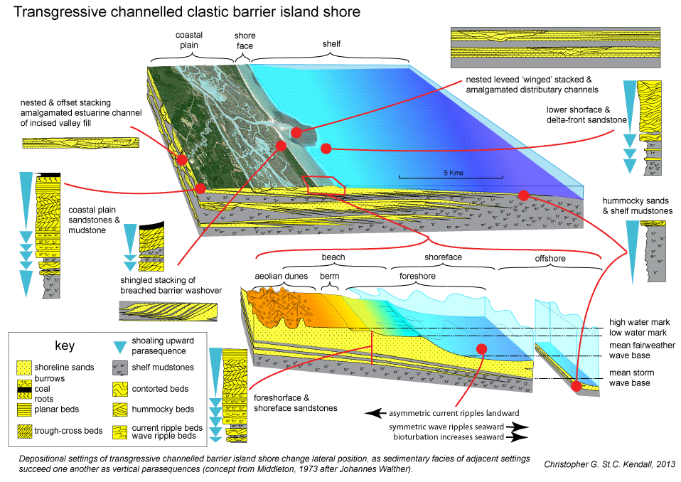
Barrier Coastal Elements

Slide 49
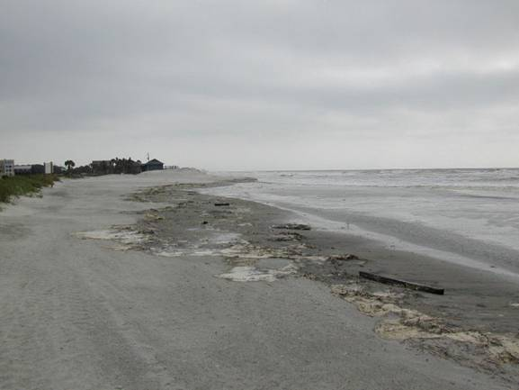
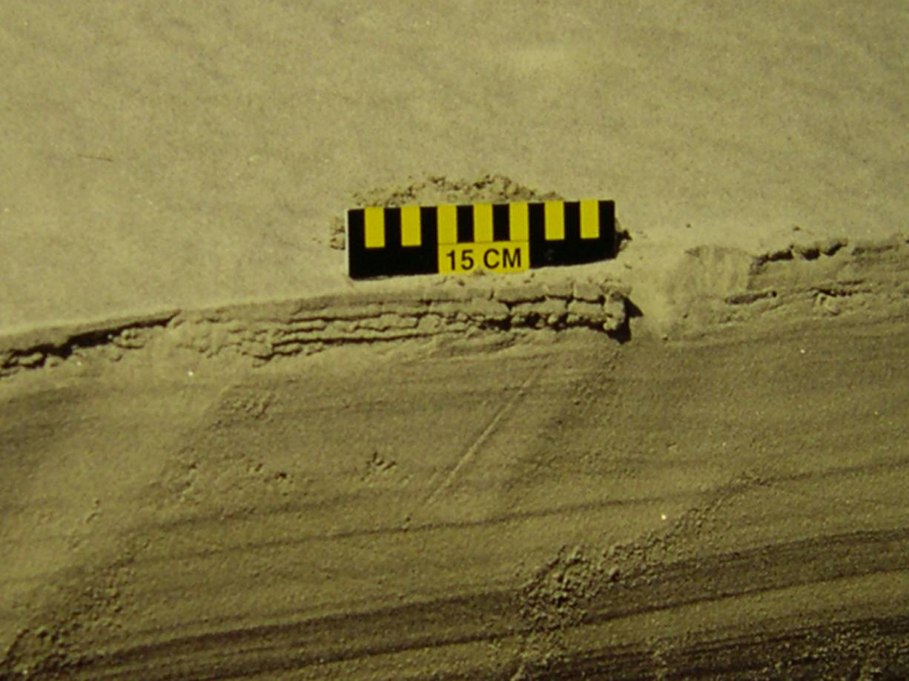
Beach Face - South Carolina Foreshore
Note High Energy Planar Beds
“Swash Zone
Foreshore”
Facies
Photo: G. Voulgaris

Slide 50
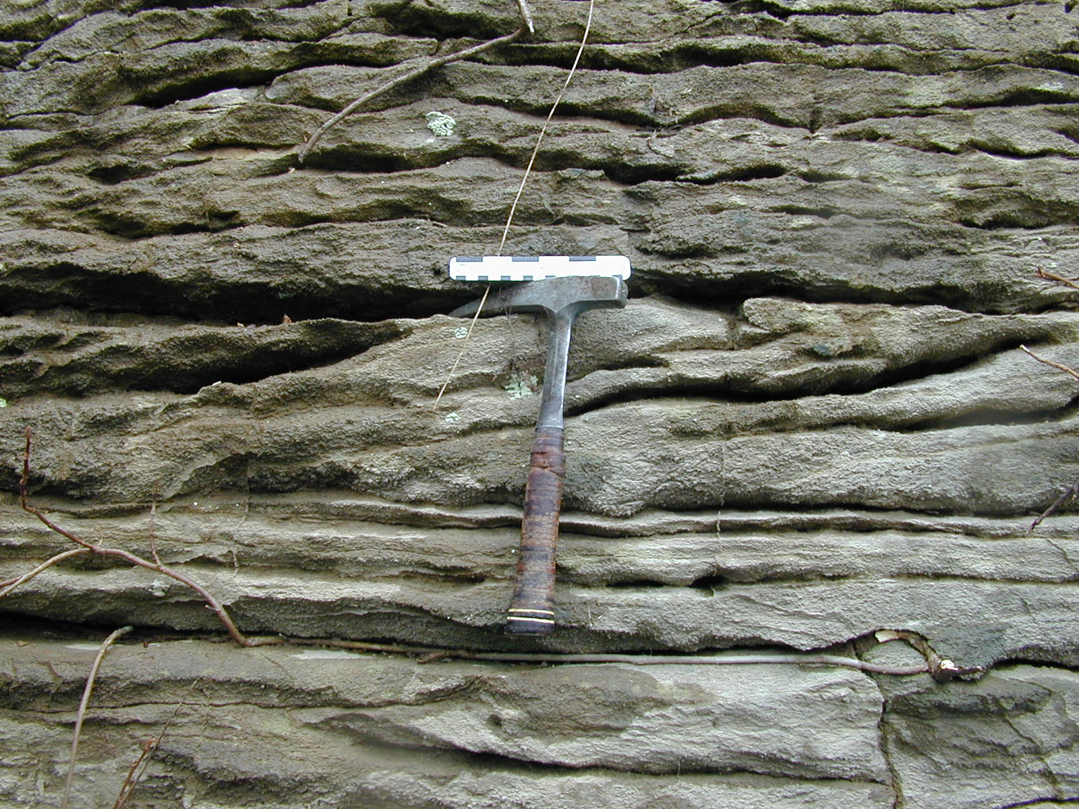
Trough Cross-bed Current Ripples
“Shoreface”
Facies
Ordovician – Near Winchester
Kentucky

Slide 51
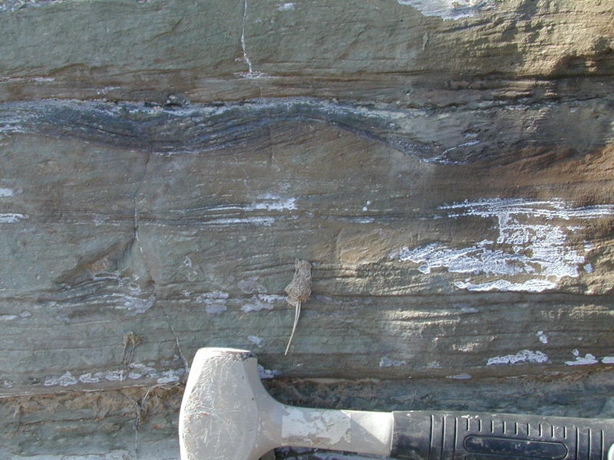
Offshore Coastal Profile - Hummocky
“Offshore
Transition”
Facies

Slide 52
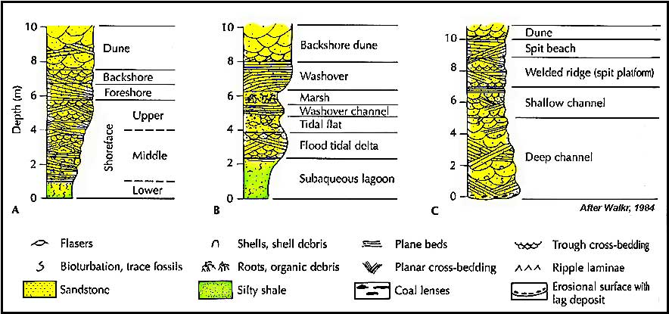
Coastal Lithofacies Assemblages
Progradation
Transgression
Inlet

Slide 53
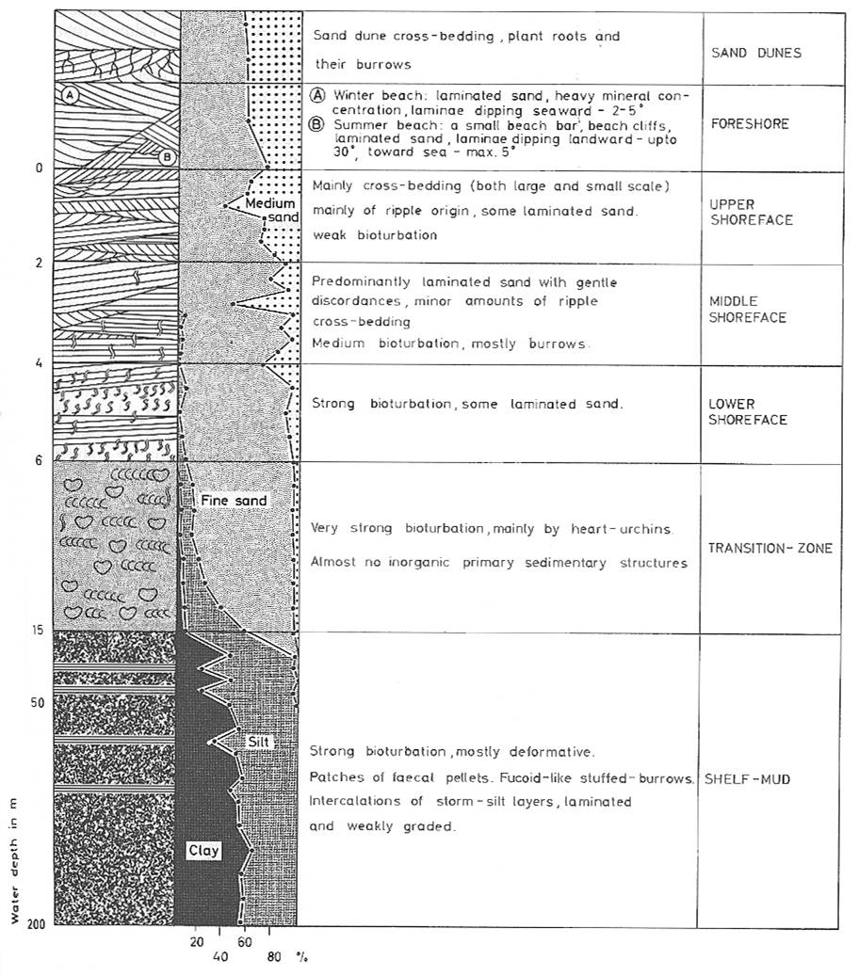
Coastal
Lithofacies
Associations
-
Coarse to
Fine
-
Onshore to
Offshore
-
Shallow to
Deep
Coastal Lithofacies Assemblages
DUNES
FORESHORE
UPPER
SHOREFACE
MIDDLE
SHOREFACE
LOWER
SHOREFACE
TRANSITION
ZONE
SHELF
MUDS
After Reineck & Singh, 1980

Slide 54
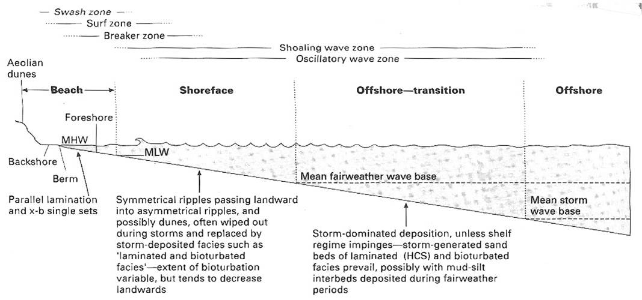
Coastal Profile
Foreshore
Shoreface
Offshore
Transition

Slide 55
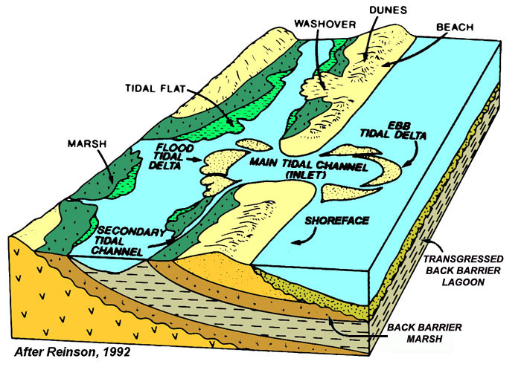
Elements of Barrier Island Coast
Transgressed
Barrier Islands

Slide 56
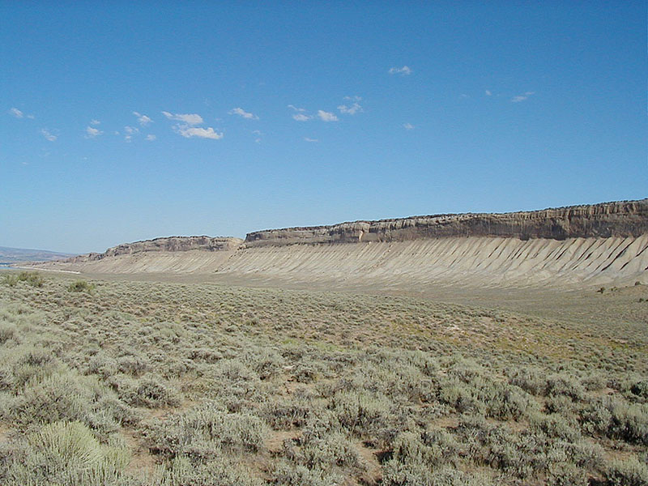
Book Cliffs – Prograding Cretaceous Shoreline
Sequence stratigraphic interpretation uses the composition and framework of genetically related stacked vertical facies successions, their geometries and their bounding surfaces to determine their depositional setting
PROGRADING
Photo by Torbjörn Törnqvis

Slide 57
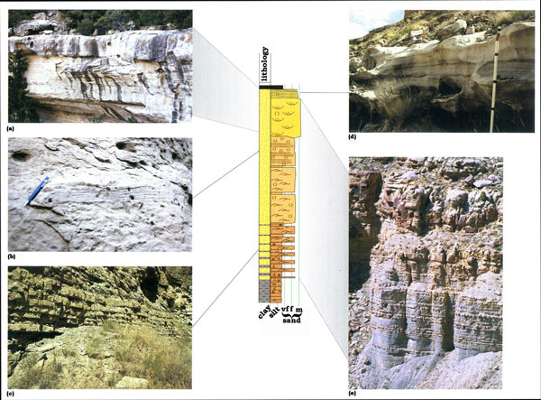
Facies Associations, Successions & Geometries - Setting
After Coe et al

Slide 58
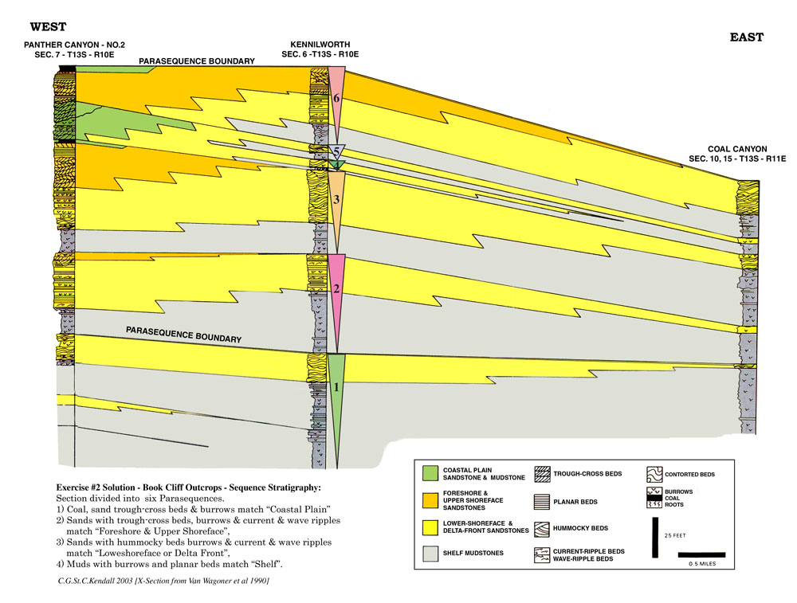
Facies Successions
Use parasequences and sands to enable correlation!
A combination of sequence stratigraphy &
lithostratigraphy to enable correlation!
parasequence
sand

Slide 59
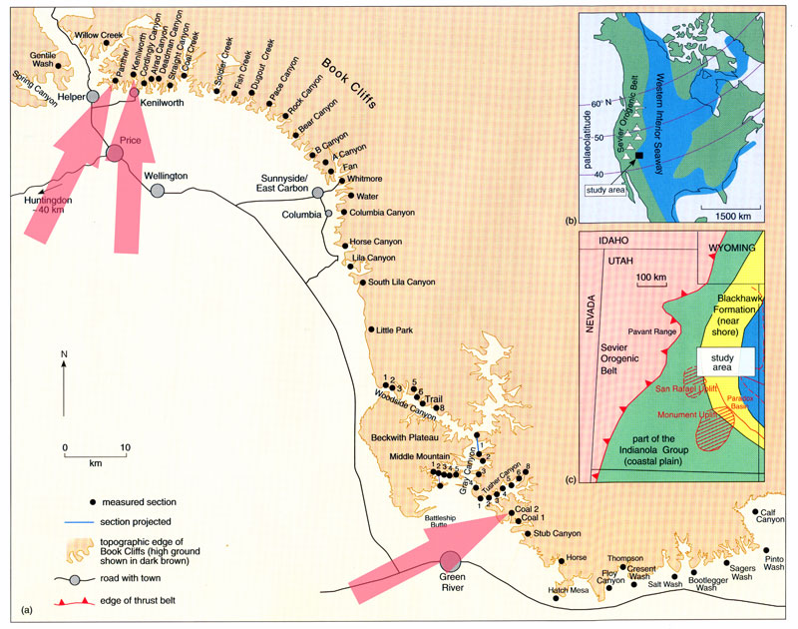
Book Cliffs

Slide 60
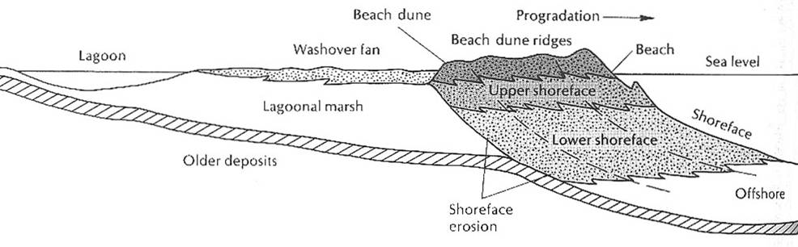
Coastal Profile and Lithofacies

Slide 61
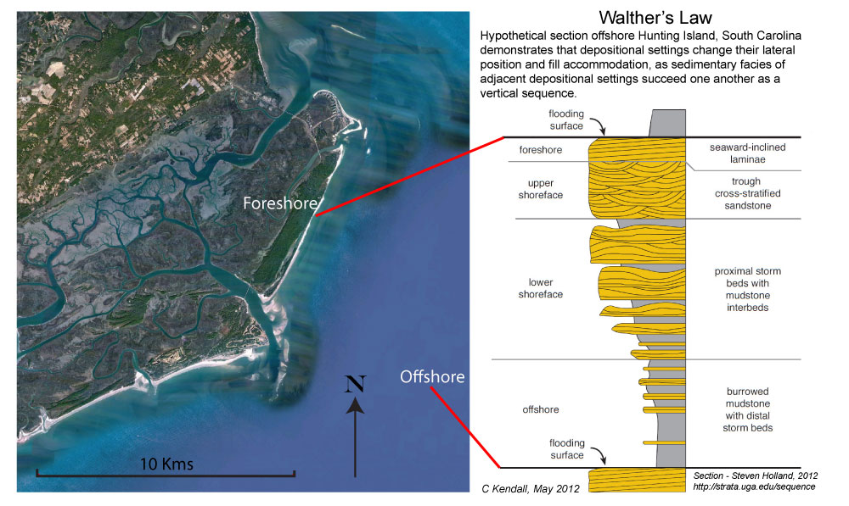
Sequence Stratigraphy Methodology

Slide 62
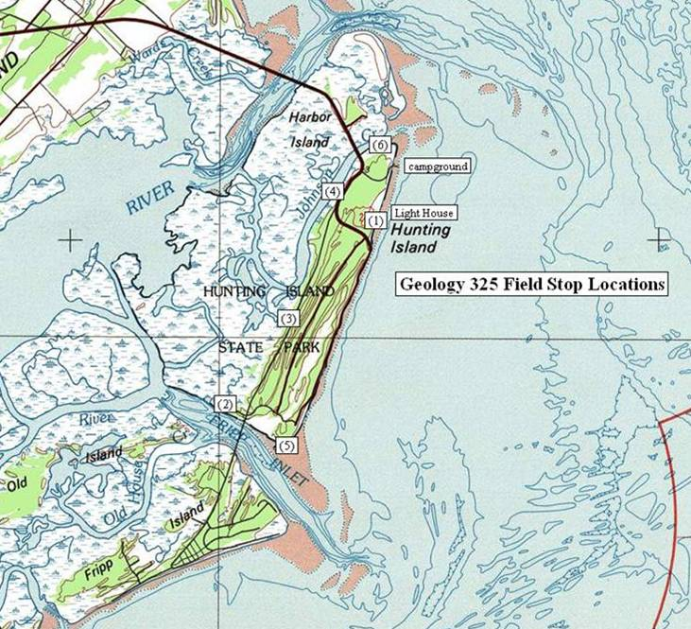
Hunting Island and Fripp Inlet

Slide 63
Characteristics of Beach Systems
Sediments coarsen upward from marine shales
Linear sand bodies parallel to basin margin, serrated margins landward
Formed by a mix of waves and tidal currents
Facies
  Subdivided erosion surfaces formed during
    Lowering of base level
      Local channels
    Raising of base level
  Well sorted and rounded pure quartz arenites common
  Sedimentary facies & structures
    Offshore hummocky wavy bedding
    Nearshore cut and fill
    Gently seaward dipping thin parallel beds
  Geometric Elements
    Open linear sheets and lenses parallel to shore - Barrier Islands
    Confined incised channels - Tidal Channels
    Stacked amalgamated lobes - Flood & Ebb Deltas
    En-echelon landward dipping discontinuous sheets - Storm Washover
    Discontinuous horizontal sheets parallel to shore - Back Barrier Lagoon
  Fauna & flora
    Marine fauna at base of units
    Terrestrial flora at crest of units

Slide 64
Sedimentary Facies
Facies: the total textural, compositional and structural characteristics of a sedimentary deposit resulting from accumulation and modification in a particular setting.

Slide 65
Sedimentary Facies
facies: the total textural, compositional and structural characteristics of a sedimentary deposit resulting from accumulation and modification in a particular setting.
grain size, sorting, rounding
lithology
sedimentary structures
bedding type
fossil assemblages

Slide 66
Sedimentary Facies
Facies: the total textural, compositional and structural characteristics of a sedimentary deposit resulting from accumulation and modification in a particular setting.
EX: well-sorted, moderately rounded, trough cross-stratified, horizontally burrowed & normally graded arkosic coarse sandstone

Slide 67
Lithofacies & Lithofacies Codes
Sedimentary facies often get reduced to lithofacies which detail grain-size, composition, and dominant sedimentary structures only
  EX: planar cross-stratified gravel, inversely graded massive sandstone
This has led to lithofacies codes (after Miall, 1978).
  EX: Gmm, St, Fsl

Slide 68
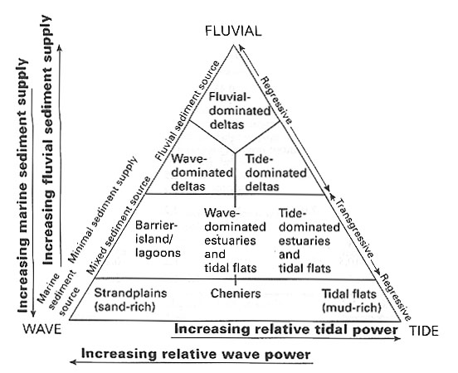
Coast Types
Dalrymple et al, 1992

Slide 69
Sedimentary Facies
Facies: the total textural, compositional and structural characteristics of a sedimentary deposit resulting from accumulation and modification in a particular setting.
Facies associations: collection of multiple facies (often in a vertical cycle) resulting from genetically related accumulation and modification.
EX: lenticularly bedded stratified pebble conglomerate with subordinate planar cross-stratified sandstone
OR: fluvial channel lithofacies assemblage

Slide 70
Sedimentary Facies
Facies: the total textural, compositional and structural characteristics of a sedimentary deposit resulting from accumulation and modification in a particular setting.
Facies associations: collection of multiple facies (often in a vertical cycle) resulting from genetically related accumulation and modification.
Facies successions: collection of multiple stacked vertically facies associations resulting from genetically related accumulation and modification.

Slide 71
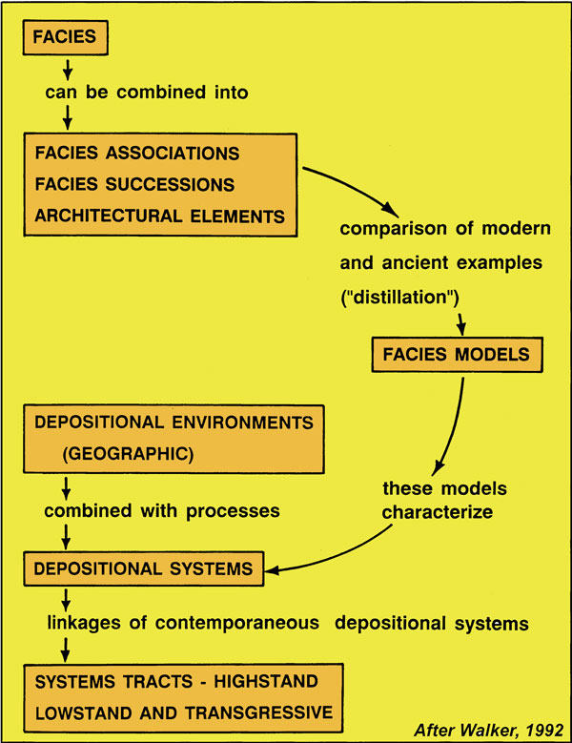
Sedimentary Geology
Relationship between:
Facies
Architectural elements
Depositional settings
Systems
Systems tracts
Scheme used to characterize each depositional system in lecture series

Slide 72
Depositional Setting - Element Hierarchy
What is it?
A Framework for Systematic Description and Comparison of that Setting's Deposits
  Based on physical relationships (geometry) of strata and their bounding surfaces
  Based on recognition of genetically-related stratigraphic elements
  Independent of type of setting
  Applicable at all scales and to all styles
What are the benefits?
Analysis and comparison of like Aquifer/Reservoir Elements
  Net to-gross, aspect ratio, and connectivity
  Lithofacies type and aquifer/reservoir quality
Application to the Production Environment
  More accurate aquifer/resource assessment
  Optimize strategy for depletion of aquifer/resource

Slide 73
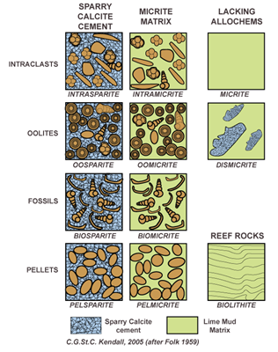
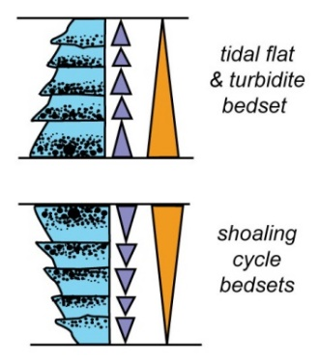
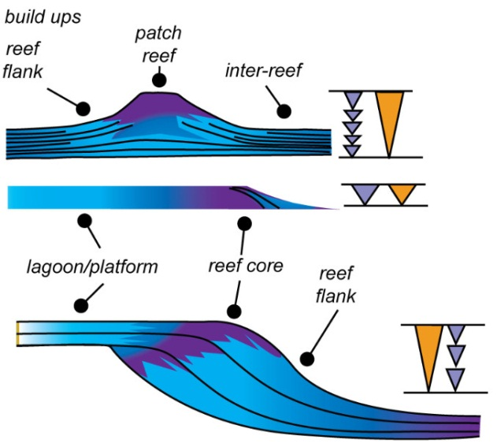
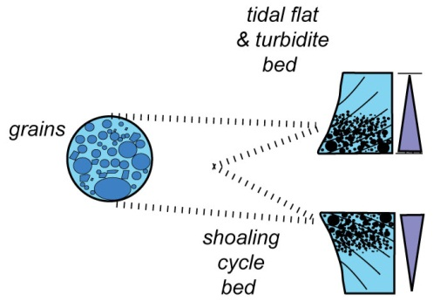
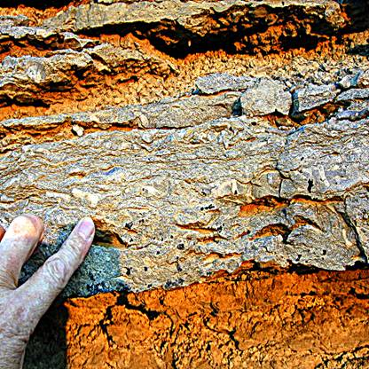
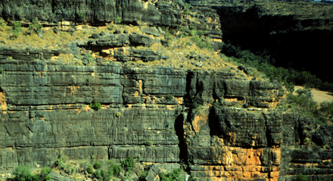
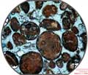
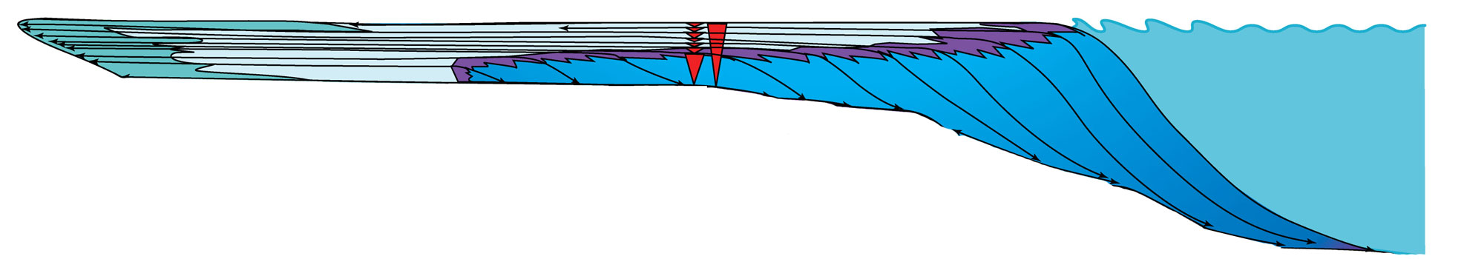
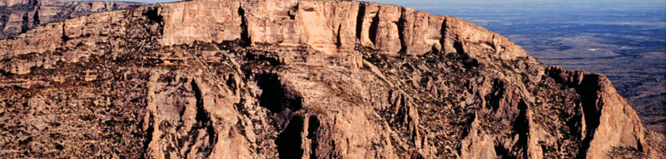
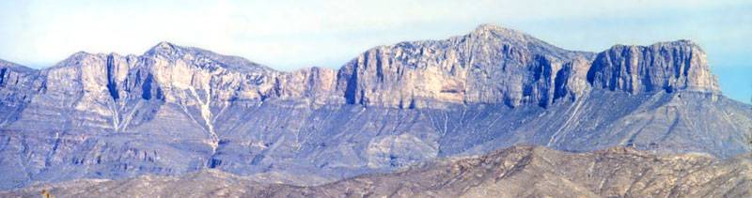

Carbonate Platform Architectural Elements
ALLOCHEMS
CEMENTATION
& DIAGENESIS
,
SEDIMENTARY
STRUCTURES
FAUNA
GRAINS
STACKED
BED
CYCLES
CYCLES OF
BEDS
REEFS
PROGRADING MARGIN
HST MARGIN
COMPLEX
MARGIN
COMPLEX
PROGRADING MARGIN
SHELF
MARGIN
COMPLEX
SHELF
COMPLEX
ONLAPPING MARGIN
PROGRADING MARGIN

Slide 74
Fluvial Hierarchy
What is it?
A framework for the Systematic Description and Comparison of River Deposits
  Based on the physical relationships of strata and their bounding surfaces
  Based on recognition of gentically-related stratigraphic elements
  Independent of channel type and sinuosity
  Applicable at all scales and to all fluvial styles
What are the benefits
Analysis and comparison of like reservoir elements
  Net to gross, aspect ratio, and connectivity
  Lithofacies type and reservoir quality
Application to the Production environment
  More accurate resource assessment
  Optimize depletion strategy

Slide 75

Fluvial - Architectural Elements

Slide 76

Deepwater - Architectural Elements

Slide 77
Types of Depositional Systems
marine → ocean, sea
terrestrial → land
transitional → part land, part ocean

Slide 78
Marine Depositional Systems
Shallow/nearshore
  Tide-dominated
  Wave-dominated
  Reef
Shelf/platform
  Carbonate
  Clastic
Deep marine
    Deep sea fans
    Pelagic

Slide 79

Charleston Cooper River – Barrier Island Coastline

Slide 80

Cape Hatteras – Barrier Island Coastline

Slide 81

Mississipi Delta transitioning to Barrier Island Coastline

Slide 82
Transitional Depositional Systems
Deltas
Estuaries

Slide 83

Tide Dominated Delta System

Slide 84

Fluvial Dominated Delta System

Slide 85

Tide Dominated Delta System

Slide 86

Shatt Al Arab Delta – Fluvial Domination

Slide 87


Sequence Boundary (SB) from well logs, core and outcrop
SB
mfs
TS
Erosion or incision of underlying flooding surfaces (mfs and TS)
Inferred from interruption in the lateral continuity of these surfaces
Establish a framework of genetically
related stratigraphic facies geometries
and their bounding surfaces to
determine depositional setting
“Sequence Stratigraphy – Basics”
C. G. St. C. Kendall

Slide 88
Coastal Elements

Slide 89



Carbonate Depositional Setting Physiography
Basin
Ramp
Open
Shelf
Restricted
Shelf

Slide 90


Carbonate Depositional Setting Physiography
Open
Shelf
Rim
Basin
Restricted
Shelf

Slide 91

Bahamas Bank and Location of Seismic Line

Slide 92

Great Barrier Reef of Australia
Reef Pinnacles
Reef Pinnacles
Reef Pinnacles

Slide 93

Shark Bay - Western Australia
Shark Bay

Slide 94
Terrestrial Depositional Systems
Fluvial-alluvial fan
Glacial
Eolian
Lacustrine
Playa

Slide 95

Alluvial Fan System

Slide 96

Alluvial Fan System

Slide 97

Braided Stream System

Slide 98

Meandering Stream System Dominated by Point Bars

Slide 99

Mid Stream Bars

Slide 100

Windblown Dunes

Slide 101

Windblown Dunes

Slide 102

Windblown Carbonate Dunes - UAE

Slide 103




Glacial Action

Slide 104
Large Numbers
What is a million?
How tall (in feet) would a stack of 1,000,000 $1 bills be?
At the rate of 1 count/second, how many work weeks would it
take you to count to one million?
What is a billion?
How tall (in feet) would a stack of 1,000,000,000 $1 bills be?
At the rate of $1,000/day, how long would it take you to spend
$1,000,000,000?
2,740 years

Slide 105
Large Numbers
What is a million?
1,000,000 $1 bills = a stack 330' tall
(1,000 new $1 bills stack 4” high)
At the rate of 1 count/second, it would take you seven work
weeks to count to one million.
What is a billion?
1,000,000,000 $1 bills = a stack 62.5 miles tall
would require ~2,7At the rate of $1,000/day, to spend $1,000,000,000
38 years.

Slide 106
Units of Time
Time Units Used in Everyday Life
seconds
minutes
hours
days
weeks
months
years
centuries
millennia
Time Units in History of Earth and Life (Deep Time)
Age (1,000,000 to 10,000,000 years)
Epoch (10 to 20 million)
Period (23 to 80 million)
Era (65 to 300 million)
Eon (more than 500 million [>0.5 billion])

Slide 107

Geologic Timescale

Slide 108
SB
mfs
TS
Establish a framework of genetically
related stratigraphic facies geometries
and their bounding surfaces to
determine depositional setting

Slide 109
Coastal Elements

Slide 110
Lecture Ends!!

